Slide 1





Digital transition and the impact of AI
Stevan Armaković, PhD
University of Novi Sad, Faculty of Sciences
Department of Physics

Slide 2
AGENDA
Introduction
Updates on post-CONNECT-2025 activities
Examples of Digital Transition in Computational Materials Science
Cloud vs. Local
The Role of AI in Academic Activities
Ideas for post-CONNECT 2026 period

Slide 3
Introduction
EMOS Research Group
Association for the International Development of Academic and Scientific Collaboration
AIDASCO Reviews
Atomistica Online

Slide 4

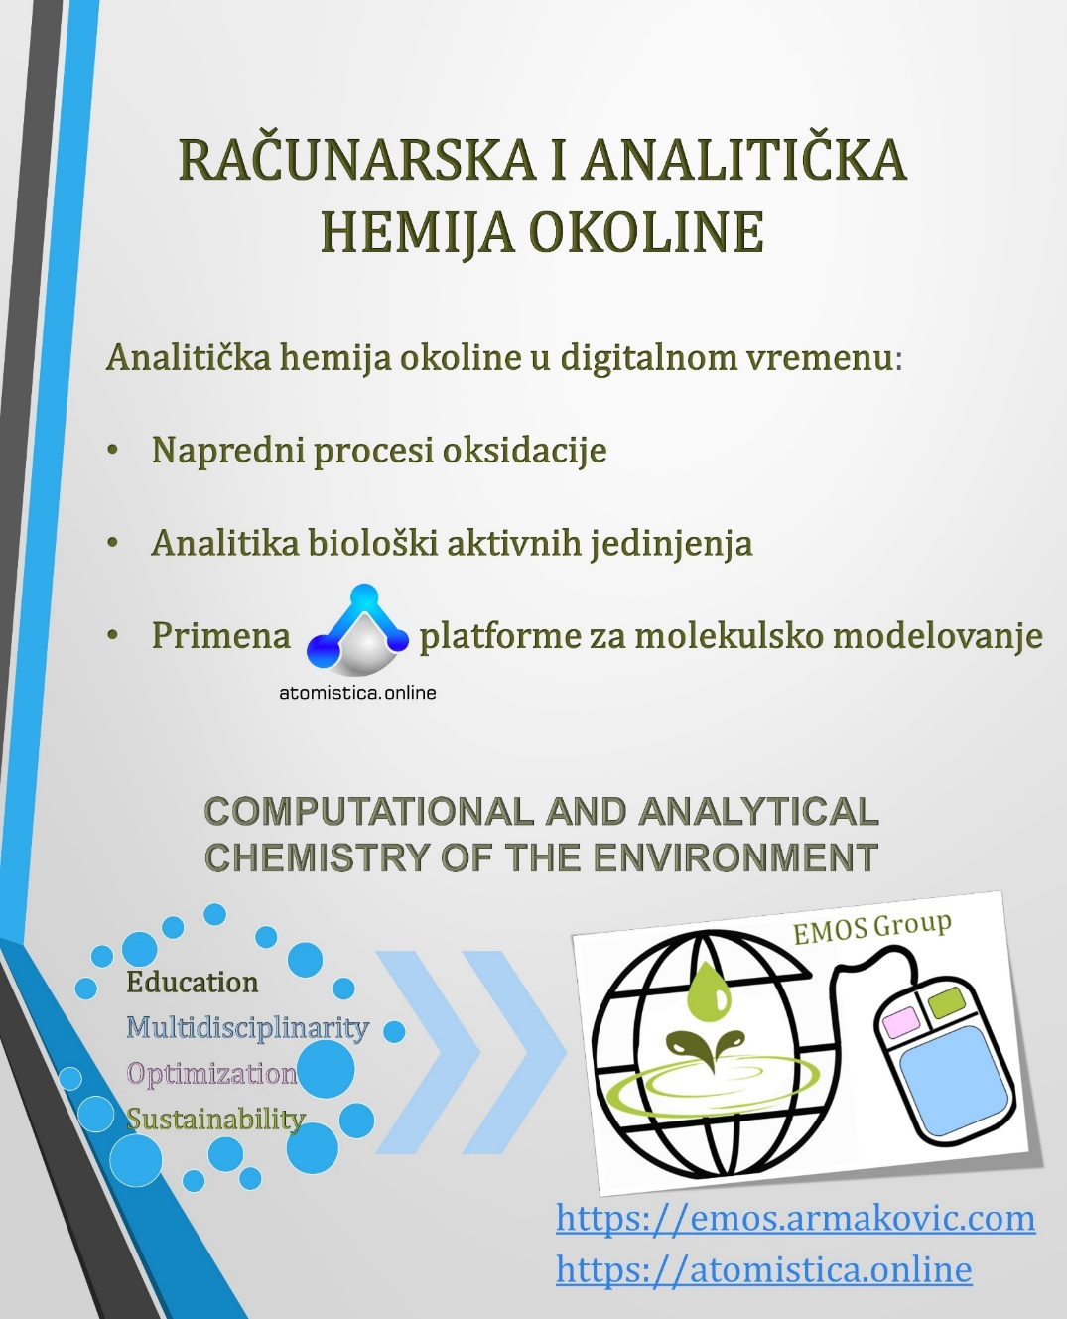
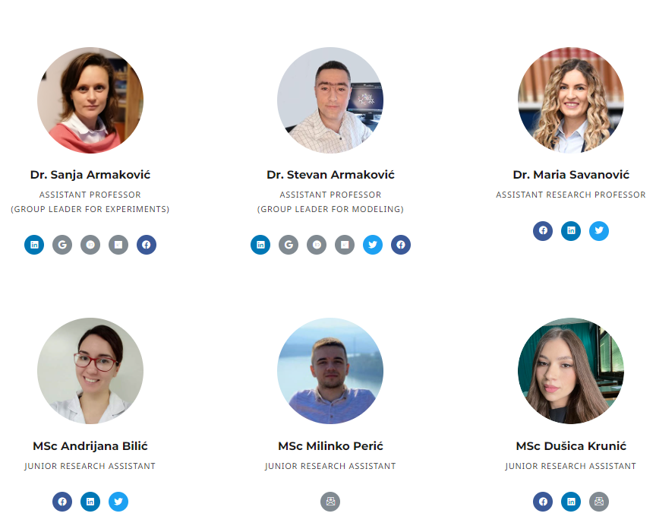
Members of the research group for
COMPUTATIONAL AND ANALYTICAL
ENVIRONMENTAL CHEMISTRY
ASSOCIATE PROFESSOR
GROUP LEADER FOR EXPERIMENTS
ASSOCIATE PROFESSOR
GROUP LEADER FOR MODELING
ASSISTANT RESEARCH PROFESSOR
RESEARCH ASSISTANT
JUNIOR RESEARCH ASSISTANT
JUNIOR RESEARCH ASSISTANT

Slide 5

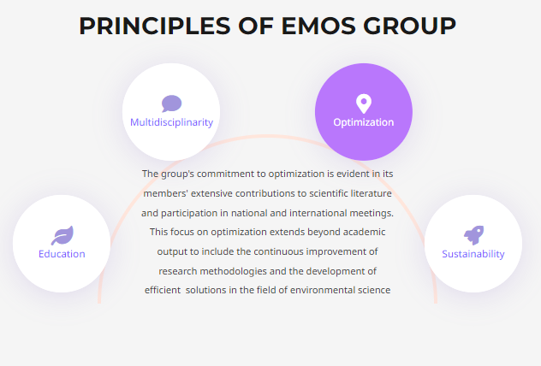
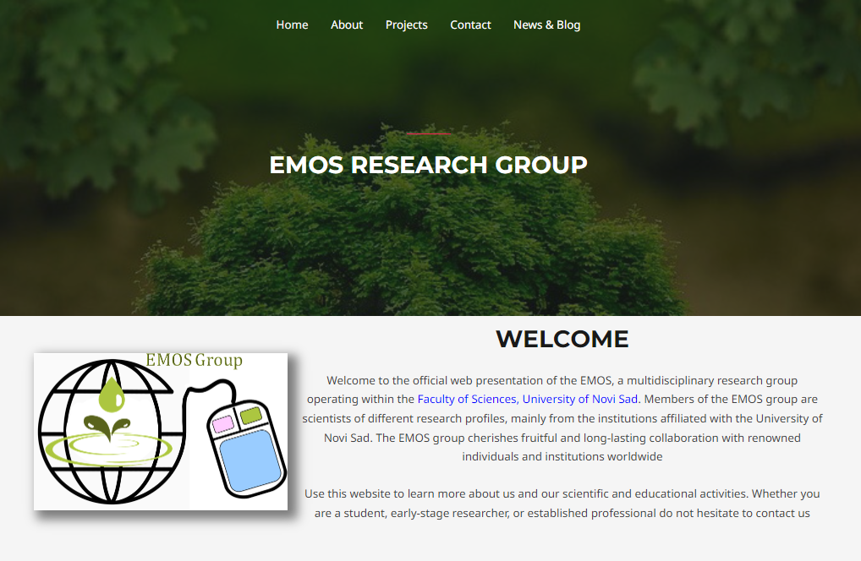
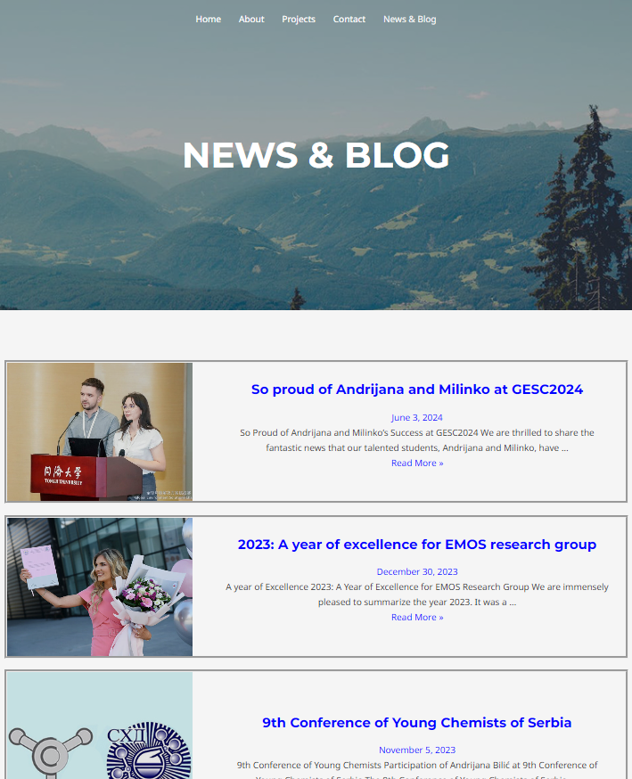
https://emos.armakovic.com/

Slide 6
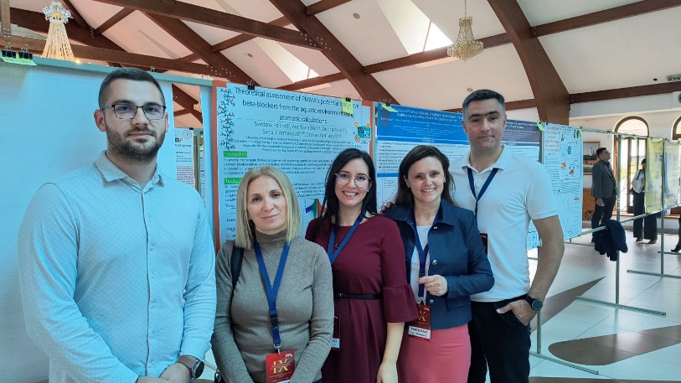
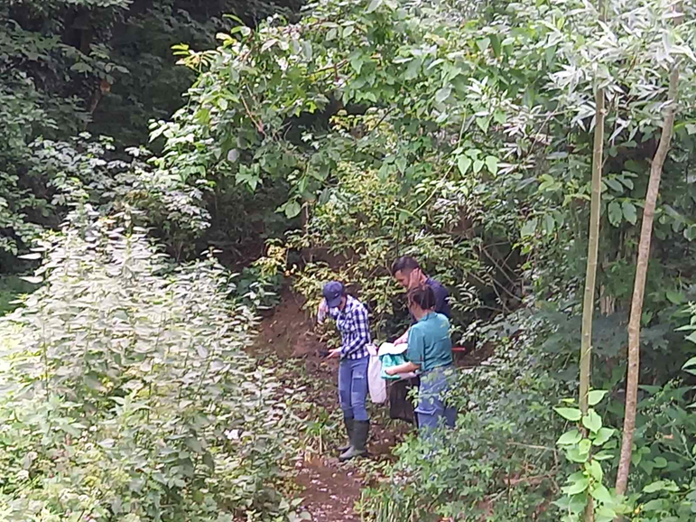
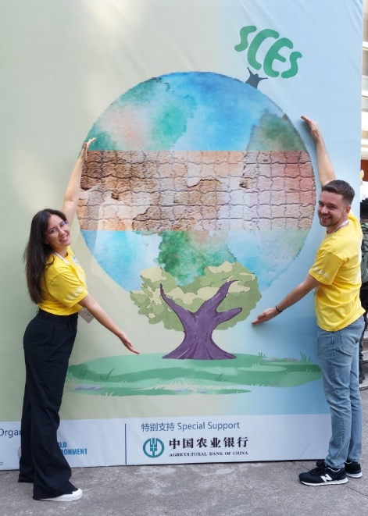

Slide 7
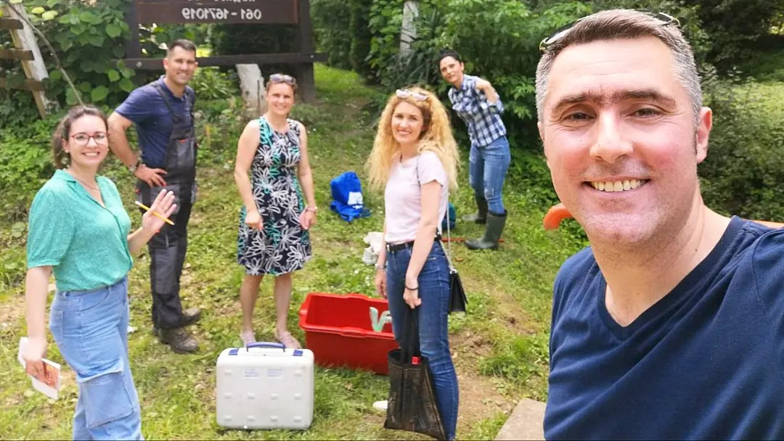
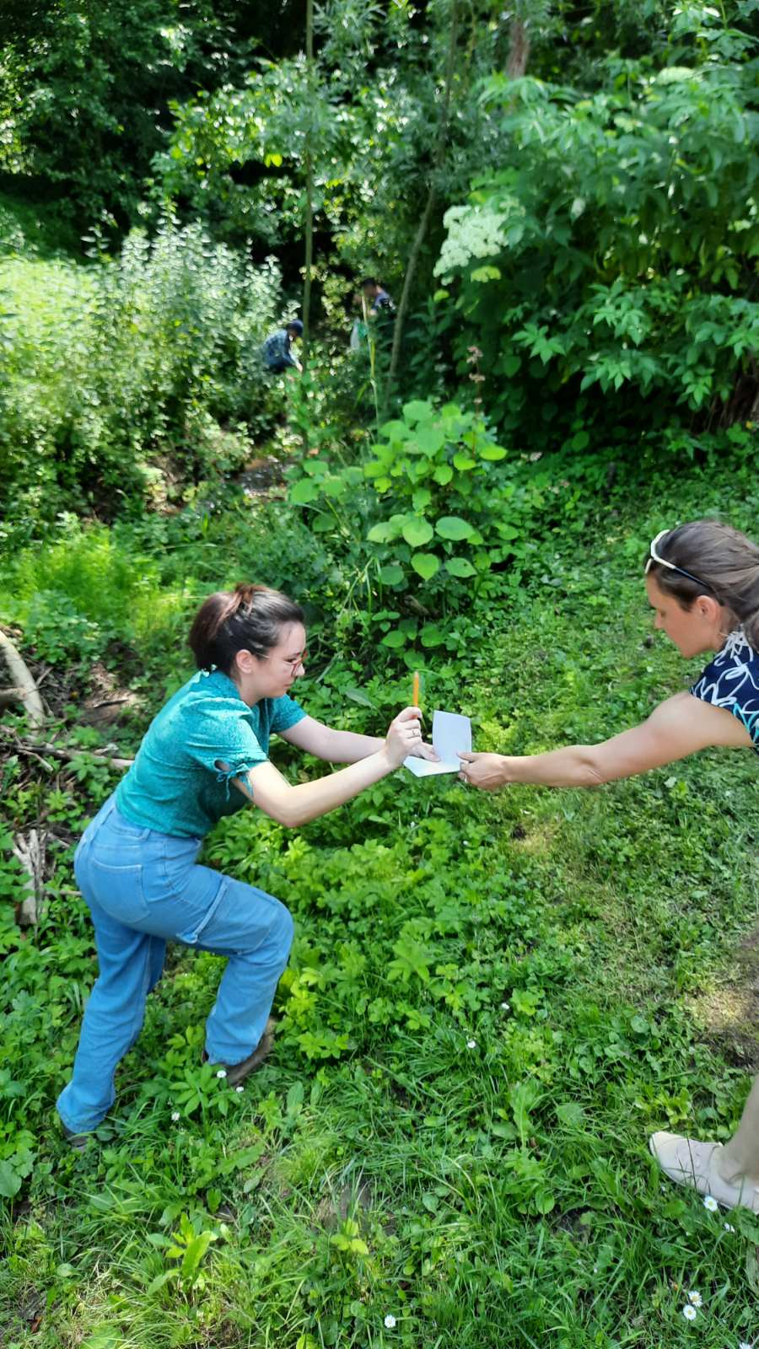
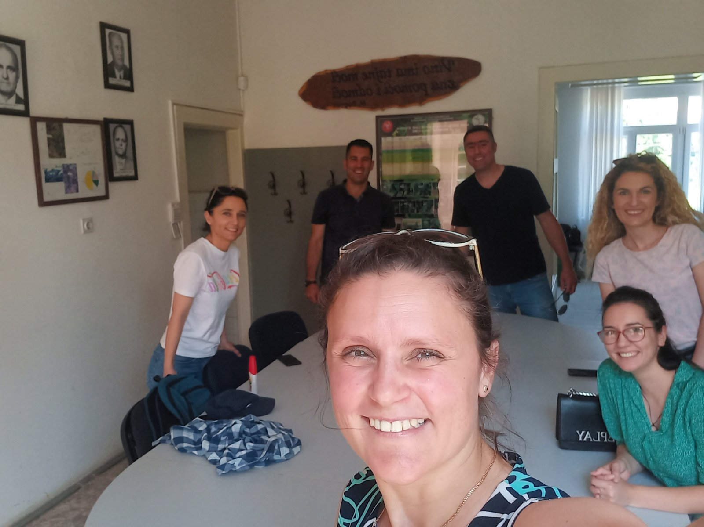


Slide 8
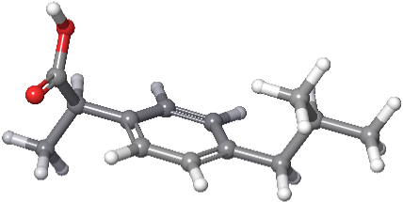
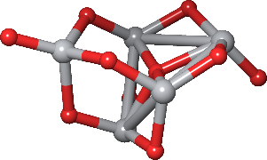
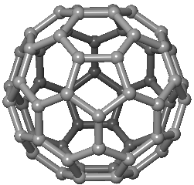
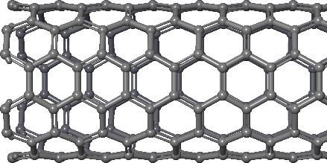
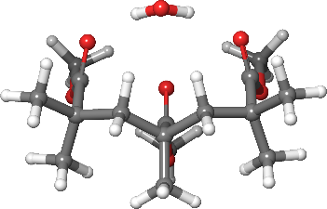
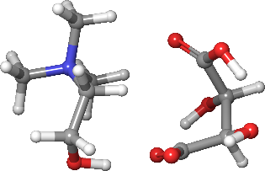
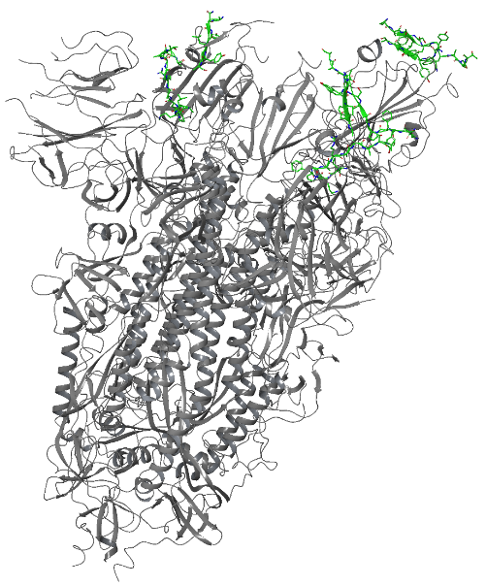

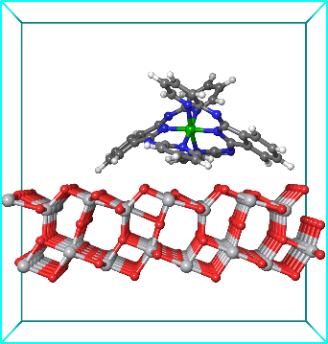
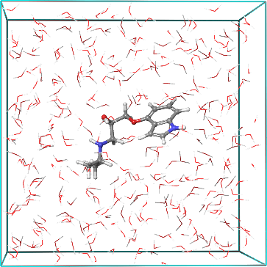
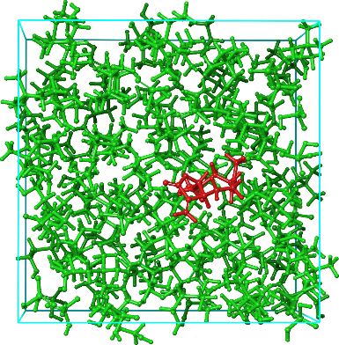
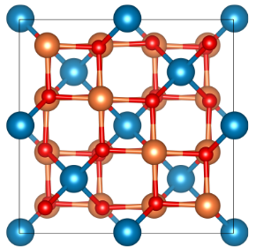
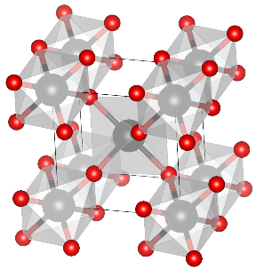
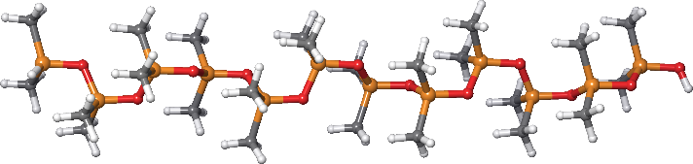
What am I doing for living (and for fun)
Molecular systems
Periodic systems
Interactions
ibuprofen
TiO₂ cluster
C60 (0D)
(6,0) CNT (1D)
PMMA + H₂O
Ch-based IL
Spike protein
6VSB
Graphene (2D)
Adsorption on TiO₂ surface
PIN in water
PDMS polymer
(10 monomers)
ZnFe₂O₄ (3D)
TiO₂ rutile (3D)
Plant extract in Ch-based IL

Slide 9


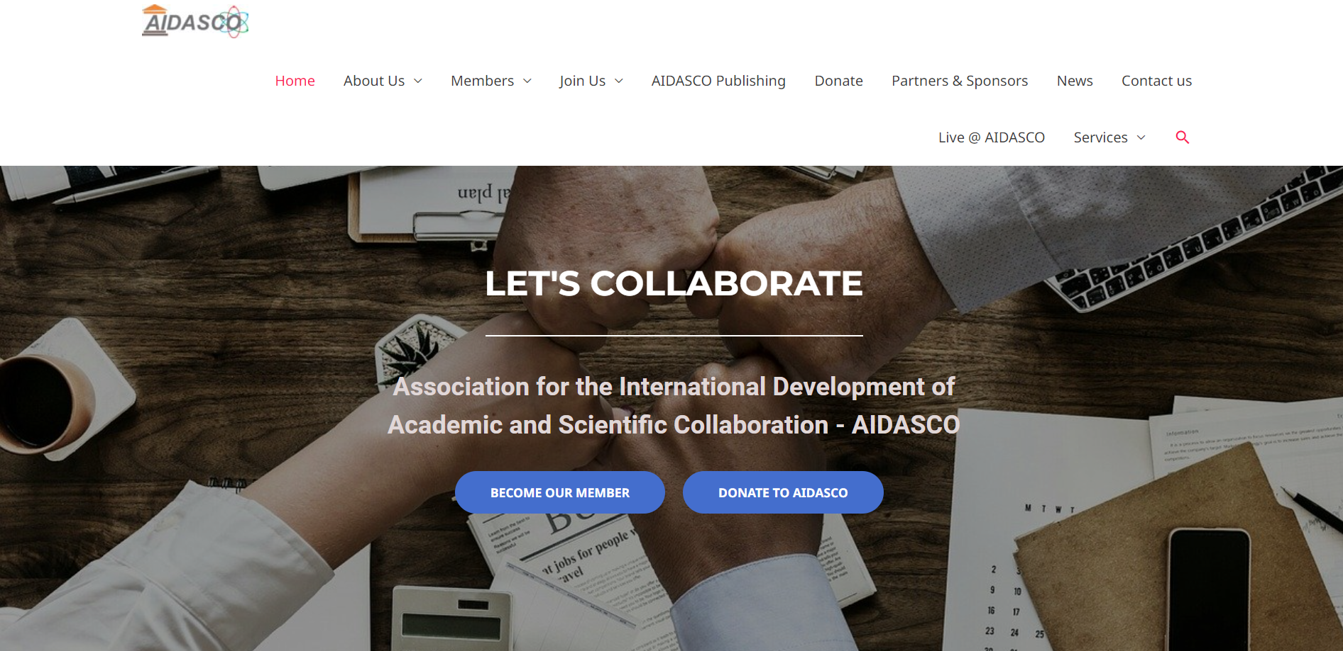
https://aidasco.org/

Slide 10
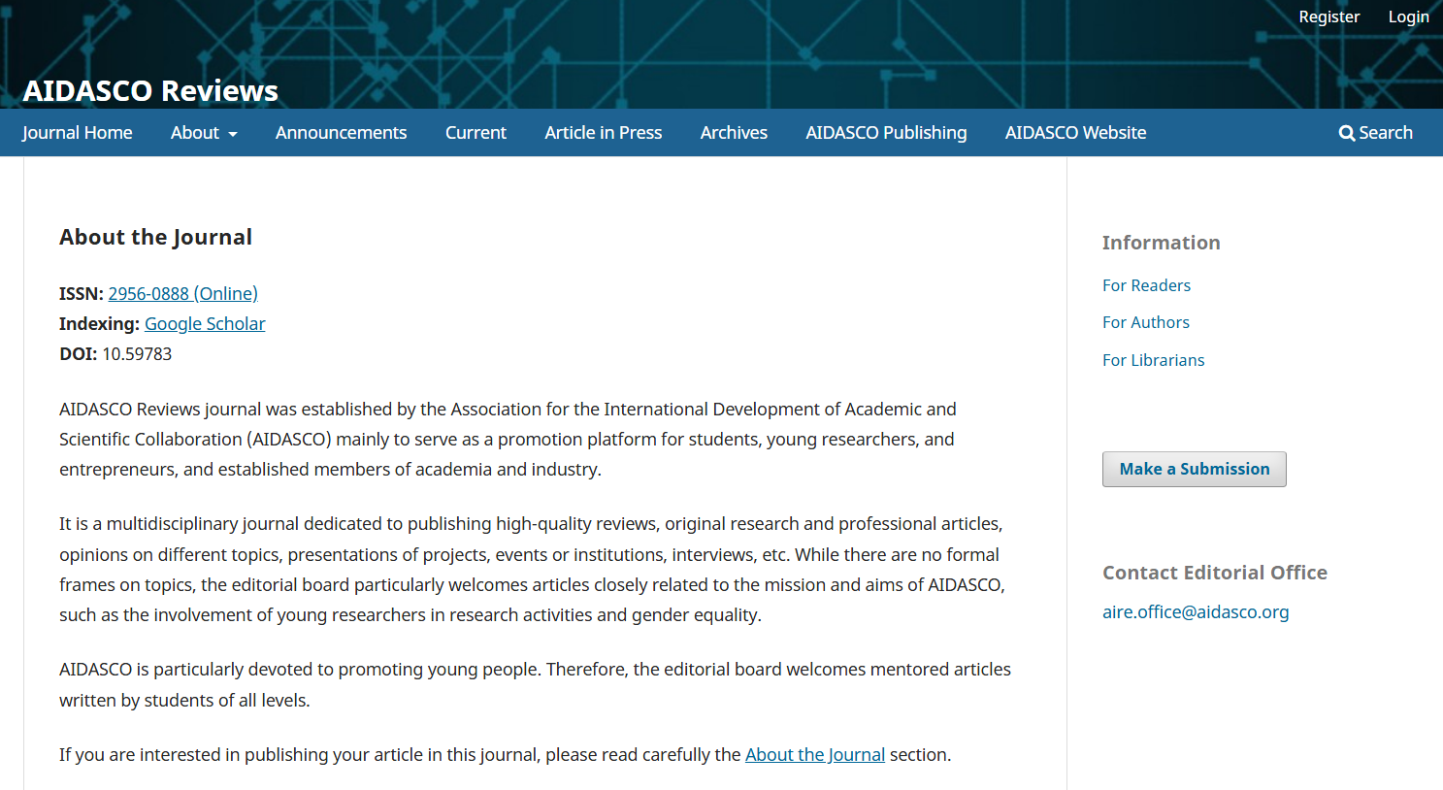

Slide 11
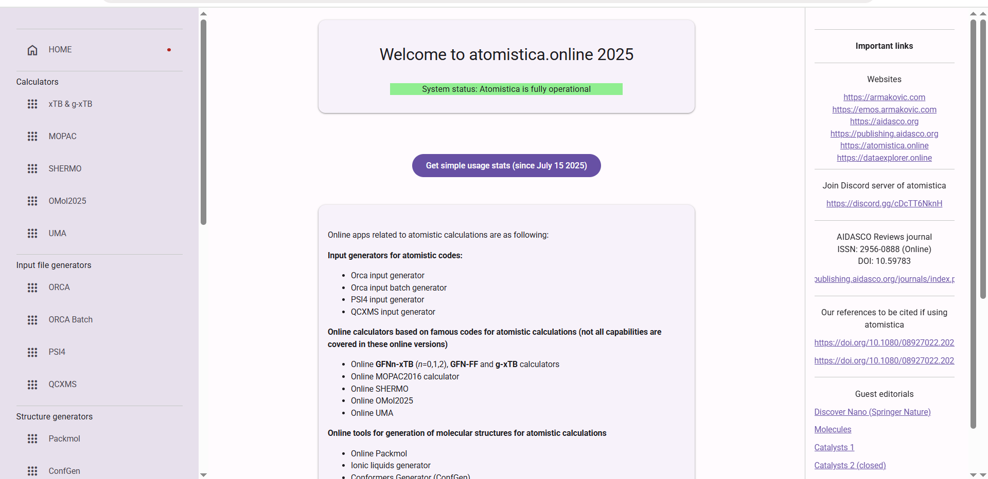

Slide 12
Why CONNECT matters
Overview and post-conference activities

Slide 13
Why CONNECT matters?
Connect 1.0 (2017) “Science and society“
Connect 2.0 (2018) “Common research and education“
Connect 3.0 (2019) “Awareness and convergence“
Connect 4.0 (2020) „Communication and popularization“
Connect 5.0 (2021) „Science Communication“
Connect 6.0 (2022) „Science Communication“
Connect 7.0 (2025) „Towards the ERA“
Connect 8.0 (2026) “Towards the ERA”
~160 students
~40 lecturers

Slide 14
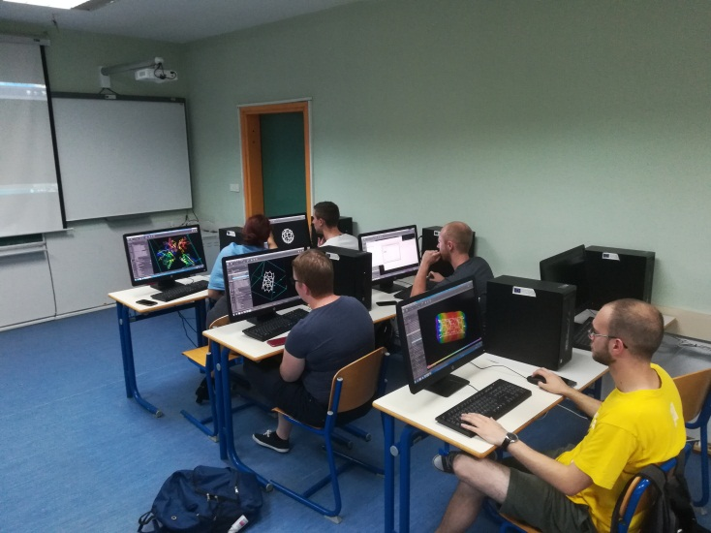
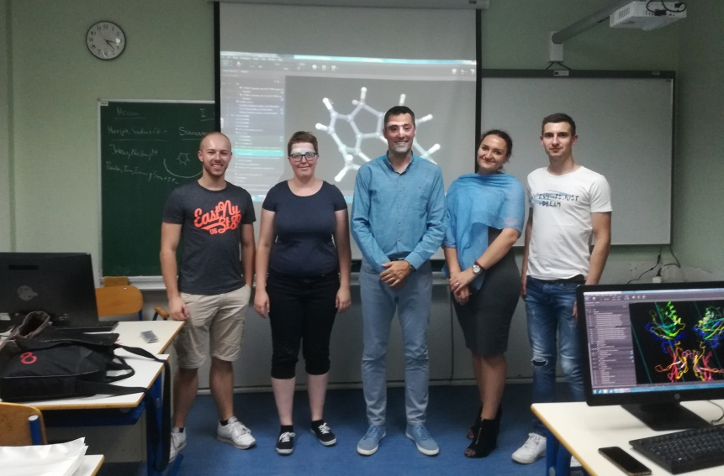
(CONNECT 2.0 Molecular modeling workshop in Tuzla)
The aim of the 3-day workshop was to introduce students with fundamental principles of molecular modeling and to demonstrate the usage of state-of-the-art modeling suite.
Molecular Modeling Workshop group:
1. Paula Hillman (Physics, FIAS, III)
2. Marija Vučićević, (Biology, UNTZ, II)
3. Jelena Vuković, (Phyiscs, UNBL, III)
4. Tom Reichert, (Physics, FIAS, II)
5. Nedim Baraković (Geography, UNTZ, I)
6. Slađan Jelić (Physics, UNS, I)
Computers kindly hosted by the Department of Geography, UNTZ

Slide 15

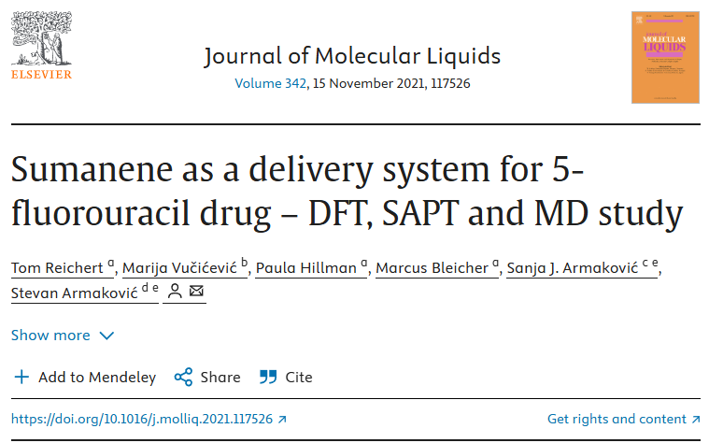
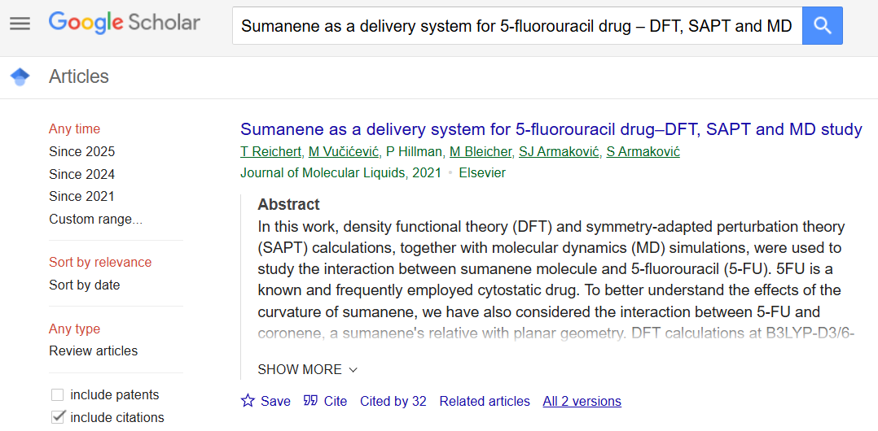
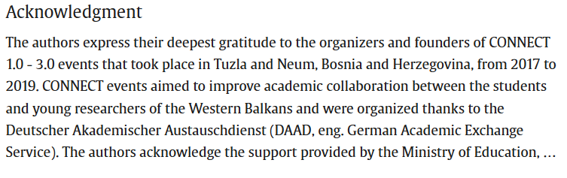

Slide 16

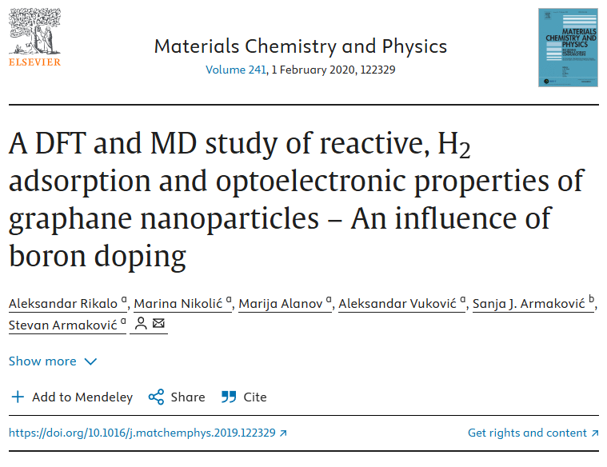
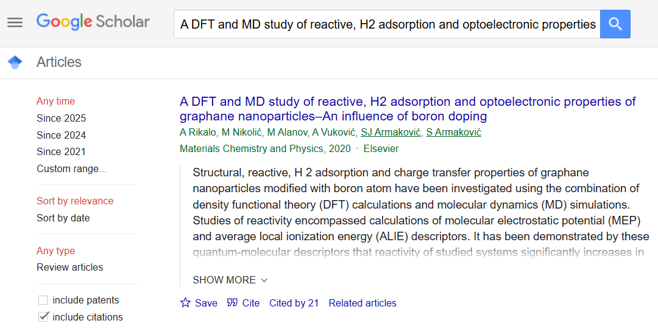
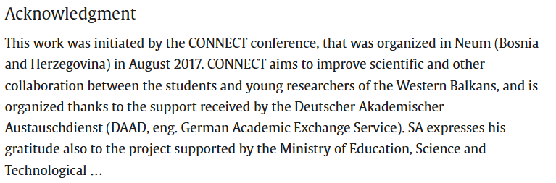

Slide 17
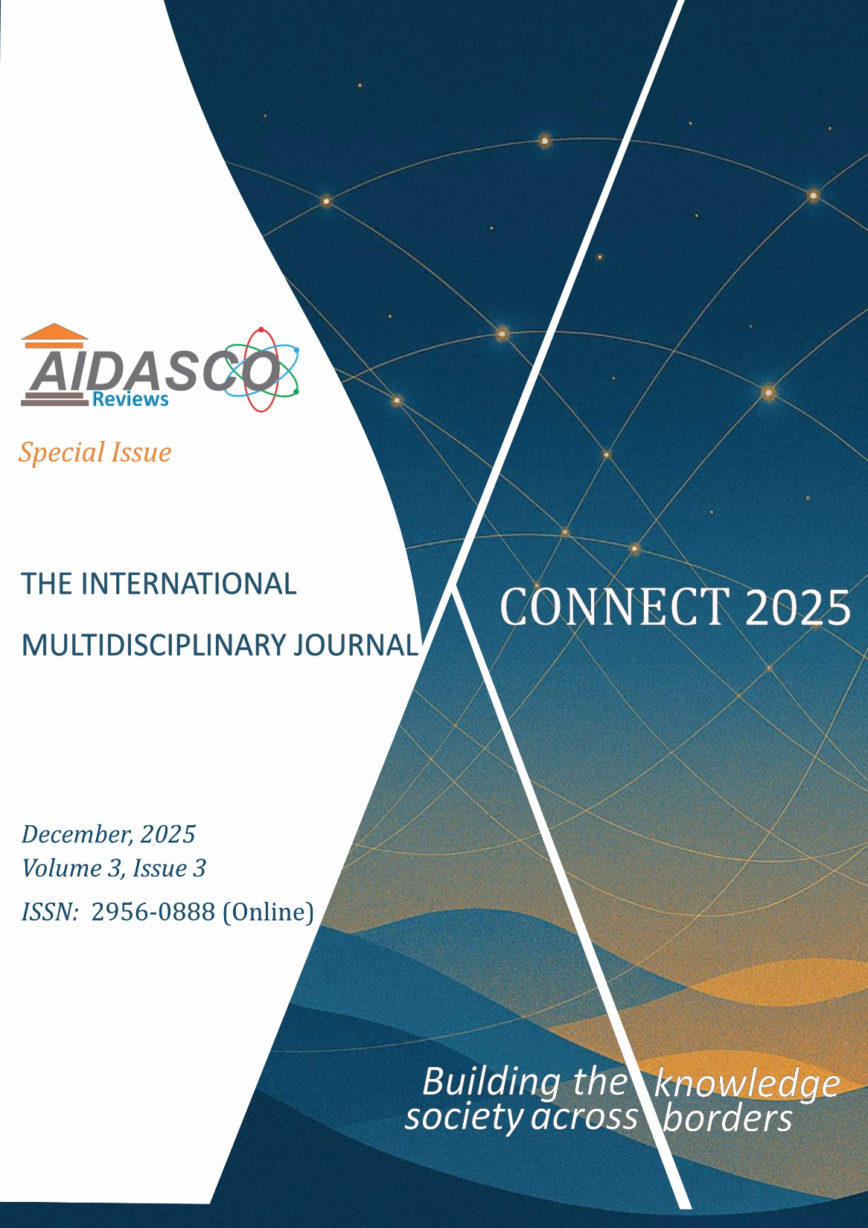
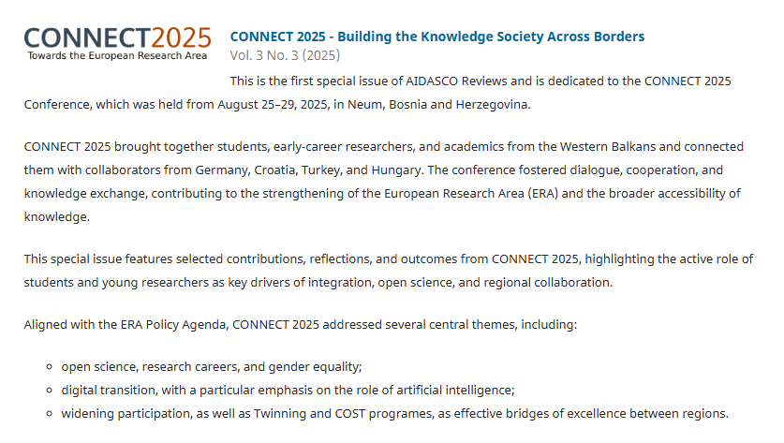
https://publishing.aidasco.org/journals/index.php/aire/issue/view/9
Editorial
Authors: Stevan Armaković, Sanja J. Armaković and Maria M. Savanović
The Editorial introduces the first Special Issue of AIDASCO Reviews and explains the motivation for dedicating it to CONNECT 2025.
Read the Editorial
CONNECT: A Student-Centered Conference Model for Dialogue, Mentorship and Interdisciplinary Exchange
Author: Stevan Armaković
The article discusses the philosophy behind CONNECT and its student-centered approach to scientific dialogue, mentorship, interdisciplinary exchange and long-term community building.
Read the article
8 Years Later: CONNECT 2017 Alumni’s Reflection on CONNECT 2025
Authors: Ajla Nurkanović and Goran Stanić
The contribution reflects on the authors’ journey from participation in CONNECT 2017 toward academic and research careers in Germany, and their return to CONNECT 2025 as contributors to the program.
Read the article
Experiencing CONNECT 2025
Author: Dušica Krunić
Written from the perspective of a young researcher, this contribution describes the value of international networking, World Café discussions, teamwork and exposure to different research environments.
Read the article
Science Communication as a Creative Endeavor
Author: Aleksandar Sredojević
This article examines science communication through the experience of the CONNECT 2025 group activities, emphasizing creativity, teamwork and the challenge of communicating scientific ideas effectively.
Read the article
CONNECT 2025: A Young Researcher’s Perspective
Author: Tina Tadic
The article presents CONNECT through the eyes of a young researcher and highlights networking, interdisciplinary interaction and the supportive environment created for early-career scientists.
Read the article
When Science Becomes Both the Impetus to Depart and the Rationale to Return
Author: Nikolina Nikolić
This contribution discusses Open Science, scientific mobility, the European Research Area and the role of international scientific connections in creating opportunities for researchers from the Western Balkans.
Read the article
Interdisciplinarity as a Foundation of Scientific Research
Author: Srđan Jakovljević
The article reflects on why increasingly specialized scientific disciplines also create a growing need for interdisciplinary collaboration, using experiences from CONNECT and its collaborative discussion formats as an example.
Read the article

Slide 18
Editorial
Stevan Armaković, Sanja J. Armaković and Maria M. Savanović
CONNECT: A Student-Centered Conference Model for Dialogue, Mentorship and Interdisciplinary Exchange
Stevan Armaković
8 Years Later: CONNECT 2017 Alumni’s Reflection on CONNECT 2025
Ajla Nurkanović and Goran Stanić
Experiencing CONNECT 2025
Dušica Krunić
Science Communication as a Creative Endeavor
Aleksandar Sredojević
CONNECT 2025: A Young Researcher’s Perspective
Tina Tadić
When Science Becomes Both the Impetus to Depart and the Rationale to Return
Nikolina Nikolić
Interdisciplinarity as a Foundation of Scientific Research
Srđan Jakovljević

Slide 19
Examples of Digital Transition in Computational Materials Science
Deep Tech From the Web
Atomistica Online
Facebook FAIR team
Atomistic calculations

Slide 20
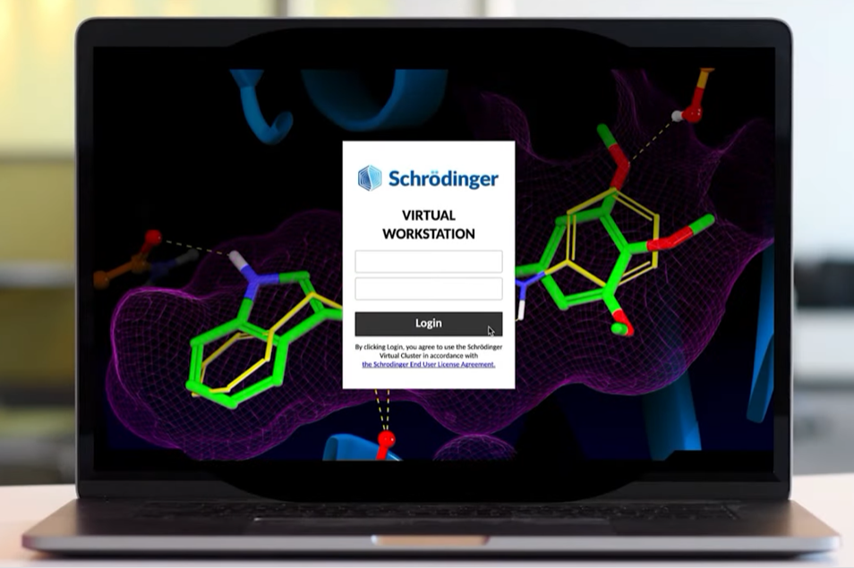
Digital Transformation
(Workshop in 2021. using Schrödinger Virtual Station)
Participation in beta testing
4 students from JJZ high school
10 PhD students from University of Novi Sad with the experimental materials science background
We focused on quasi periodic structures and used molecular DFT
DEEP TECH COMES FROM THE WEB(BROWSER)!!!

Slide 21
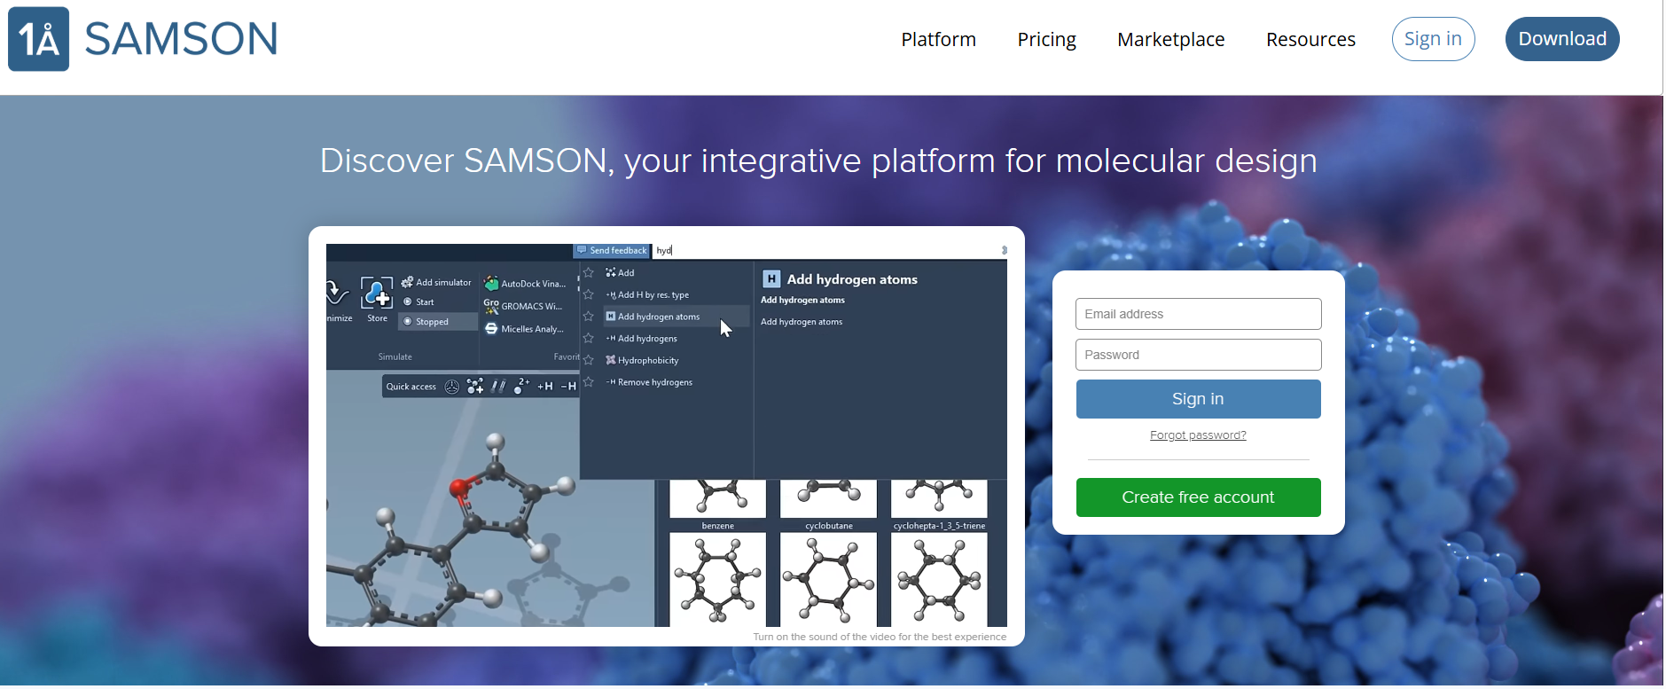
Notes:
Geometry (G): The models use an extended tight-binding Hamiltonian, finely tuned to reproduce bond lengths and angles across a wide range of elements and bonding situations.
Frequency (F): GFN-xTB includes analytical second derivatives (Hessians), allowing accurate vibrational frequency calculations without resorting to numerical.
Noncovalent interactions (N): Captured through empirically corrected dispersion terms (e.g., D3-like in GFN1 and advanced density-dependent D4-like in GFN2) and multipole electrostatics, enabling the method to handle hydrogen bonding, π–π stacking, and van der Waals interactions effectively.

Slide 22
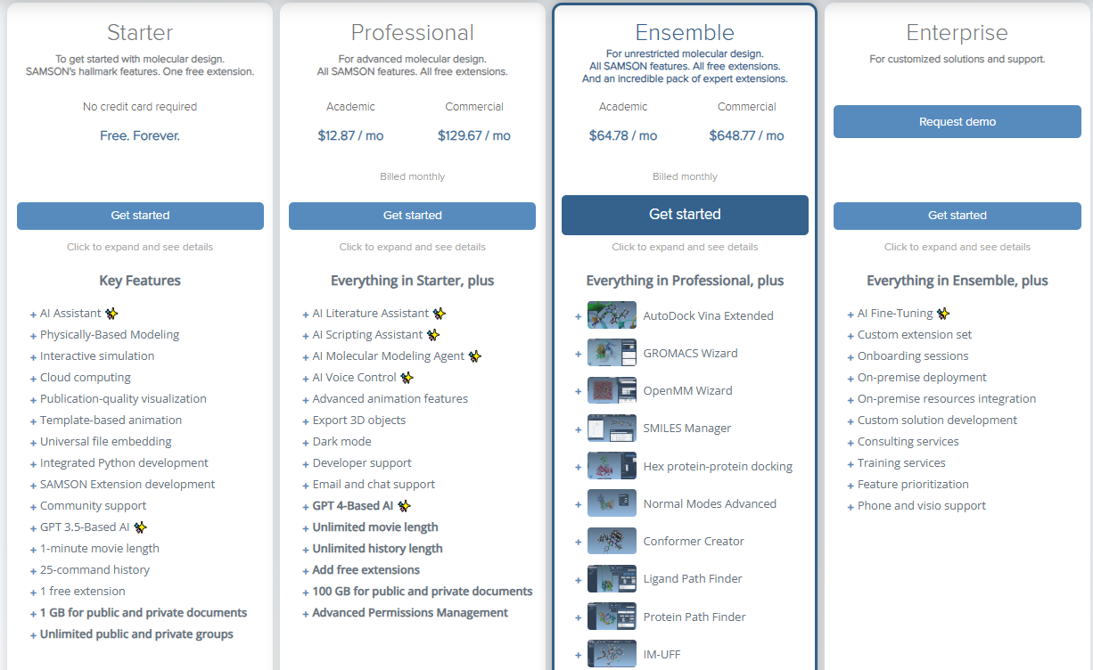

Slide 23
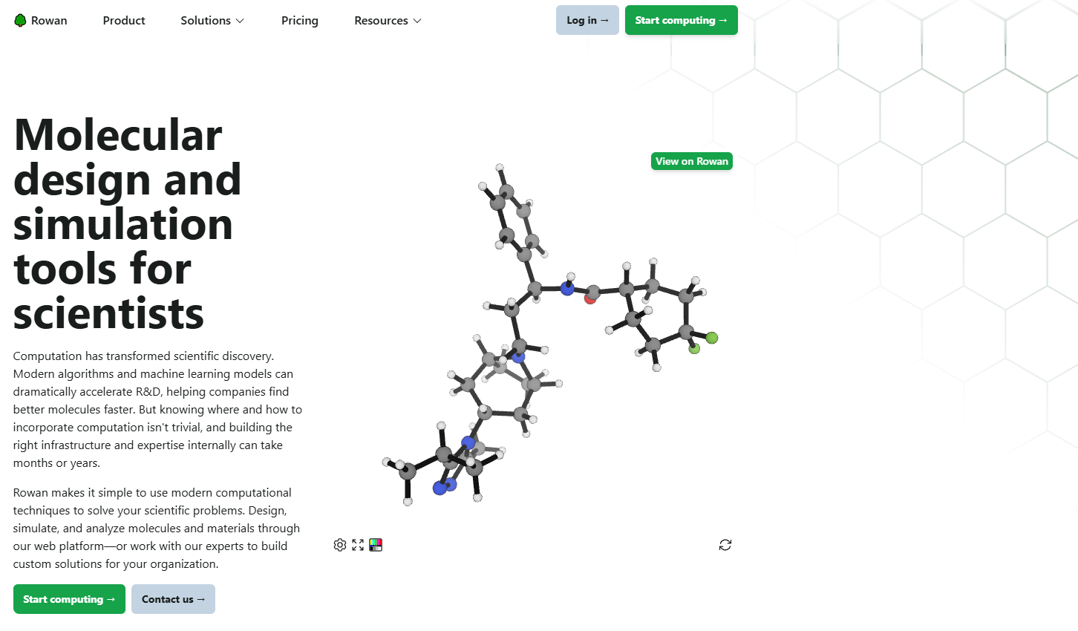

Slide 24
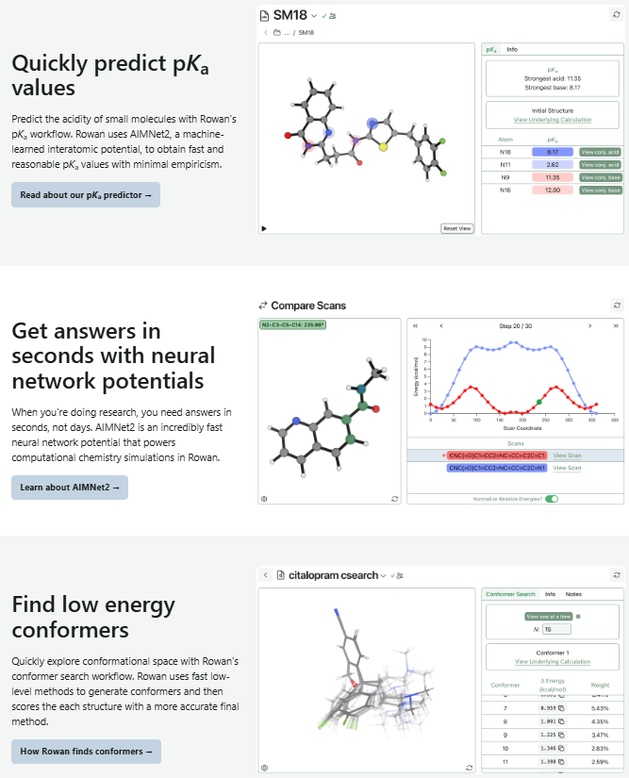
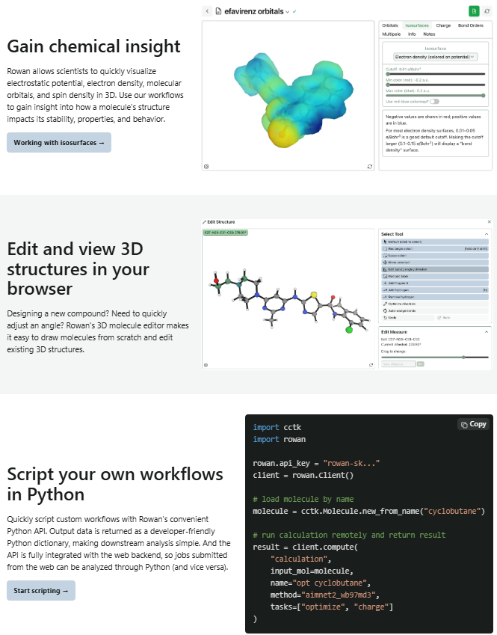

Slide 25
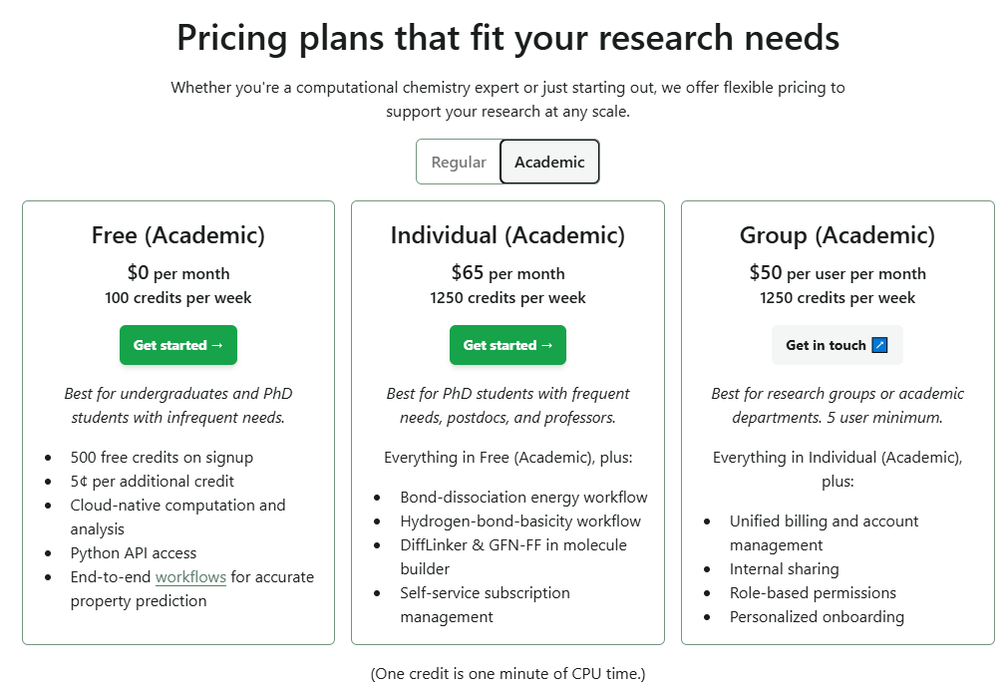

Slide 26
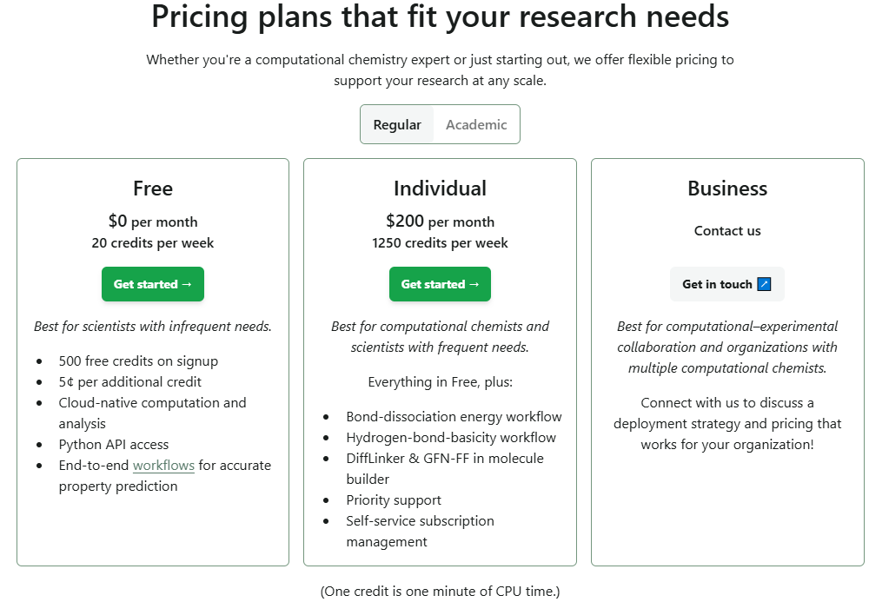

Slide 27


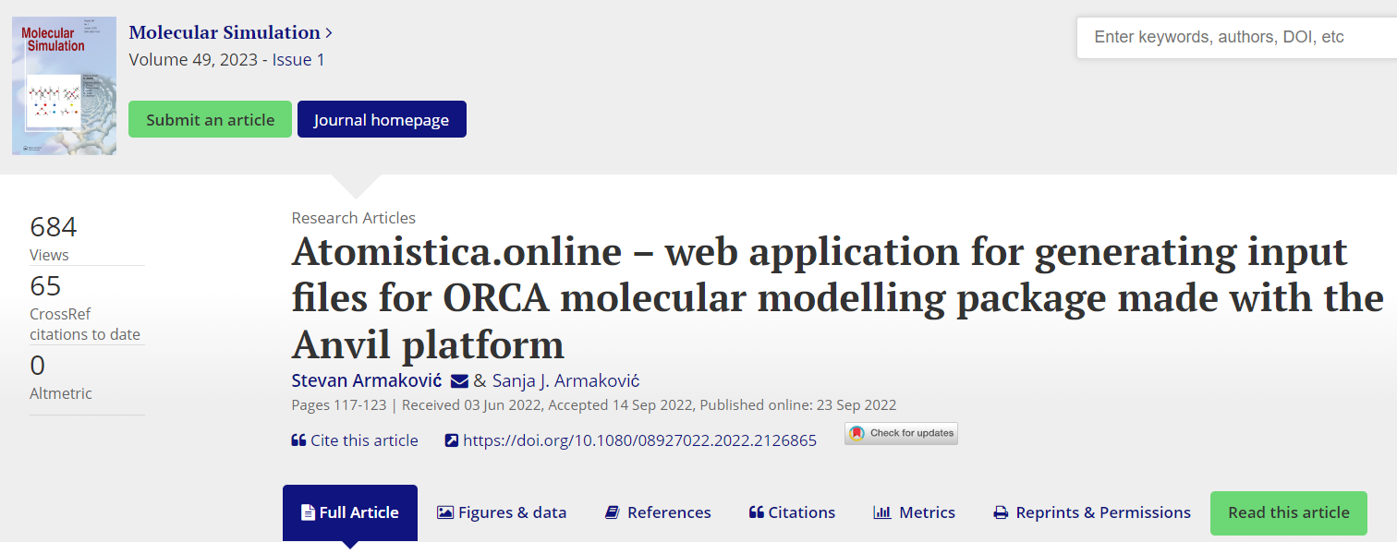
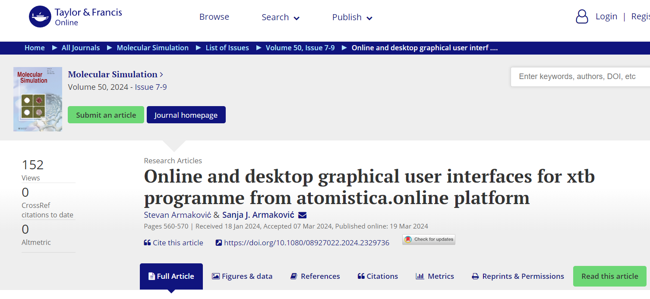
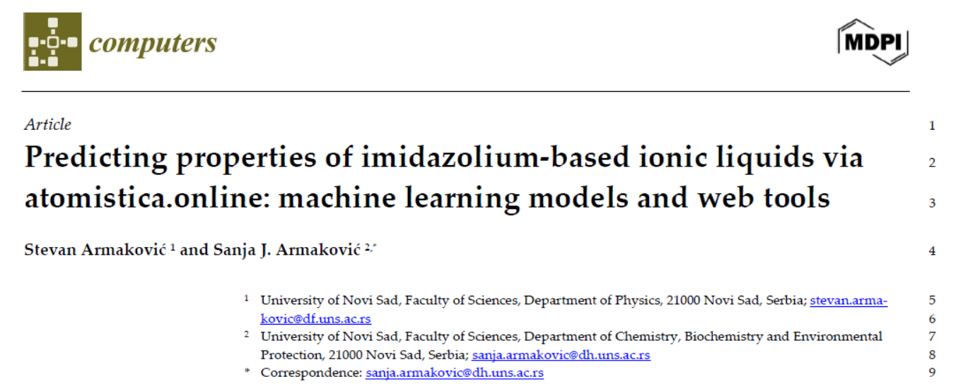
Atomistica.online - our contribution to deep tech from the web
Presented in papers published in “Molecular Simulation” journal
Initially conceived “just” as an online input generator for ORCA program
Intended for teaching molecular modeling and for beginners in this field
Developed using python and the Anvil platform
https://atomistica.online
Join Discord server
https://discord.gg/cDcTT6NknH

Slide 28
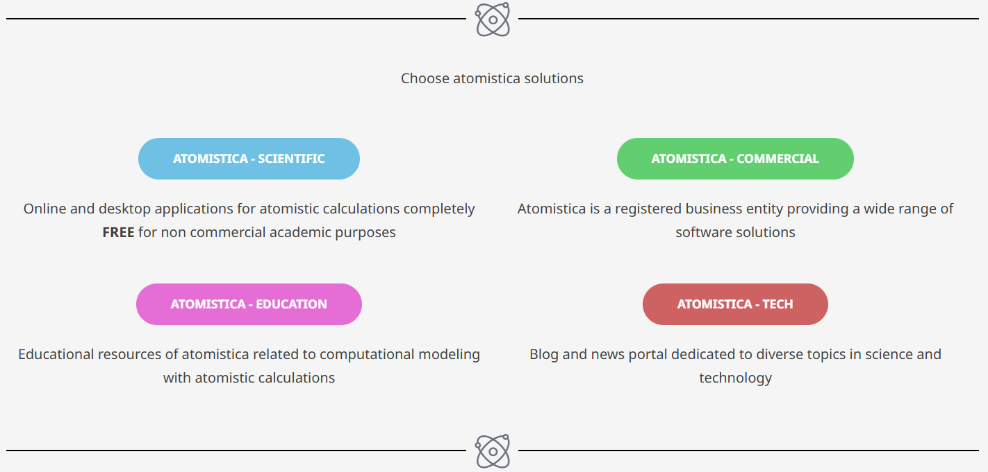

Slide 29
Tools of atomistica.online 2025
Input generators
Orca input generator
Orca input batch generator
PSI4 input generator
QCXMS input generator
Online calculators
Online xtb calculator
Online MOPAC2016 calculator
Online SHERMO
Generation of molecular structures
Online Packmol
Ionic liquids generator
Conformers Generator (ConfGen)
Property calculators
Detonation Properties (DEPRO)
IR & UV spectra generators
Descriptors
ADME calculator
Multiwfn tools
Online RDG
Partial density of states generator
Molecular surface analysis
Converters
.gbw to .wfn and .wfx converter
Desktop tools
XTB GUI
ORCA launch and monitor GUI

Slide 30
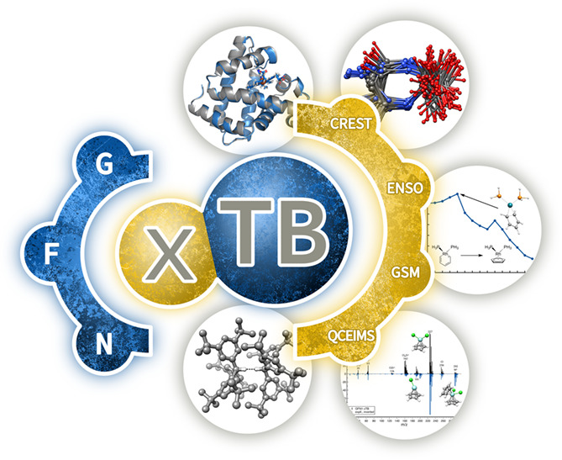

xtb
Open source
Semiempirical methods based on extended tight binding method (XTB)
GFNn-xTB family ($n=2, 1, 0$) and GFN-FF
g-xTB – the latest and most powerful
GFN (Geometry, Frequency, Noncovalent), parametrized for all elements up to Z=86.
Geometry (G): extended tight-binding Hamiltonian
Frequency (F): analytical second derivatives (Hessians)
Noncovalent interactions (N): Empirically corrected dispersion terms (e.g., D3-like in GFN1 and advanced density-dependent D4-like in GFN2) and multipole electrostatics
WIREs Computational Molecular Science 2020
https://doi.org/10.1002/wcms.1493
Notes:
Geometry (G): The models use an extended tight-binding Hamiltonian, finely tuned to reproduce bond lengths and angles across a wide range of elements and bonding situations.
Frequency (F): GFN-xTB includes analytical second derivatives (Hessians), allowing accurate vibrational frequency calculations without resorting to numerical.
Noncovalent interactions (N): Captured through empirically corrected dispersion terms (e.g., D3-like in GFN1 and advanced density-dependent D4-like in GFN2) and multipole electrostatics, enabling the method to handle hydrogen bonding, π–π stacking, and van der Waals interactions effectively.

Slide 31



The power of semiempirical methods
-MET in explicit solvation-
344 atoms
Ryzen 7950X/64GB
Method | Solvation | Iterations | Timing
DFT | Explicit | 700 | Days
SE/GFN2-xTB | Explicit | 620 | 11m, 27 s
FF/GFN-FF | Explicit | 603 | 1m, 8s
FF/OPLS | Explicit | 2300 | 5 s

Slide 33


Slide 34


Slide 35


Slide 36


Slide 37


Slide 38


Slide 39


Slide 40


Slide 41


Slide 42


Slide 43


Ionic liquids generator
Cations: 1316
Anions: 456
In total: 600 000 +
ML friendly database coming soon

Slide 44


Registration

Slide 45


Digital transition by
Meta Platforms, Inc
Platforms:
Facebook
Instagram
Messenger
WhatsApp
Threads
…
Divisions:
Reality Labs
FAIR
…

Slide 46
Meta’s Metaverse Bet: Expensive Vision Uncertain Return
A bold attempt to redefine social computing, with enormous cost and still-limited mainstream adoption
THE VISION
THE VISION
THE REALITY
Build the next computing platform
>$80B
A persistent ecosystem where social interaction, work, entertainment and digital identity move beyond the flat screen.
cumulative Reality Labs operating losses
since 2020
◎
Horizon Worlds
◉
Meta Quest
Virtual social spaces
VR hardware ecosystem
20
21
22
23
24
25
◌
Ray-Ban Meta
◇
AR / VR platform
Annual operating loss trend
AI-enabled smart glasses
Long-term spatial computing bet
Mass adoption has been slower than the scale of investment.

Slide 47

https://ai.meta.com/research
Meta FAIR team

Slide 48
OMol25 and UMA by Meta FAIR
Open Molecules 2025 (OMol25)
UMA: A Family of Universal Models for Atoms
https://doi.org/10.48550/arXiv.2505.08762
https://doi.org/10.48550/arXiv.2506.23971
small molecules, biomolecules, metal complexes, and electrolytes
Based on equivariant graph neural network
B97M-V/def2-TZVPD level of theory
ORCA 6.0.1
∼500M atomic systems
https://huggingface.co/facebook/OMol25
https://huggingface.co/facebook/UMA

Slide 49
META FAIR – One Year Later
Key updates since OMol25 and the first UMA release
DATA UPDATE
MODEL UPDATE
Open Polymers 2026 (OPoly26)
New UMA model versions
New open FAIR Chemistry dataset focused on polymers
Direct extension of the OMol25 initiative
Uses the same DFT settings as OMol25
Can be combined consistently with OMol25 data
Current checkpoints include UMA-S 1.1, 1.2, and 1.2.1
Medium model available: UMA-M 1.1
Original uma-s-1 archived due to a known extensivity bug
Maintained through the FAIR Chemistry ecosystem
6.57 million single-point density functional theory (DFT) calculations on capped substructures of diverse polymer chains
March 2026 - UMA-1.2 released! ~50% faster, ~40% more accurate on Open Molecules test set, and expanded data coverage for catalysts (oxides and interfaces), molecules, and polymers!
https://arxiv.org/abs/2512.23117
https://github.com/facebookresearch/fairchem

Slide 50
More from META
Model / family | Main area | Key idea / importance
Llama 4 | LLMs / multimodal AI | Meta’s flagship open-weight language models; mixture-of-experts architecture and multimodal capabilities
SAM 3 / SAM 3.1 | Computer vision | General-purpose segmentation and tracking of objects in images and video
SAM 3D | 3D vision / spatial AI | Reconstruction and understanding of 3D objects and scenes
SAM Audio | Audio AI | Prompt-based separation and segmentation of speech, music and other sounds
V-JEPA 2 | World models / robotics | Learns physical-world dynamics from video and supports planning and embodied AI
UMA | Chemistry / materials science | Universal Model for Atoms; general-purpose atomistic ML model for molecules, materials and catalysts
ImageBind | Multimodal learning | Places image, text, audio, depth, thermal and motion data into a shared embedding space
SeamlessM4T / Seamless | Speech / translation | Multilingual speech and text translation in a unified model family
AudioCraft / MusicGen / AudioGen | Generative audio | Generation of music, sound and audio from text prompts
Voicebox | Speech generation | Multilingual speech synthesis, editing, denoising and style transfer

Slide 51

Hot Summer of 2025

Slide 52




Slide 53
Cloud vs. Local

Slide 54
Cloud vs. local
Closed source
Open source
ChatGPT
Claude.ai
Perplexity.ai
Grok
Cursor
…
DeepSeek-V3.1
gemma-3-270m
Qwen3 Coder
GPT-OSS
Llama 3.1 8B
…

Slide 55

The power of local AI
“Make sure you own your AI. AI in the cloud is not aligned with you; it's aligned with the company that owns it.”

Slide 56

The power of local AI
“Make sure you own your AI. AI in the cloud is not aligned with you; it's aligned with the company that owns it.”

Slide 57
Open vs. Closed LLMs: Where Is the Real Cost?
CLOSED / API
OPEN / SELF-HOSTED
Pay per token or request
Infrastructure handled by provider
Updates and security managed externally
Fast to deploy and scale
More predictable operational model
Less control; vendor dependence
No traditional API fee, but GPUs cost money
Infrastructure becomes your responsibility
Updates, security and compatibility are internal
Deployment and optimization expertise required
Greater control over data and deployment
Hardware / software-stack dependence
The solution might be VPS – Virtual Private Servers

Slide 58




Slide 59





Slide 60
Overview of AI companies
Country | GDP ($ trillion) | Companies and institutions building LLMs
🇺🇸 USA | 30.50 | xAI; OpenAI; Perplexity; Amazon; Meta; Nvidia; Microsoft; Databricks; Bloomberg; Cerebras; Eleuther; Anthropic
🇨🇳 China | 19.23 | Alibaba; DeepSeek; Huawei; Baidu; MiniMax; ByteDance; Tencent; ZhipuAI; iFlytek; Shanghai Univ.; Moonshot AI
🇩🇪 Germany | 4.74 | DeepL; BlackForestLabs; DFKI; Aleph Alpha
🇮🇳 India | 4.18 | AI4Bharat; Sarvam AI; Krutrim; Reliance AI
🇯🇵 Japan | 4.18 | NTT; Fujitsu; SoftBank; CyberAgent; Kotoba; ELYZA; RIKEN; Rakuten
🇬🇧 UK | 3.73 | Stability AI; Inflection AI; DeepMind
🇫🇷 France | 3.28 | Mistral AI; Hugging Face; LightOn
🇮🇹 Italy | 2.45 | Almawave; iGenius
🇨🇦 Canada | 2.33 | Cohere; MILA
🇧🇷 Brazil | 2.30 | Maritaca AI; NeuralMind
🇷🇺 Russia | 2.19 | Yandex; Sber AI
🇰🇷 South Korea | 1.94 | LG; Upstage; Kakao Brain; Naver; ETRI
🇦🇺 Australia | 1.88 | Katonic AI
🇪🇸 Spain | 1.82 | BSC
🇲🇽 Mexico | 1.81 | UNAM; Tecnológico de Monterrey
🇮🇩 Indonesia | 1.49 | Datasaur; Prosa.ai; GoTo; Indosat Ooredoo
🇹🇷 Turkey | 1.45 | Commencis; Brew Interactive; T3 Foundation

Slide 61
The Role of AI in
Academic Activities

Slide 62


AI in scientific publishing

Slide 63

https://retractionwatch.com/papers-and-peer-reviews-with-evidence-of-chatgpt-writing/

Slide 64



Slide 65



The role of LLMs
Assistant
Content creation
Problem solving

Slide 66


Solving problem with LLM
MD simulation, RDF functions
Motivation letter

Slide 67
“Dead” document
Formally required piece of writing produced to satisfy administrative or procedural demands, but which is never meaningfully read, analyzed, or used in decision-making
Never treat your CV, Cover Letter or Motivation letter as a “dead” document

Slide 68

Common words used by ChatGPT
I would add also: Paradigm and Democratization

Slide 69
Conclusions
Digital transition → digital transformation: from tools to deep changes in how science and society operate.
Web-based deep tech: Online platforms show how powerful science can run directly in the browser.
AI in research: from large-scale models (OMol25, UMA) to small, local LLMs that ensure independence and control.
Ethics & responsibility: Use digital tools transparently, as a sidekick
Future outlook: open science, collaboration, and human creativity remain at the center of the digital era.

Slide 70
Ideas for post-CONNECT 2026 period

Slide 71
Post-CONNECT 2026
8 CONNECT Events:
~160 student participants
At least 40 established professionals (scientists, professors, etc)
Disciplines represented: physics, chemistry, biology, engineering, IT, law, geography, humanities etc.
International reach: participants from 10 countries and 10 universities
HUGE ALUMNI POTENTIAL!!!

Slide 72



Post-CONNECT 2026
IDEA 1:
Special Issue in AIDASCO Reviews
CONNECT 2026 - Digital Transformation and AI: Science, Society and Creativity
https://publishing.aidasco.org/journals/index.php/aire/announcement/view/11
Student-focused projects: guided by mentors
Write, publish, and share: transform your ideas into scientific articles
Collaborative spirit: teamwork between students and mentors
First publishing experience: supportive, open-access environment

Slide 73

Post-CONNECT 2026
IDEA 2:
Joint research activities involving students
Application of atomistic calculations
For example: Interactions between carbon-based nanomaterials and pharmaceutical components

Slide 74


Slide 75
Thank you for your attention
Q/A Session

