Slide 1





Digital transition and the impact of AI
Stevan Armaković, PhD
University of Novi Sad, Faculty of Sciences
Department of Physics

Slide 2
AGENDA
Introduction
Updates on post-CONNECT-2025 activities
Examples of Digital Transition in Computational Materials Science
Cloud vs. Local
The Role of AI in Academic Activities
Ideas for post-CONNECT 2026 period

Slide 3
Introduction
EMOS Research Group
Association for the International Development of Academic and Scientific Collaboration
AIDASCO Reviews
Atomistica Online

Slide 4

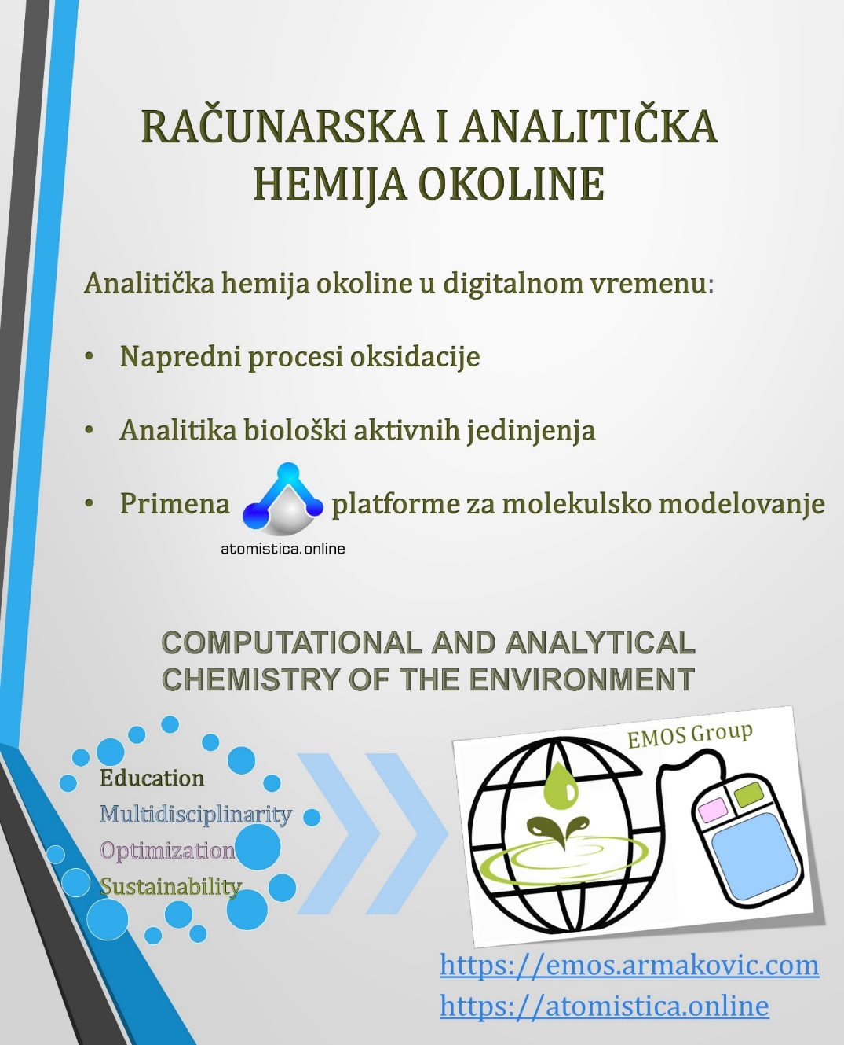
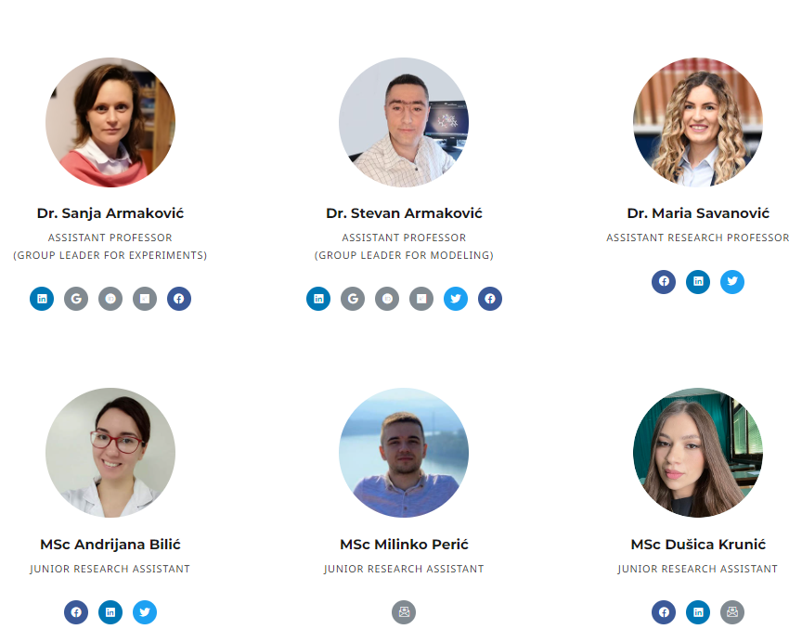
Members of the research group for
COMPUTATIONAL AND ANALYTICAL
ENVIRONMENTAL CHEMISTRY
ASSOCIATE PROFESSOR
GROUP LEADER FOR EXPERIMENTS
ASSOCIATE PROFESSOR
GROUP LEADER FOR MODELING
ASSISTANT RESEARCH PROFESSOR
RESEARCH ASSISTANT
JUNIOR RESEARCH ASSISTANT
JUNIOR RESEARCH ASSISTANT

Slide 5

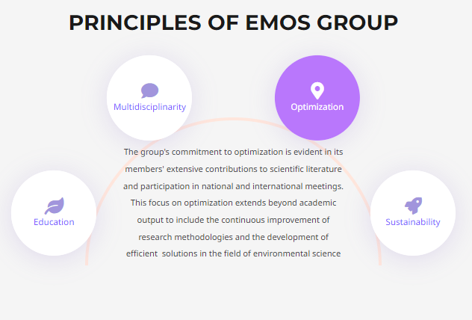
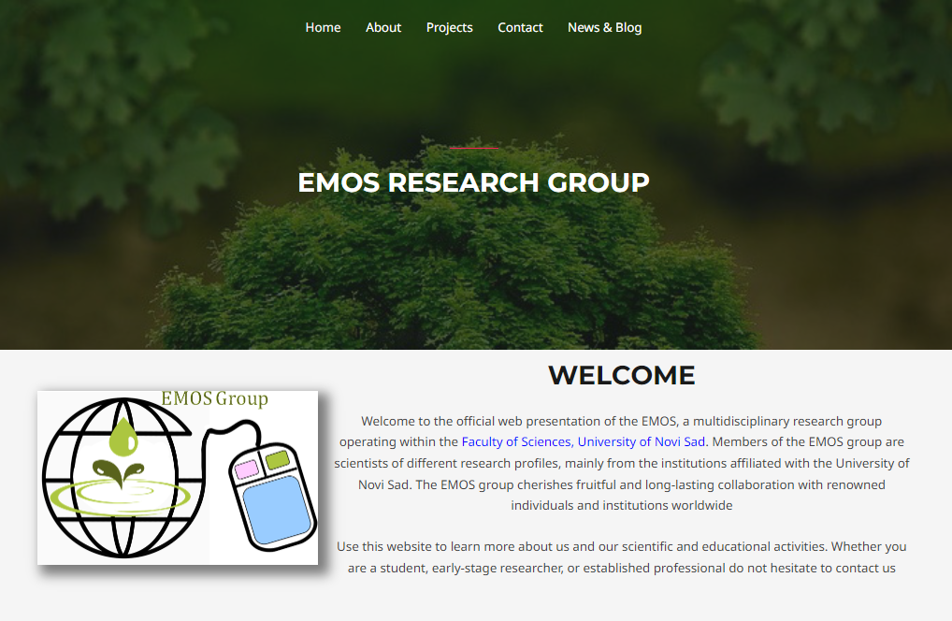
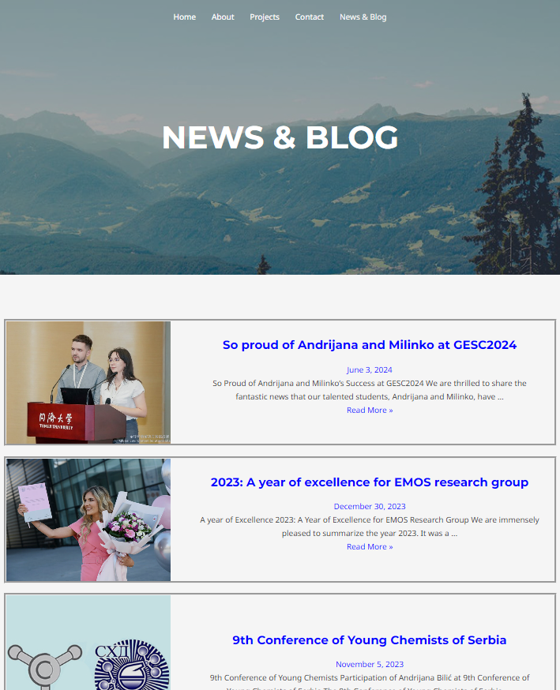
https://emos.armakovic.com/

Slide 6
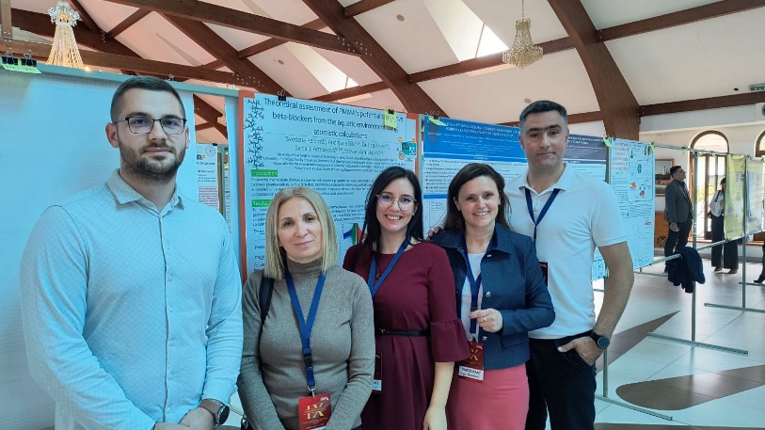
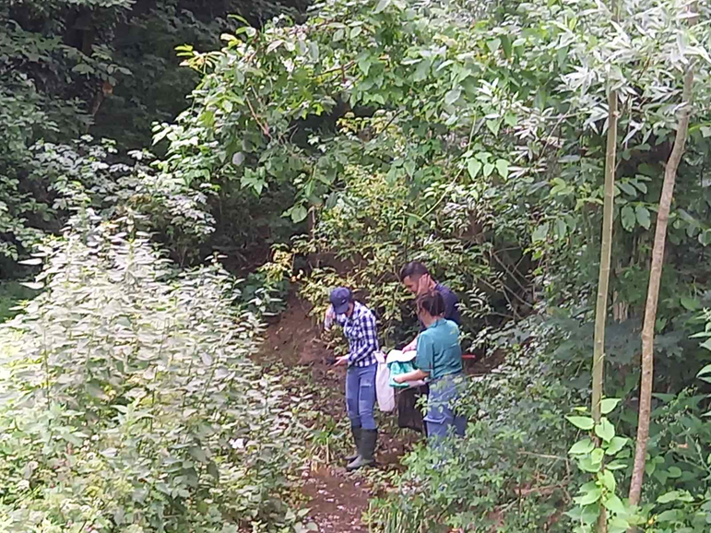
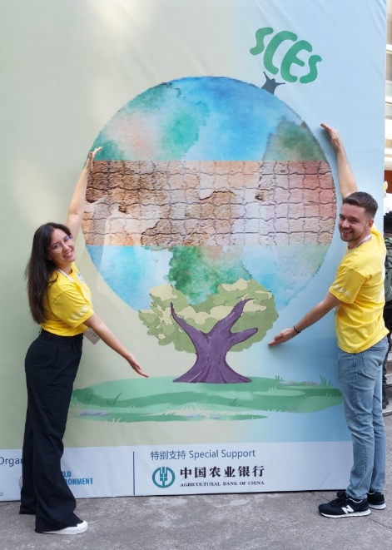

Slide 7
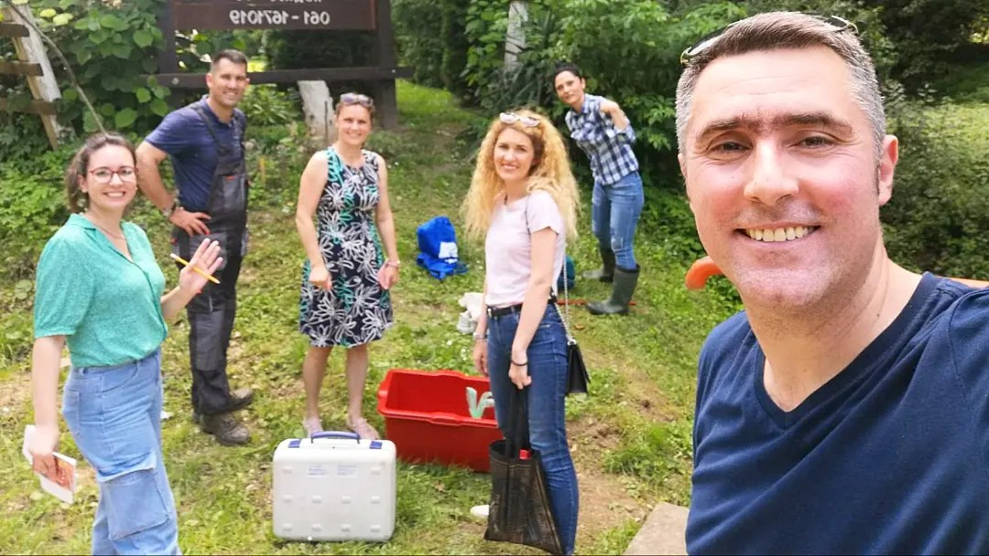
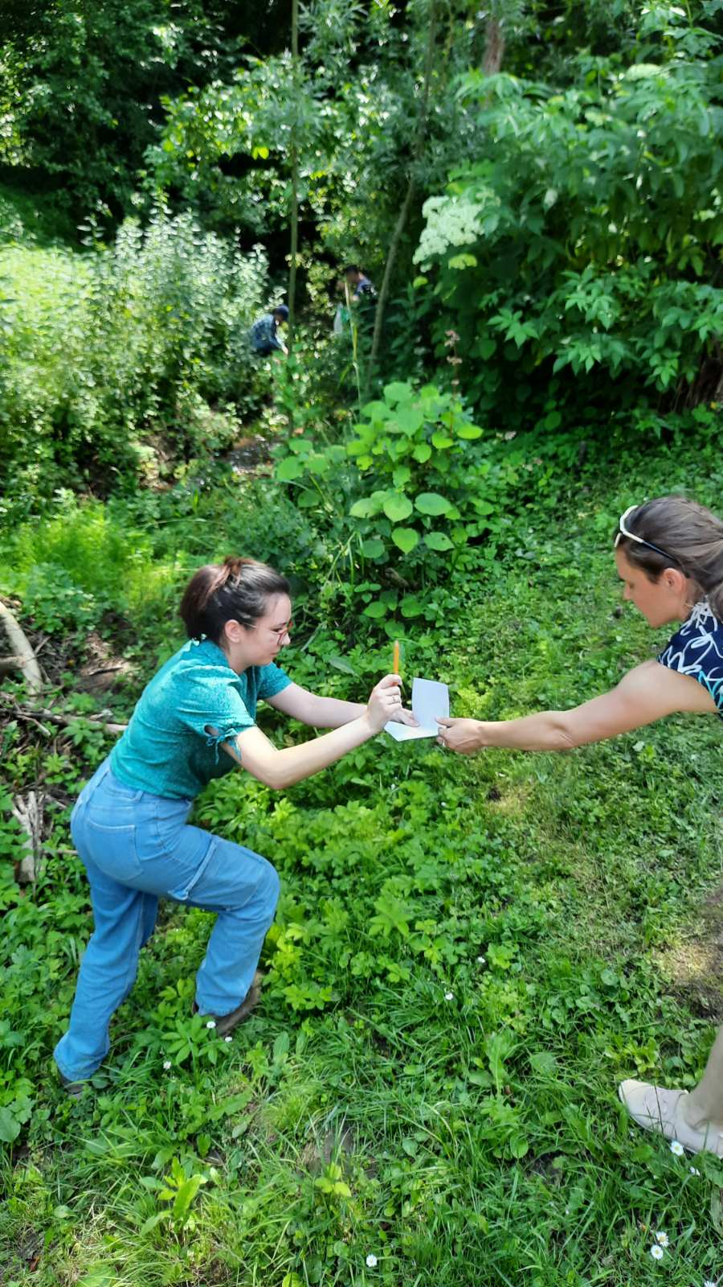
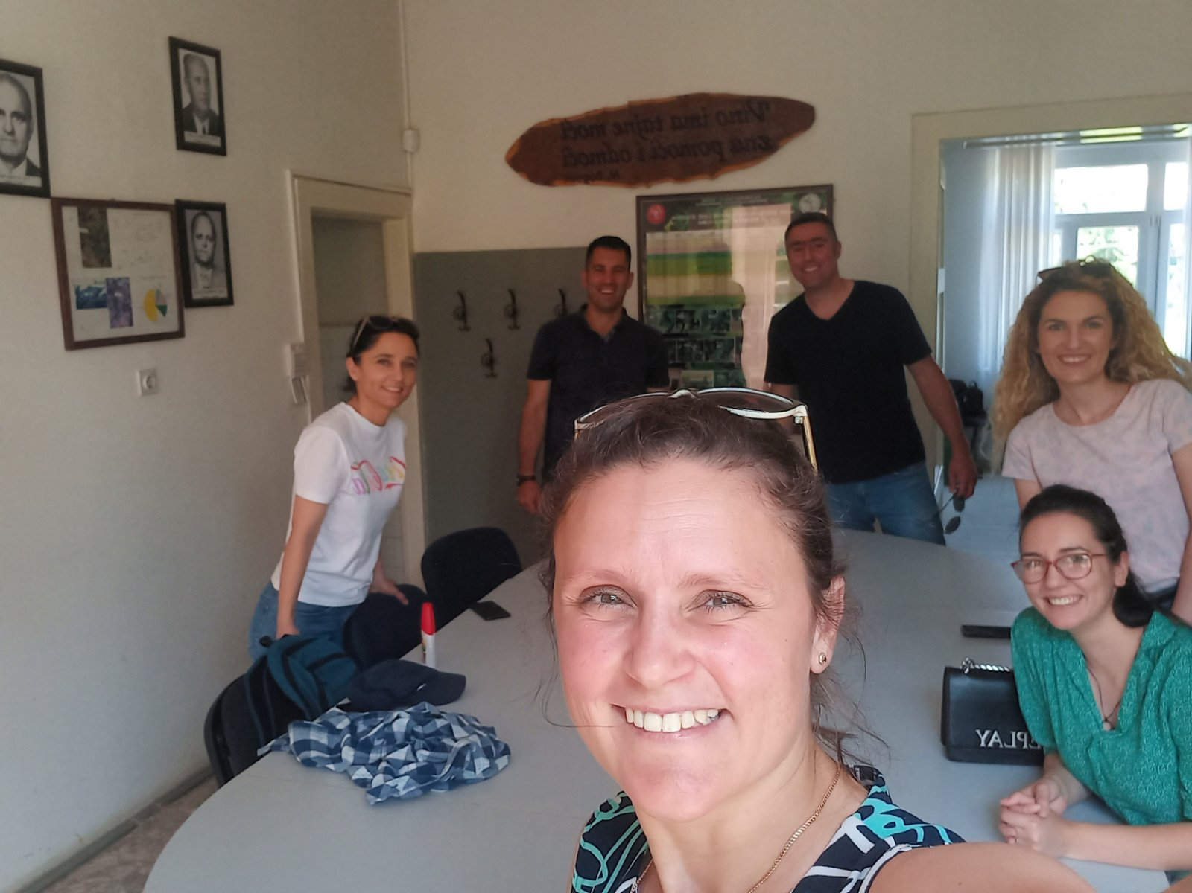


Slide 8
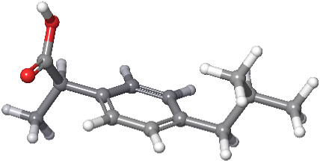
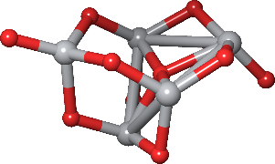
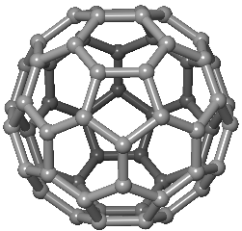
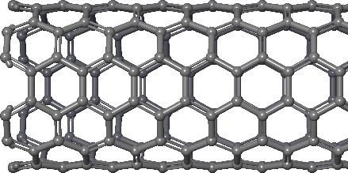
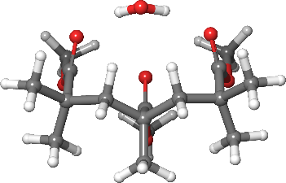
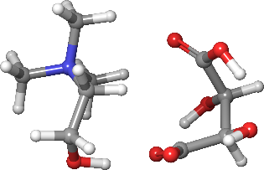
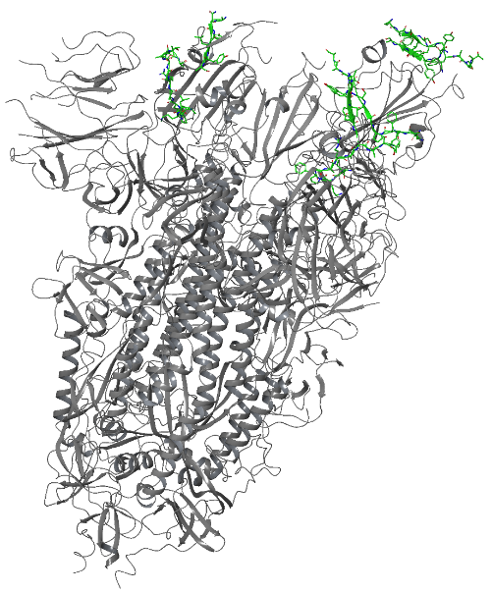
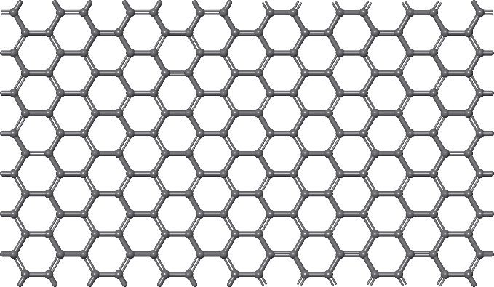
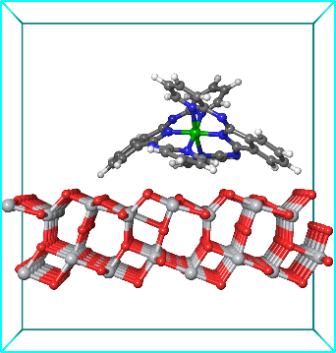
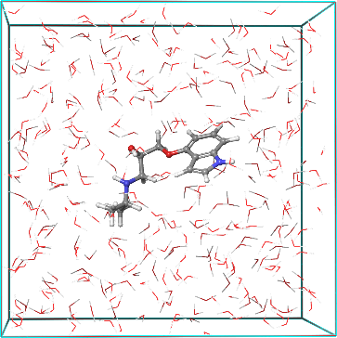
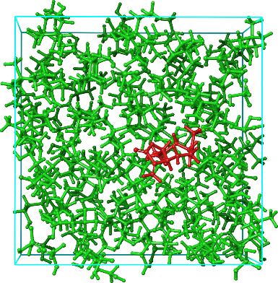
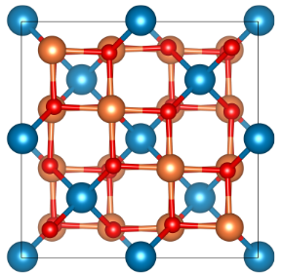
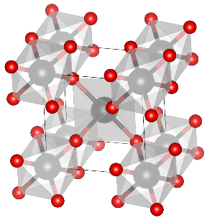
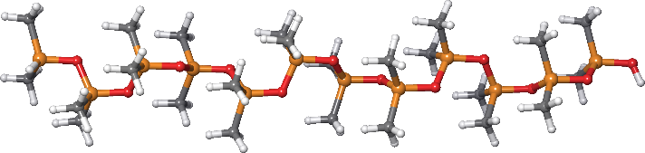
What am I doing for living (and for fun)
Molecular systems
Periodic systems
Interactions
ibuprofen
TiO₂ cluster
C60 (0D)
(6,0) CNT (1D)
PMMA + H₂O
Ch-based IL
Spike protein
6VSB
Graphene (2D)
Adsorption on TiO₂ surface
PIN in water
PDMS polymer
(10 monomers)
ZnFe₂O₄ (3D)
TiO₂ rutile (3D)
Plant extract in Ch-based IL

Slide 9


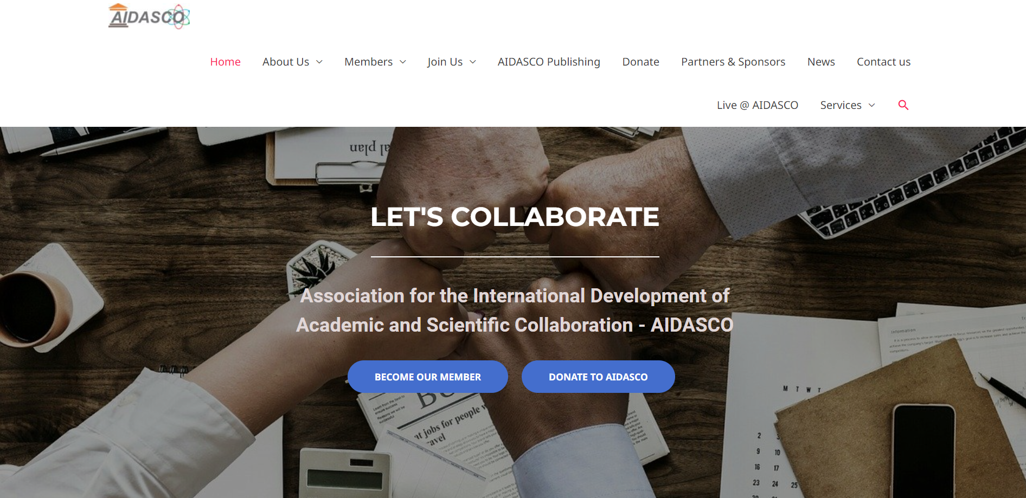
https://aidasco.org/

Slide 10
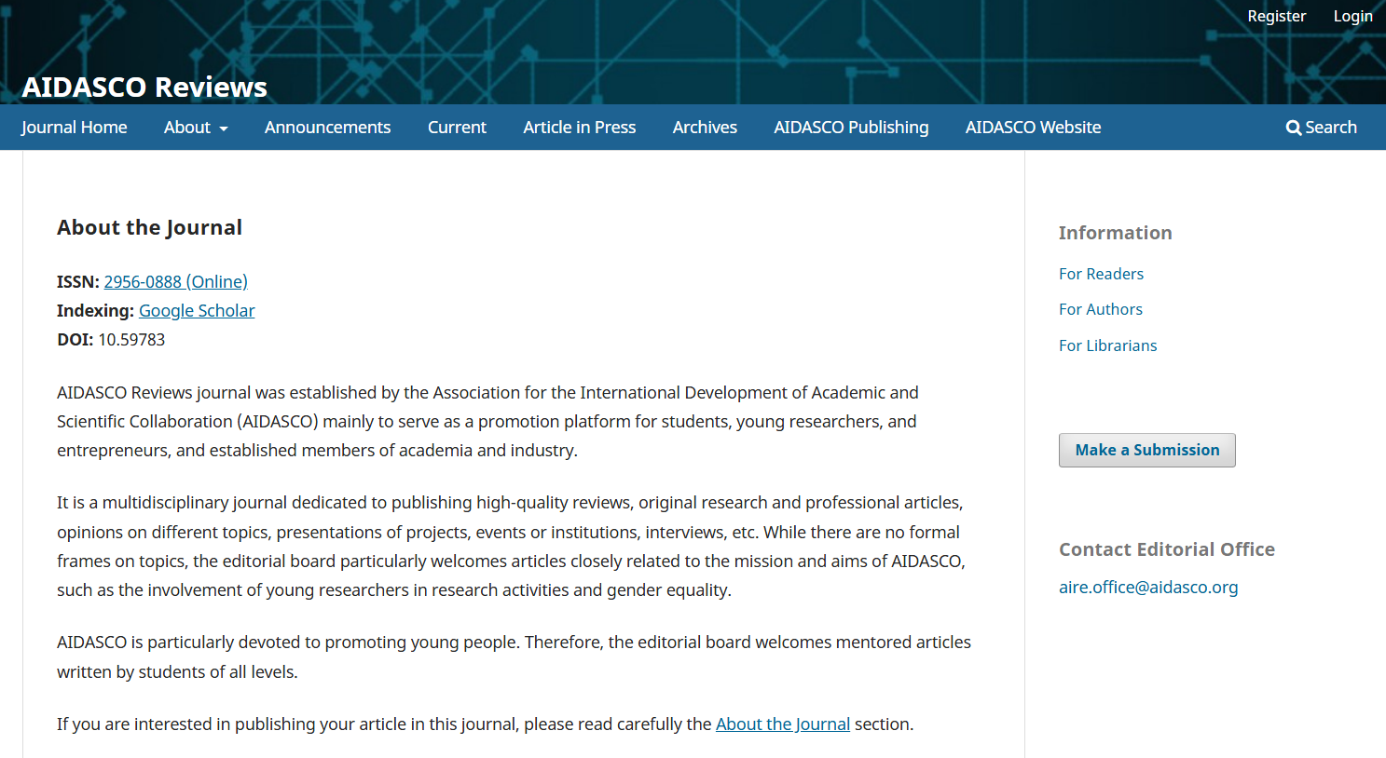

Slide 11
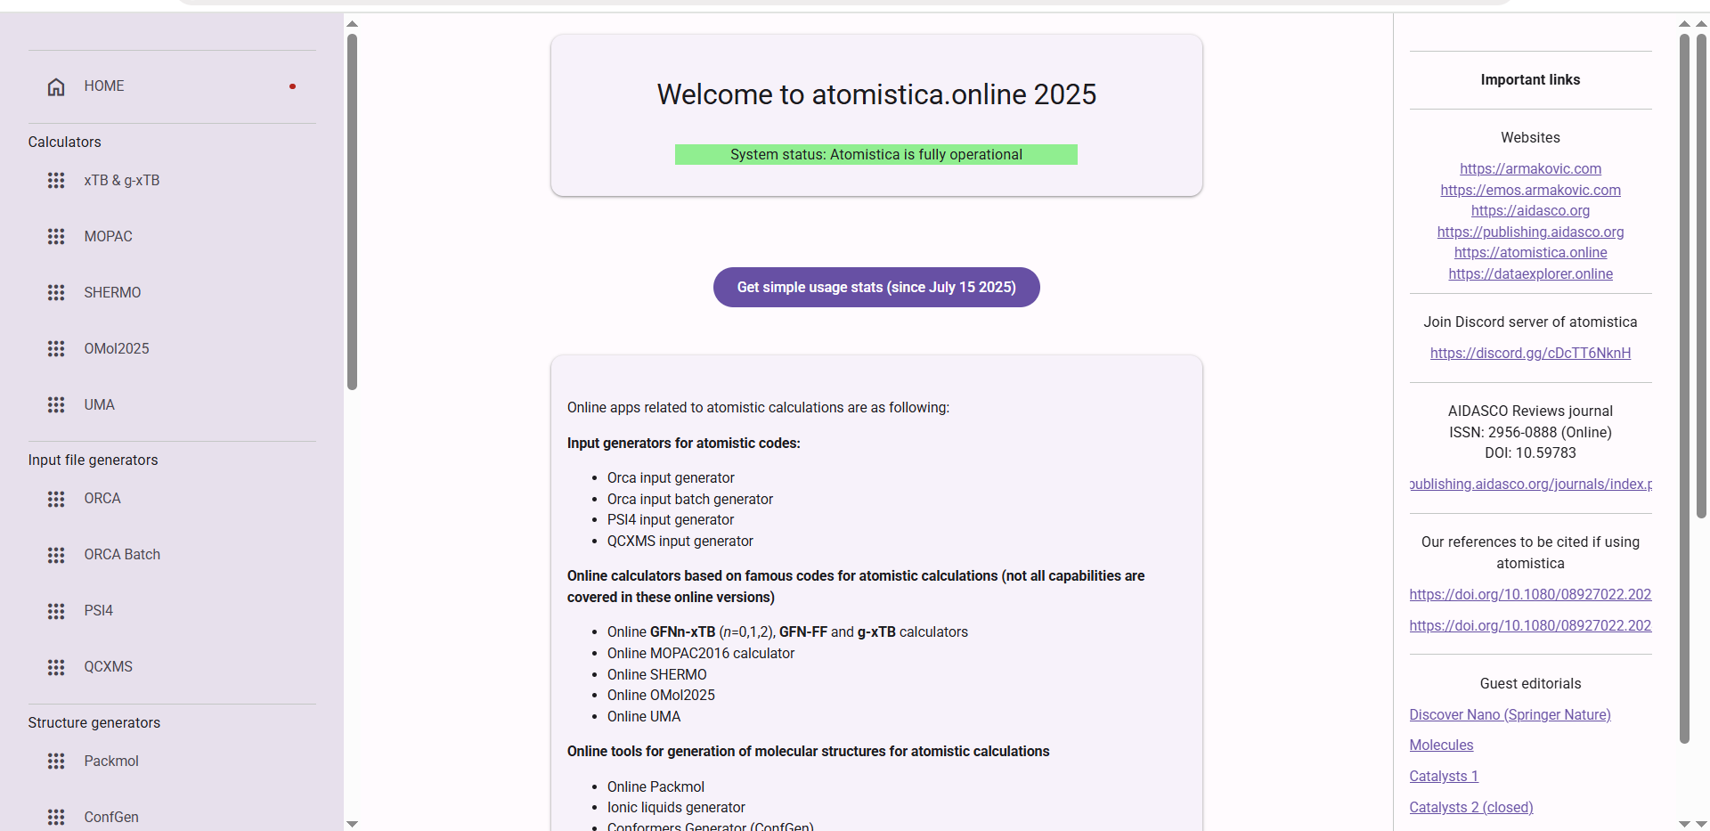

Slide 12
Why CONNECT matters
Overview and post-conference activities

Slide 13
Why CONNECT matters?
Connect 1.0 (2017) “Science and society“
Connect 2.0 (2018) “Common research and education“
Connect 3.0 (2019) “Awareness and convergence“
Connect 4.0 (2020) „Communication and popularization“
Connect 5.0 (2021) „Science Communication“
Connect 6.0 (2022) „Science Communication“
Connect 7.0 (2025) „Towards the ERA“
Connect 8.0 (2026) “Towards the ERA”
~160 students
~40 lecturers

Slide 14


Typical Conference Pattern
CONFERENCE 2025
CONFERENCE 2026
CONFERENCE 2027
CONNECT Vision
CONNECT 2025
CONNECT 2026
CONNECT 2027

Slide 15
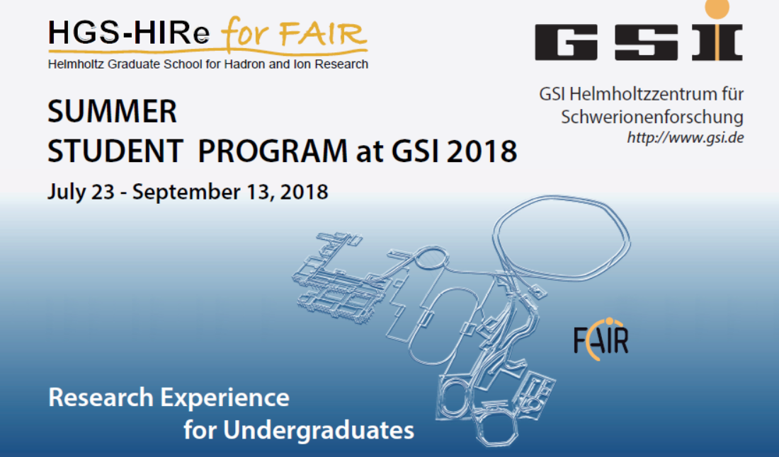

Slide 16
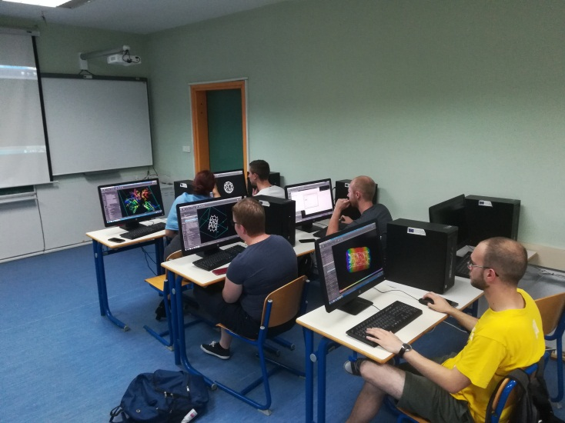
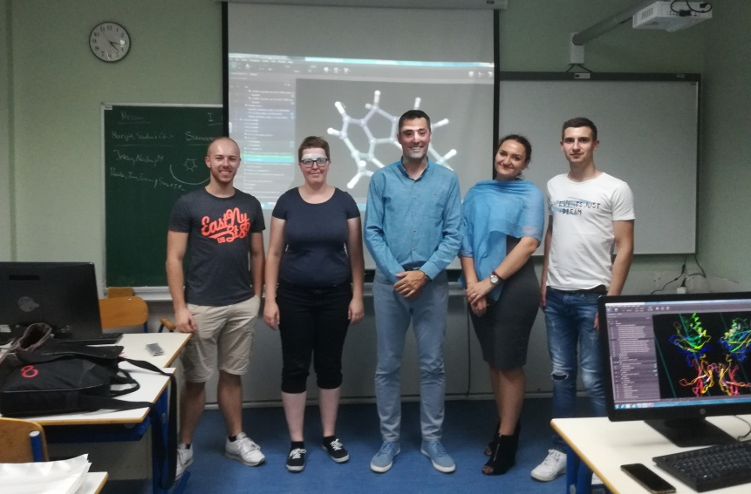
(CONNECT 2.0 Molecular modeling workshop in Tuzla)
The aim of the 3-day workshop was to introduce students with fundamental principles of molecular modeling and to demonstrate the usage of state-of-the-art modeling suite.
Molecular Modeling Workshop group:
1. Paula Hillman (Physics, FIAS, III)
2. Marija Vučićević, (Biology, UNTZ, II)
3. Jelena Vuković, (Phyiscs, UNBL, III)
4. Tom Reichert, (Physics, FIAS, II)
5. Nedim Baraković (Geography, UNTZ, I)
6. Slađan Jelić (Physics, UNS, I)
Computers kindly hosted by the Department of Geography, UNTZ

Slide 17

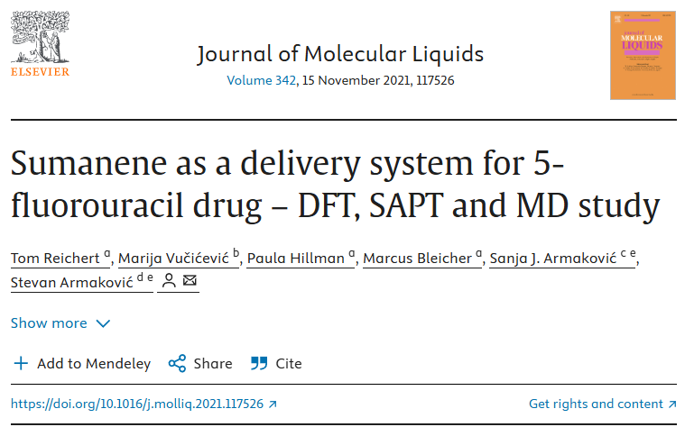
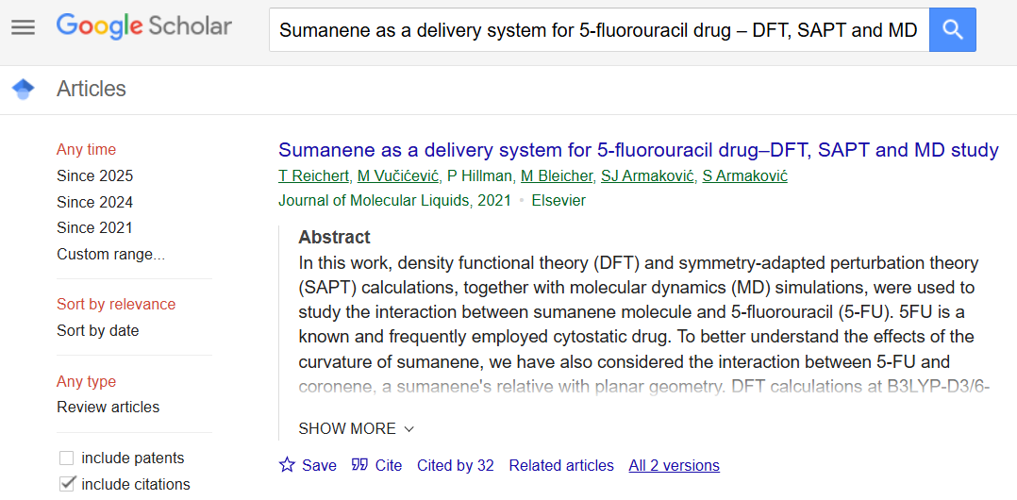
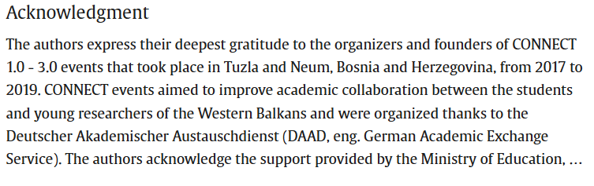

Slide 18

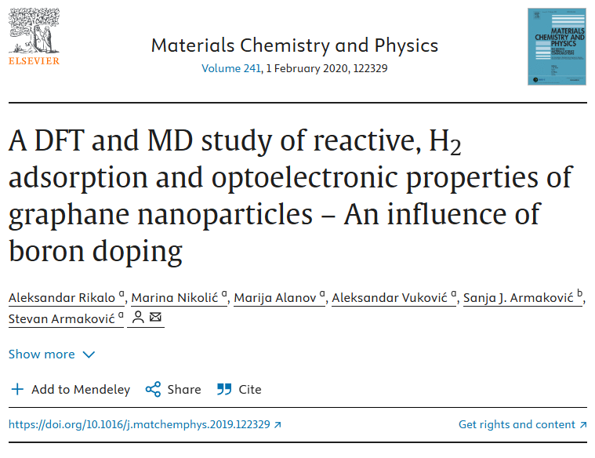
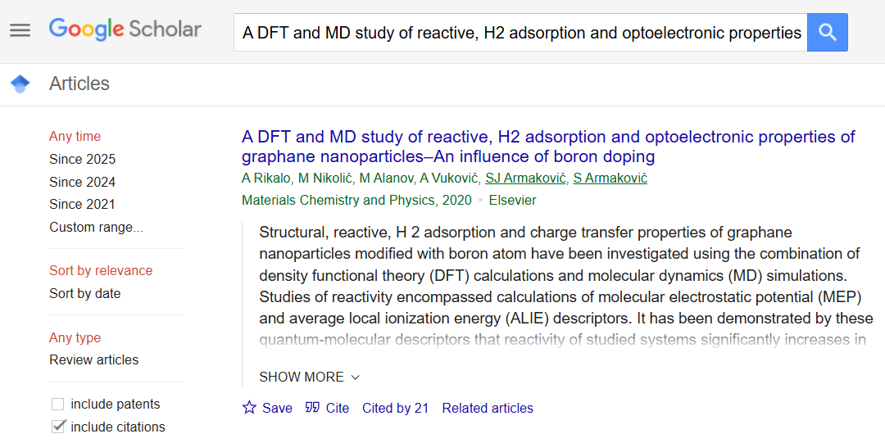
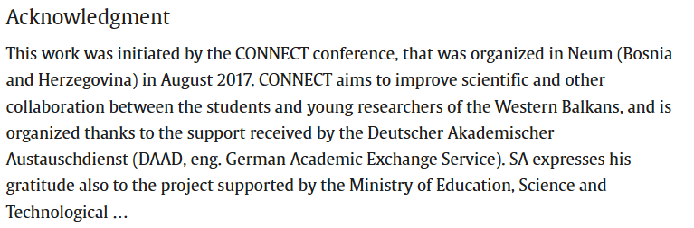

Slide 19
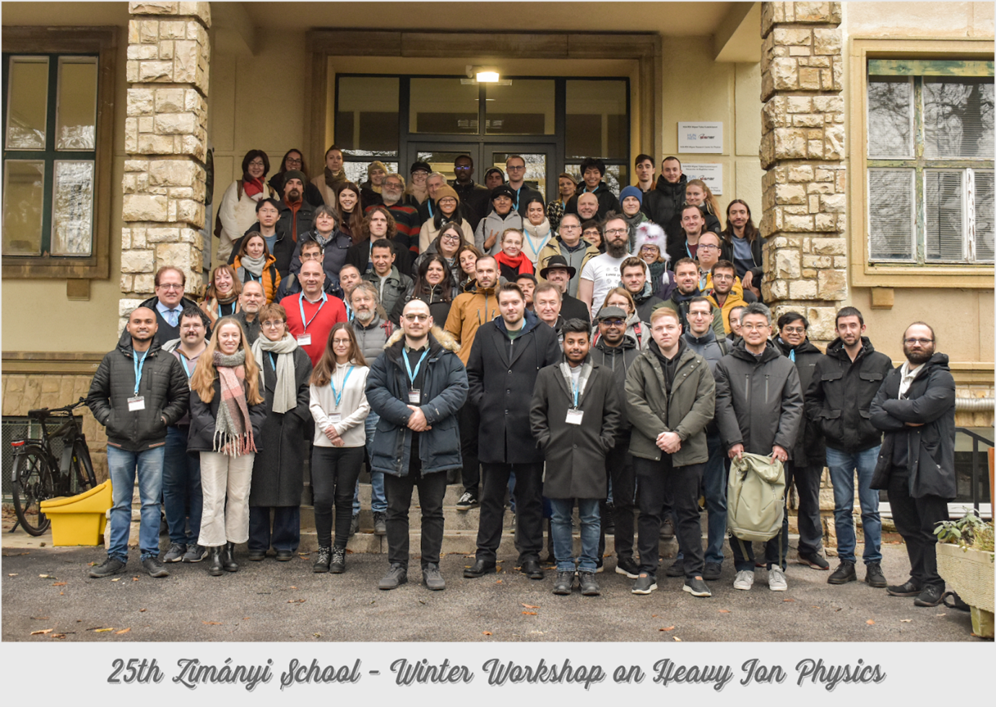

Slide 20
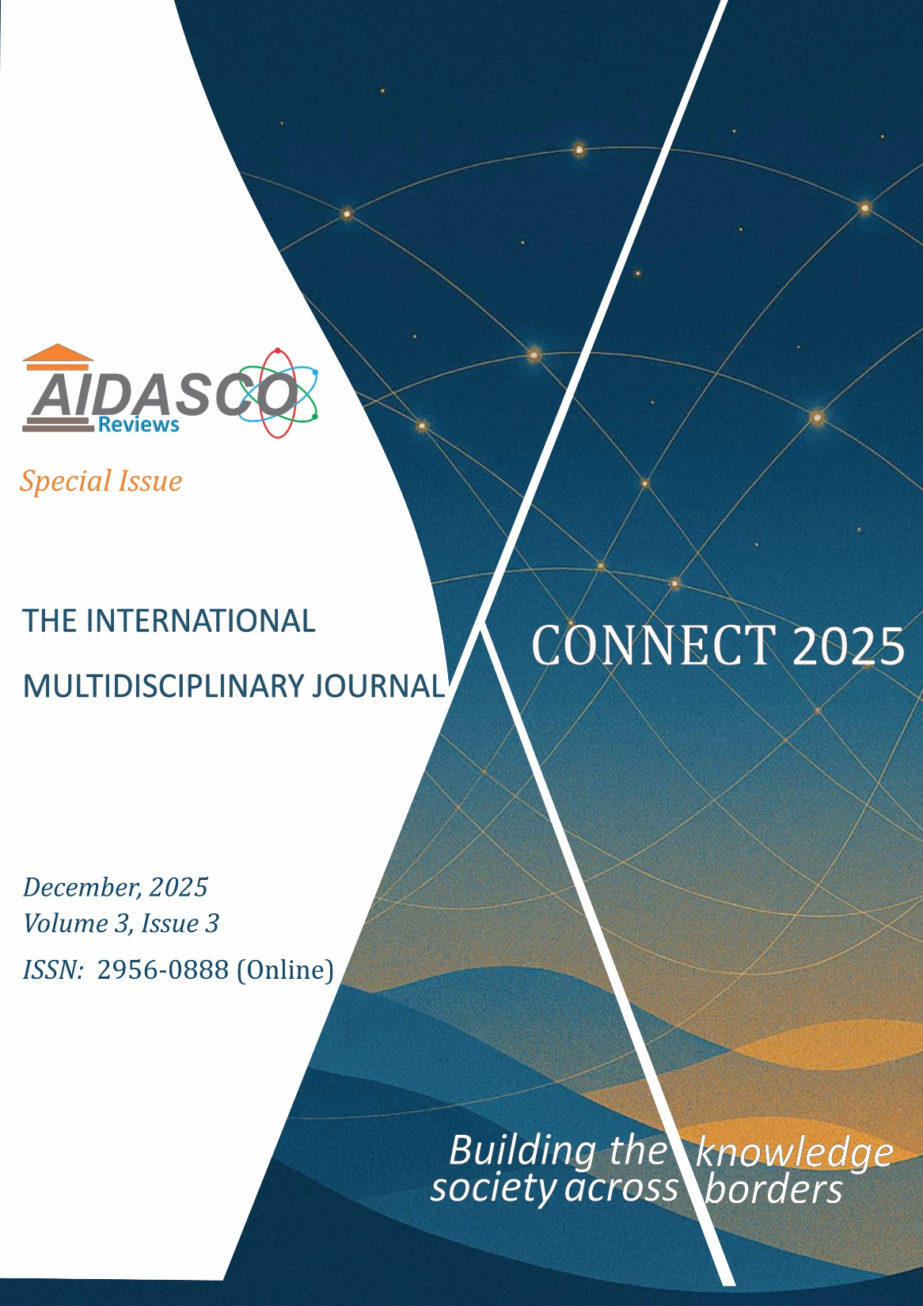
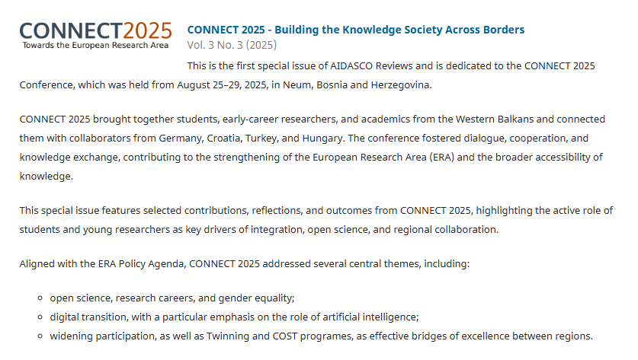
https://publishing.aidasco.org/journals/index.php/aire/issue/view/9

Slide 21
Editorial
Stevan Armaković, Sanja J. Armaković and Maria M. Savanović
CONNECT: A Student-Centered Conference Model for Dialogue, Mentorship and Interdisciplinary Exchange
Stevan Armaković
8 Years Later: CONNECT 2017 Alumni’s Reflection on CONNECT 2025
Ajla Nurkanović and Goran Stanić
Experiencing CONNECT 2025
Dušica Krunić
Science Communication as a Creative Endeavor
Aleksandar Sredojević
CONNECT 2025: A Young Researcher’s Perspective
Tina Tadić
When Science Becomes Both the Impetus to Depart and the Rationale to Return
Nikolina Nikolić
Interdisciplinarity as a Foundation of Scientific Research
Srđan Jakovljević

Slide 22
Examples of Digital Transition in Computational Materials Science
Deep Tech From the Web
Atomistica Online
Facebook FAIR team
Atomistic calculations

Slide 23
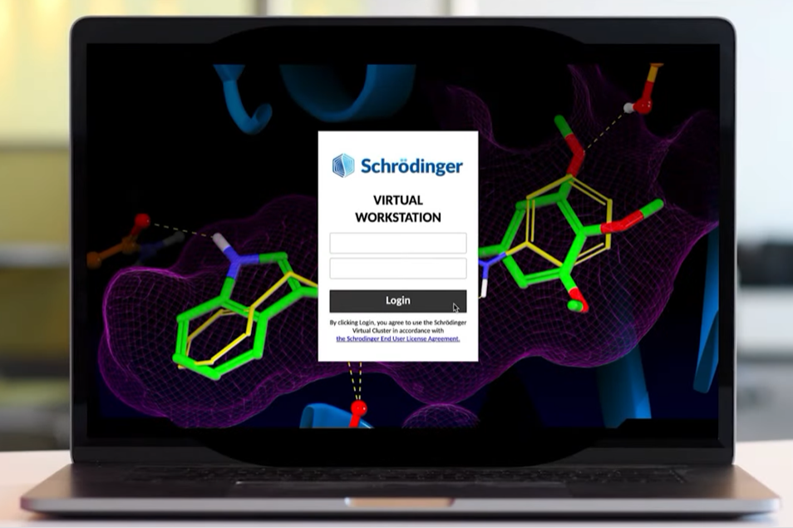
Digital Transformation
(Workshop in 2021. using Schrödinger Virtual Station)
Participation in beta testing
4 students from JJZ high school
10 PhD students from University of Novi Sad with the experimental materials science background
We focused on quasi periodic structures and used molecular DFT
DEEP TECH COMES FROM THE WEB(BROWSER)!!!

Slide 24
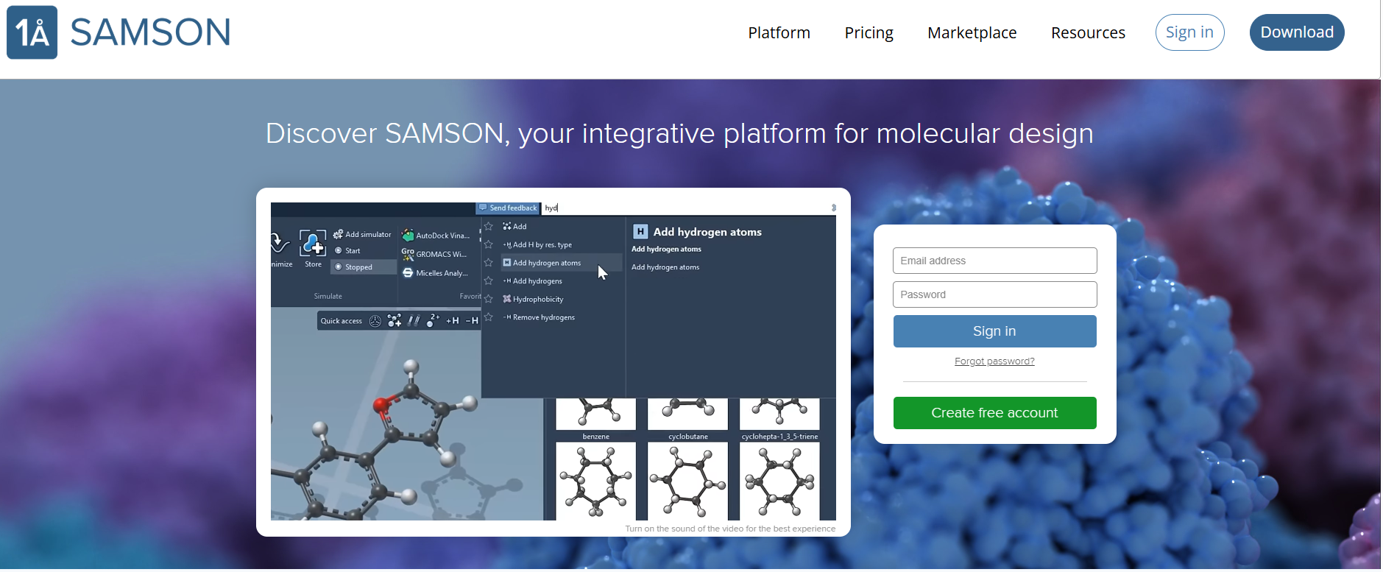
Notes:
Geometry (G): The models use an extended tight-binding Hamiltonian, finely tuned to reproduce bond lengths and angles across a wide range of elements and bonding situations.
Frequency (F): GFN-xTB includes analytical second derivatives (Hessians), allowing accurate vibrational frequency calculations without resorting to numerical.
Noncovalent interactions (N): Captured through empirically corrected dispersion terms (e.g., D3-like in GFN1 and advanced density-dependent D4-like in GFN2) and multipole electrostatics, enabling the method to handle hydrogen bonding, π–π stacking, and van der Waals interactions effectively.

Slide 25
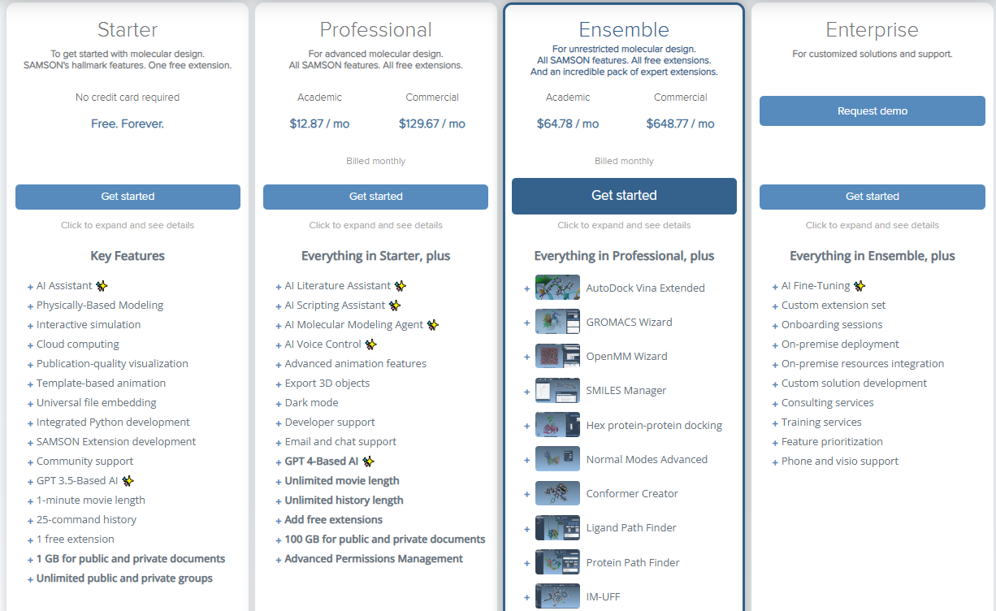

Slide 26
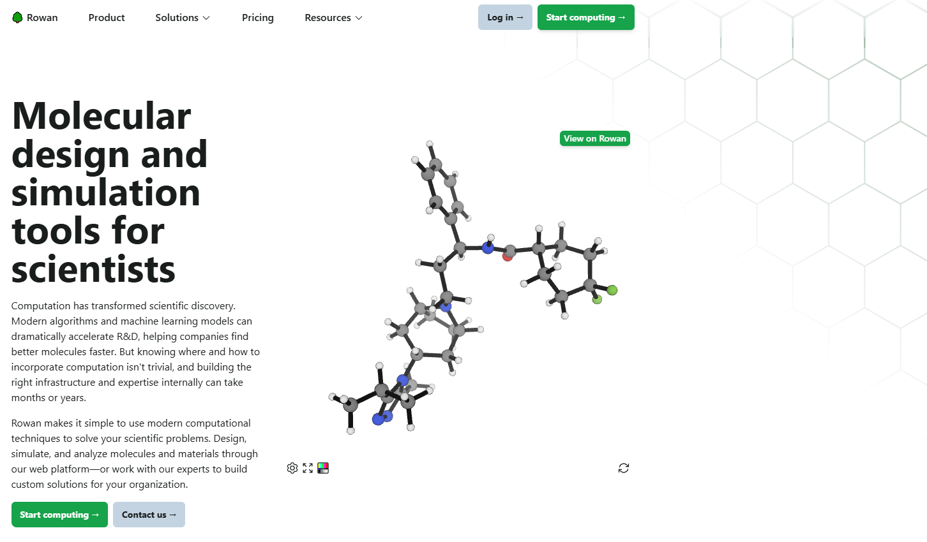

Slide 27
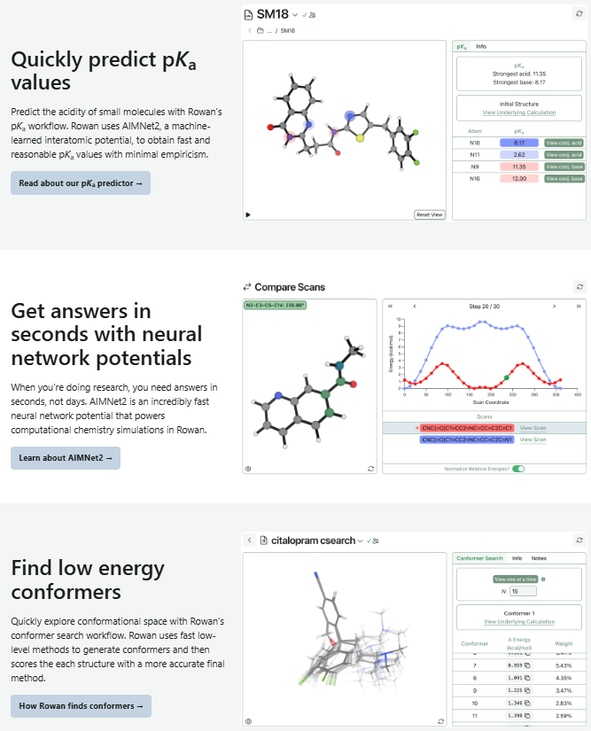
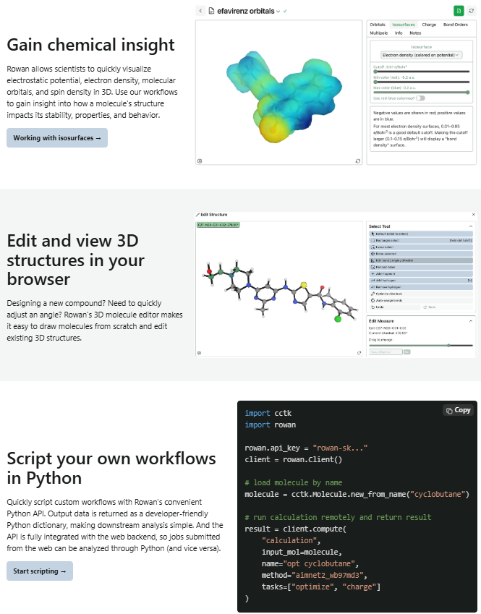

Slide 28
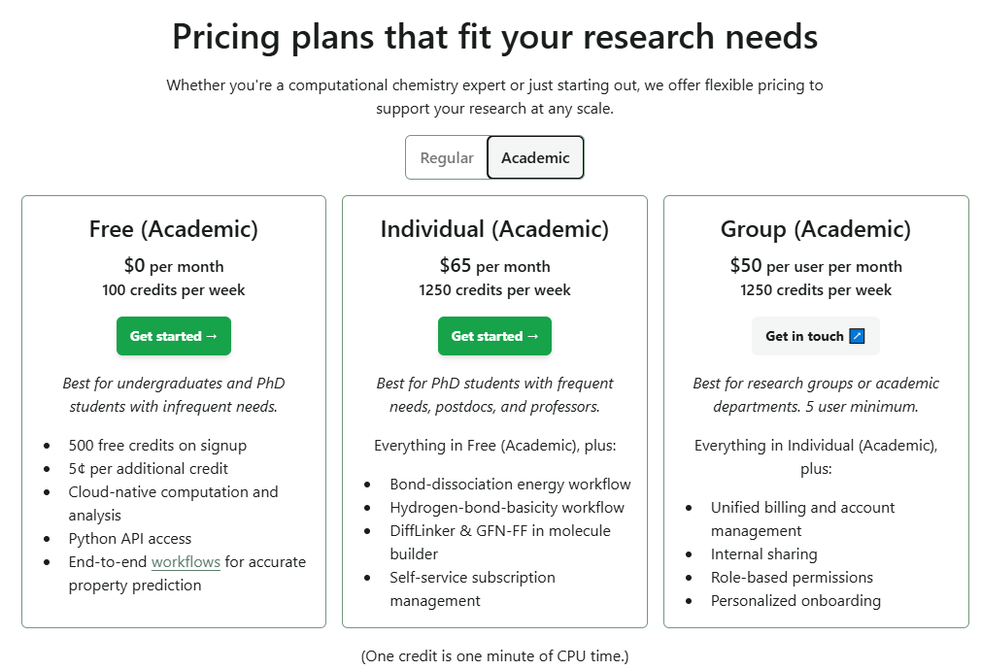

Slide 29
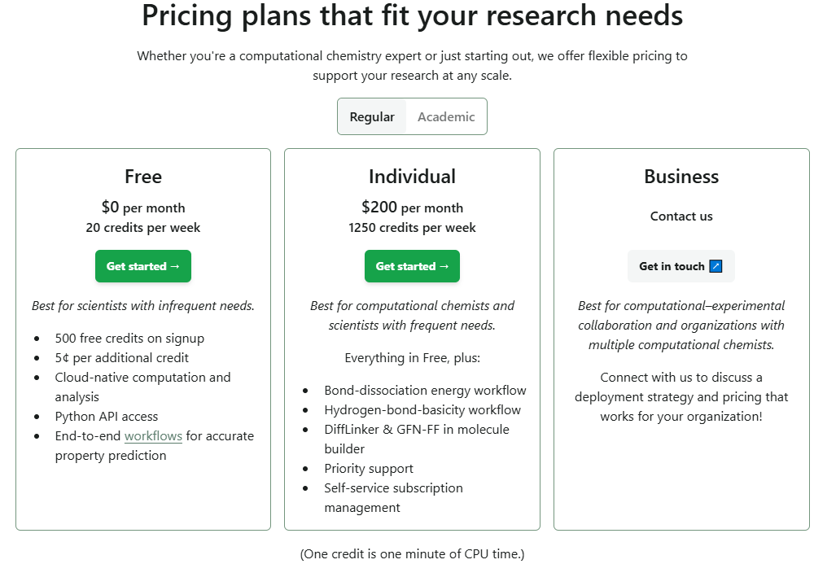

Slide 30


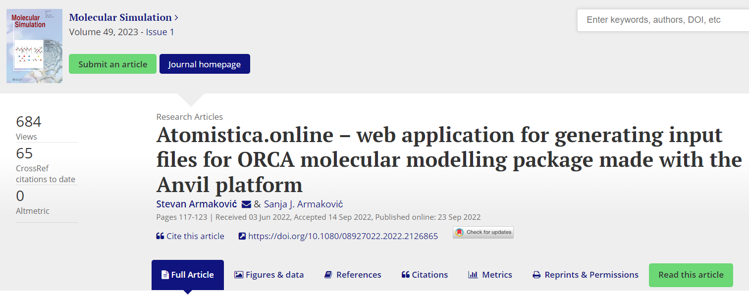
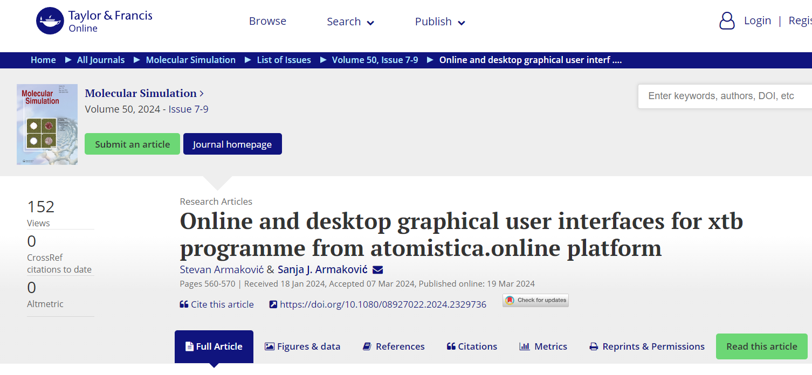

Atomistica.online - our contribution to deep tech from the web
Presented in papers published in “Molecular Simulation” journal
Initially conceived “just” as an online input generator for ORCA program
Intended for teaching molecular modeling and for beginners in this field
Developed using python and the Anvil platform
https://atomistica.online
Join Discord server
https://discord.gg/cDcTT6NknH

Slide 31


Slide 32
Tools of atomistica.online 2025
Input generators
Orca input generator
Orca input batch generator
PSI4 input generator
QCXMS input generator
Online calculators
Online xtb calculator
Online MOPAC2016 calculator
Online SHERMO
Generation of molecular structures
Online Packmol
Ionic liquids generator
Conformers Generator (ConfGen)
Property calculators
Detonation Properties (DEPRO)
IR & UV spectra generators
Descriptors
ADME calculator
Multiwfn tools
Online RDG
Partial density of states generator
Molecular surface analysis
Converters
.gbw to .wfn and .wfx converter
Desktop tools
XTB GUI
ORCA launch and monitor GUI

Slide 33


xtb
Open source
Semiempirical methods based on extended tight binding method (XTB)
GFNn-xTB family ($n=2, 1, 0$) and GFN-FF
g-xTB – the latest and most powerful
GFN (Geometry, Frequency, Noncovalent), parametrized for all elements up to Z=86.
Geometry (G): extended tight-binding Hamiltonian
Frequency (F): analytical second derivatives (Hessians)
Noncovalent interactions (N): Empirically corrected dispersion terms (e.g., D3-like in GFN1 and advanced density-dependent D4-like in GFN2) and multipole electrostatics
WIREs Computational Molecular Science 2020
https://doi.org/10.1002/wcms.1493
Notes:
Geometry (G): The models use an extended tight-binding Hamiltonian, finely tuned to reproduce bond lengths and angles across a wide range of elements and bonding situations.
Frequency (F): GFN-xTB includes analytical second derivatives (Hessians), allowing accurate vibrational frequency calculations without resorting to numerical.
Noncovalent interactions (N): Captured through empirically corrected dispersion terms (e.g., D3-like in GFN1 and advanced density-dependent D4-like in GFN2) and multipole electrostatics, enabling the method to handle hydrogen bonding, π–π stacking, and van der Waals interactions effectively.

Slide 34



The power of semiempirical methods
-MET in explicit solvation-
344 atoms
Ryzen 7950X/64GB
Method | Solvation | Iterations | Timing
DFT | Explicit | 700 | Days
SE/GFN2-xTB | Explicit | 620 | 11m, 27 s
FF/GFN-FF | Explicit | 603 | 1m, 8s
FF/OPLS | Explicit | 2300 | 5 s

Slide 36


Slide 37


Slide 38


Slide 39


Slide 40


Slide 41


Slide 42


Slide 43


Slide 44


Slide 45


Slide 46


Ionic liquids generator
Cations: 1316
Anions: 456
In total: 600 000 +
ML friendly database coming soon

Slide 47


Registration

Slide 48


Digital transition by
Meta Platforms, Inc
Platforms:
Facebook
Instagram
Messenger
WhatsApp
Threads
…
Divisions:
Reality Labs
FAIR
…

Slide 49
Meta’s Metaverse Bet: Expensive Vision Uncertain Return
A bold attempt to redefine social computing, with enormous cost and still-limited mainstream adoption
THE VISION
THE VISION
THE REALITY
Build the next computing platform
>$80B
A persistent ecosystem where social interaction, work, entertainment and digital identity move beyond the flat screen.
cumulative Reality Labs operating losses
since 2020
◎
Horizon Worlds
◉
Meta Quest
Virtual social spaces
VR hardware ecosystem
20
21
22
23
24
25
◌
Ray-Ban Meta
◇
AR / VR platform
Annual operating loss trend
AI-enabled smart glasses
Long-term spatial computing bet
Mass adoption has been slower than the scale of investment.

Slide 50

https://ai.meta.com/research
Meta FAIR team

Slide 51

OMol25 and UMA by Meta FAIR
Open Molecules 2025 (OMol25)
UMA: A Family of Universal Models for Atoms
https://doi.org/10.48550/arXiv.2505.08762
https://doi.org/10.48550/arXiv.2506.23971
small molecules, biomolecules, metal complexes, and electrolytes
Based on equivariant graph neural network
B97M-V/def2-TZVPD level of theory
ORCA 6.0.1
∼500M atomic systems
https://huggingface.co/facebook/OMol25
https://huggingface.co/facebook/UMA

Slide 52
META FAIR – One Year Later
Key updates since OMol25 and the first UMA release
DATA UPDATE
MODEL UPDATE
Open Polymers 2026 (OPoly26)
New UMA model versions
New open FAIR Chemistry dataset focused on polymers
Direct extension of the OMol25 initiative
Uses the same DFT settings as OMol25
Can be combined consistently with OMol25 data
Current checkpoints include UMA-S 1.1, 1.2, and 1.2.1
Medium model available: UMA-M 1.1
Original uma-s-1 archived due to a known extensivity bug
Maintained through the FAIR Chemistry ecosystem
6.57 million single-point density functional theory (DFT) calculations on capped substructures of diverse polymer chains
March 2026 - UMA-1.2 released! ~50% faster, ~40% more accurate on Open Molecules test set, and expanded data coverage for catalysts (oxides and interfaces), molecules, and polymers!
https://arxiv.org/abs/2512.23117
https://github.com/facebookresearch/fairchem

Slide 53
More from META
Model / family | Main area | Key idea / importance
Llama 4 | LLMs / multimodal AI | Meta’s flagship open-weight language models; mixture-of-experts architecture and multimodal capabilities
SAM 3 / SAM 3.1 | Computer vision | General-purpose segmentation and tracking of objects in images and video
SAM 3D | 3D vision / spatial AI | Reconstruction and understanding of 3D objects and scenes
SAM Audio | Audio AI | Prompt-based separation and segmentation of speech, music and other sounds
V-JEPA 2 | World models / robotics | Learns physical-world dynamics from video and supports planning and embodied AI
UMA | Chemistry / materials science | Universal Model for Atoms; general-purpose atomistic ML model for molecules, materials and catalysts
ImageBind | Multimodal learning | Places image, text, audio, depth, thermal and motion data into a shared embedding space
SeamlessM4T / Seamless | Speech / translation | Multilingual speech and text translation in a unified model family
AudioCraft / MusicGen / AudioGen | Generative audio | Generation of music, sound and audio from text prompts
Voicebox | Speech generation | Multilingual speech synthesis, editing, denoising and style transfer

Slide 54

Hot Summer of 2025

Slide 55




Slide 56
Cloud vs. Local

Slide 57
Cloud vs. local
Closed source
Open source
ChatGPT
Claude.ai
Perplexity.ai
Grok
Cursor
…
DeepSeek-V3.1
gemma-3-270m
Qwen3 Coder
GPT-OSS
Llama 3.1 8B
…

Slide 58

The power of local AI
“Make sure you own your AI. AI in the cloud is not aligned with you; it's aligned with the company that owns it.”

Slide 59

The power of local AI
“Make sure you own your AI. AI in the cloud is not aligned with you; it's aligned with the company that owns it.”

Slide 60
Open vs. Closed LLMs: Where Is the Real Cost?
CLOSED / API
OPEN / SELF-HOSTED
Pay per token or request
Infrastructure handled by provider
Updates and security managed externally
Fast to deploy and scale
More predictable operational model
Less control; vendor dependence
No traditional API fee, but GPUs cost money
Infrastructure becomes your responsibility
Updates, security and compatibility are internal
Deployment and optimization expertise required
Greater control over data and deployment
Hardware / software-stack dependence
The solution might be VPS – Virtual Private Servers

Slide 61




Slide 62





Slide 63
Overview of AI companies
Country | GDP ($ trillion) | Companies and institutions building LLMs
🇺🇸 USA | 30.50 | xAI; OpenAI; Perplexity; Amazon; Meta; Nvidia; Microsoft; Databricks; Bloomberg; Cerebras; Eleuther; Anthropic
🇨🇳 China | 19.23 | Alibaba; DeepSeek; Huawei; Baidu; MiniMax; ByteDance; Tencent; ZhipuAI; iFlytek; Shanghai Univ.; Moonshot AI
🇩🇪 Germany | 4.74 | DeepL; BlackForestLabs; DFKI; Aleph Alpha
🇮🇳 India | 4.18 | AI4Bharat; Sarvam AI; Krutrim; Reliance AI
🇯🇵 Japan | 4.18 | NTT; Fujitsu; SoftBank; CyberAgent; Kotoba; ELYZA; RIKEN; Rakuten
🇬🇧 UK | 3.73 | Stability AI; Inflection AI; DeepMind
🇫🇷 France | 3.28 | Mistral AI; Hugging Face; LightOn
🇮🇹 Italy | 2.45 | Almawave; iGenius
🇨🇦 Canada | 2.33 | Cohere; MILA
🇧🇷 Brazil | 2.30 | Maritaca AI; NeuralMind
🇷🇺 Russia | 2.19 | Yandex; Sber AI
🇰🇷 South Korea | 1.94 | LG; Upstage; Kakao Brain; Naver; ETRI
🇦🇺 Australia | 1.88 | Katonic AI
🇪🇸 Spain | 1.82 | BSC
🇲🇽 Mexico | 1.81 | UNAM; Tecnológico de Monterrey
🇮🇩 Indonesia | 1.49 | Datasaur; Prosa.ai; GoTo; Indosat Ooredoo
🇹🇷 Turkey | 1.45 | Commencis; Brew Interactive; T3 Foundation

Slide 64
The Role of AI in
Academic Activities

Slide 65


AI in scientific publishing

Slide 66

https://retractionwatch.com/papers-and-peer-reviews-with-evidence-of-chatgpt-writing/

Slide 67



Slide 68



The role of LLMs
Assistant
Content creation
Problem solving

Slide 69


Solving problem with LLM
MD simulation, RDF functions
Motivation letter

Slide 70
“Dead” document
Formally required piece of writing produced to satisfy administrative or procedural demands, but which is never meaningfully read, analyzed, or used in decision-making
Never treat your CV, Cover Letter or Motivation letter as a “dead” document

Slide 71

Common words used by ChatGPT
I would add also: Paradigm and Democratization

Slide 72
Ideas for post-CONNECT 2026 period

Slide 73
Post-CONNECT 2026
8 CONNECT Events:
~160 student participants
At least 40 established professionals (scientists, professors, etc)
Disciplines represented: physics, chemistry, biology, engineering, IT, law, geography, humanities etc.
International reach: participants from 10 countries and 10 universities
HUGE ALUMNI POTENTIAL!!!

Slide 74



Post-CONNECT 2026
IDEA 1:
Special Issue in AIDASCO Reviews
CONNECT 2026 - Digital Transformation and AI: Science, Society and Creativity
https://publishing.aidasco.org/journals/index.php/aire/announcement/view/11
Student-focused projects: guided by mentors
Write, publish, and share: transform your ideas into scientific articles
Collaborative spirit: teamwork between students and mentors
First publishing experience: supportive, open-access environment

Slide 75

Post-CONNECT 2026
IDEA 2:
Joint research activities involving students
Application of atomistic calculations
For example: Interactions between carbon-based nanomaterials and pharmaceutical components

Slide 76


https://doi.org/10.1021/cr3004423

Slide 77


Slide 78
Thank you for your attention
Q/A Session

Slide 79



Atomistic modeling workshop
https://atomistica.online/workshop-connect-2026/
https://test-app3.atomistica.online

