Slide 1


APPLICATIONS OF ATOMISTIC CALCULATIONS (2025-2026)
- Lecture 1: Introduction to Atomistic Calculations-
Stevan Armaković
University of Novi Sad, Faculty of Sciences
Department of Physics
https://armakovic.com
https://emos.armakovic.com
https://atomistica.online

Slide 2

Formal Agenda
What are atomistic calculations?
What types of atomistic calculations exist?
What systems can be studied with atomistic calculations?
Basic workflow in applying atomistic calculations
Tools of the trade
Examples of real-world applications
  Hydrogen capture
  Battery innovations
  Drug discovery
atomistica.online
APPLICATIONS OF ATOMISTIC CALCULATIONS (2025-2026)
Lecture 1: Introduction to atomistic calculations

Slide 3
Actual Agenda
Motivate
Motivate
Motivate
Motivate
Motivate
And...
Motivate
atomistica.online
APPLICATIONS OF ATOMISTIC CALCULATIONS (2025-2026)
Lecture 1: Introduction to atomistic calculations

Slide 4


Slide 5


Predecessors of mobile phones
Don’t forget, we are talking about 1987
APPLICATIONS OF ATOMISTIC CALCULATIONS (2025-2026)
Lecture 1: Introduction to atomistic calculations

Slide 6


My current phone
Motorola Neo 40 Edge (~ EUR 200)
It has enough computing power to run atomistic calculations!
Nowadays, everything goes online
An access to internet is enough to do research on molecules
APPLICATIONS OF ATOMISTIC CALCULATIONS (2025-2026)
Lecture 1: Introduction to atomistic calculations

Slide 7
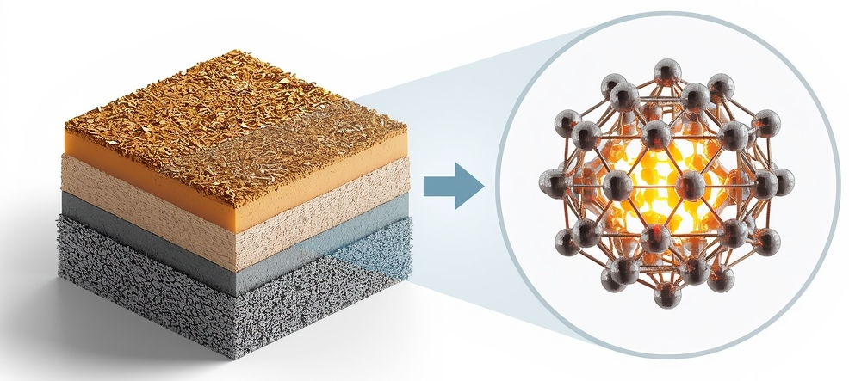
What are atomistic calculations?
DEFFINITION:
Class of computational methods used to model and simulate the behavior of
materials and molecules at the atomic level
Typical keywords in literature: ab initio, first principles, computational chemistry, computational physics, molecular modeling
APPLICATIONS OF ATOMISTIC CALCULATIONS (2025-2026)
Lecture 1: Introduction to atomistic calculations

Slide 8
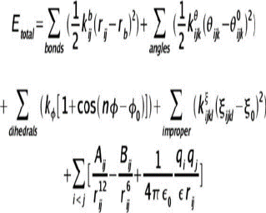
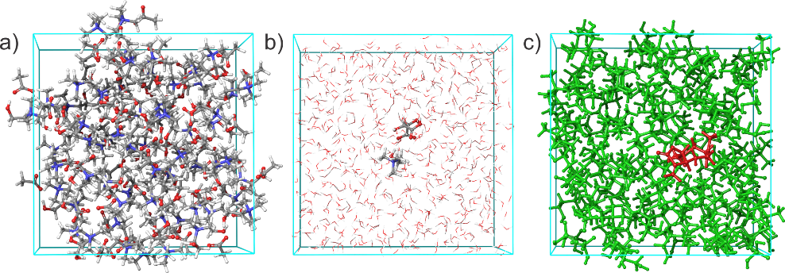
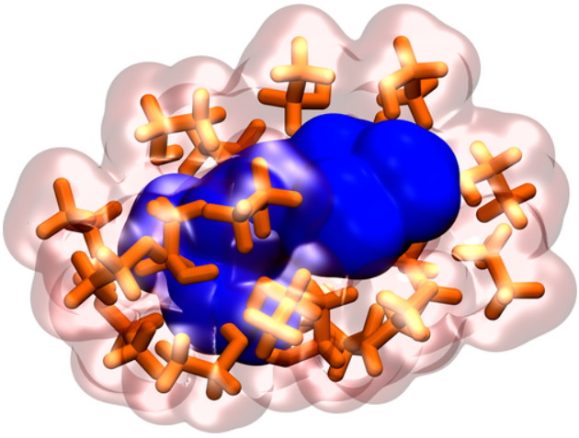

What types of atomistic calculations exist?
$$Ψ$$
  QM methods
  FF methods
  MD Simulations
  Hybrid methods
Molecules or solids as quantum objects described by quantum mechanics
Used to calculate electronic structure, bonding, and spectroscopic properties
Examples: Density Functional Theory (DFT), wavefunction-based methods (HF, MP2), semiempirical approaches (PM7, xTB)
Represent atoms as classical particles interacting through empirical potentials (“ball-and-spring” models)
Suitable for very large systems and longer simulations, though less chemically accurate than QM methods
Examples: AMBER, CHARMM, OPLS, COMPASS
Use quantum-mechanical forces or classical force fields to study time-dependent phenomena.
Investigate dynamic properties, diffusion, phase transitions, reaction kinetics, and conformational behavior.
Examples: Classical MD and ab initio MD
Combine quantum mechanics (QM) and classical molecular mechanics (MM) in a single simulation, enabling treatment of active regions.
Widely used for studying complex systems such as surface chemistry, interfaces, etc.
Examples: ONIOM, QM/MM implemented in software like ORCA and CP2K.
ACCURATE
FAST
DYNAMIC
EFFICIENT
APPLICATIONS OF ATOMISTIC CALCULATIONS (2025-2026)
Lecture 1: Introduction to atomistic calculations

Slide 9
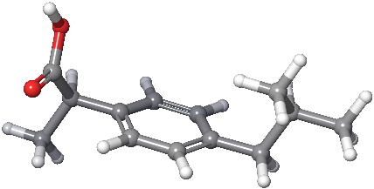
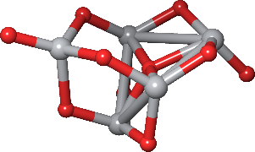
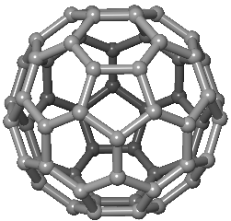
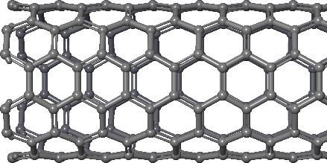
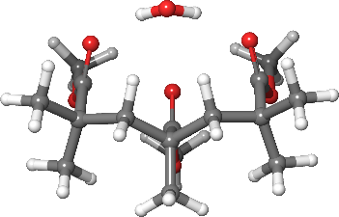
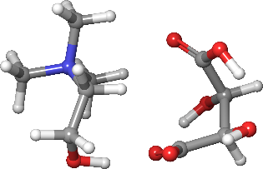
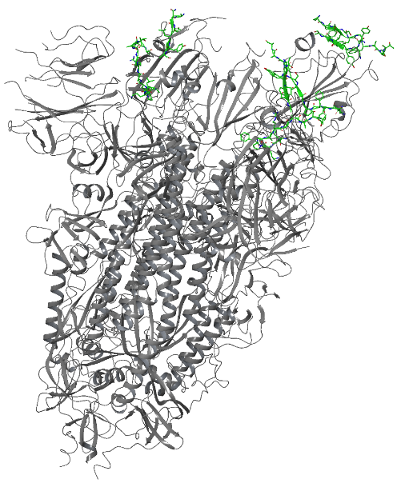

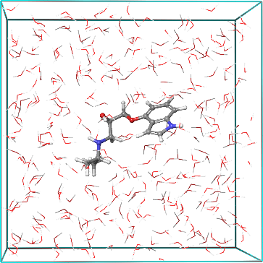
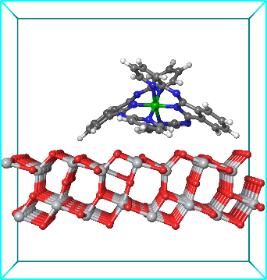
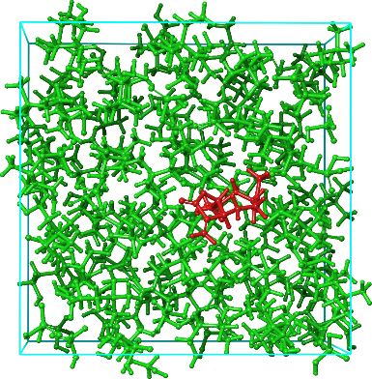
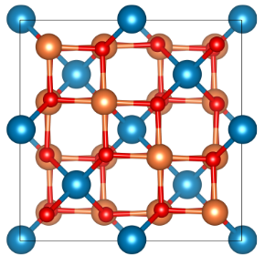
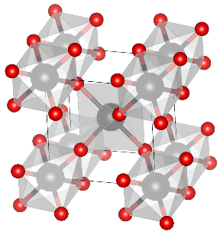
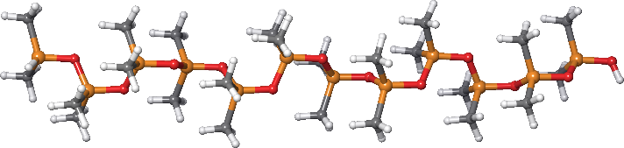
What systems can be studied with atomistic calculations?
Molecular systems
Periodic systems
Interactions
ibuprofen
TiO₂ cluster
C60 (0D)
(6,0) CNT (1D)
PMMA + H₂O
Ch-based IL
Spike protein
6VSB
Graphene (2D)
Adsorption on TiO₂ surface
PIN in water
PDMS polymer
(10 monomers)
ZnFe₂O₄ (3D)
TiO₂ rutile (3D)
Plant extract in Ch-based IL
APPLICATIONS OF ATOMISTIC CALCULATIONS (2025-2026)
Lecture 1: Introduction to atomistic calculations

Slide 10


Basic workflow in applying atomistic calculations
Step 1 – Input file
A file containing atomic coordinates of molecule or periodic structure with instructions on which and how code should perform atomistic calculations
Step 2 – Code execution
Input file along with other information, if necessary, are sent and executed by the code
Step 3 – Output analysis
Analysis of output file generated by the code execution. Information can be extracted manually or processed by third party tool or software
APPLICATIONS OF ATOMISTIC CALCULATIONS (2025-2026)
Lecture 1: Introduction to atomistic calculations

Slide 11

An example of atomistic calculation with ORCA
Command prompt:
orca my_calculation.inp > my_calculation.out
Output
…
----------------------------
! ITERATION 4 !
----------------------------
Total Energy : -40.451208803483 Eh
Energy Change : -0.006264044762 Eh
MAX-DP : 0.006770598536
RMS-DP : 0.000717374642
Actual Damping : 0.0000
Actual Level Shift : 0.2500 Eh
Int. Num. El. : 10.00000000 (UP= 5.00000000 DN= 5.00000000)
Exchange : -5.18223043
Correlation : -0.35048235
DIIS-Error : 0.014865658102
DIIS coefficients:
0.19185 -0.11953 0.92768
==>> SHARK/AuxDens: NDens=1 Thresh = 2.500000e-11 TCut= 2.500000e-12 Lmax=2 LmaxAux=4
-> Making Hermite density - ok 0.001 sec
-> Making Aux-basis density - (lmax=2)
-> L=0 0: 0.000 sec done= 2310 (100.0%) skipped= 0
…
Input file for ORCA code
!Opt Freq RKS B3LYP def2-TZVP def2/J CPCM(Water) Normalprint Printbasis PrintMOs PAL8
* xyz 0 1
C 0.00000 0.00000 0.00000
H -0.36330 1.02770 0.00000
H -0.36330 -0.51380 0.89000
H -0.36330 -0.51380 -0.89000
H 1.09000 0.00000 0.00000
*
APPLICATIONS OF ATOMISTIC CALCULATIONS (2025-2026)
Lecture 1: Introduction to atomistic calculations

Slide 12
Tools of the trade
atomistica.online
FUNCTIONALITY
AVAILABILITY
Generate input
Run calculations
Analyze output
Open source
Free for academics
Commercial
APPLICATIONS OF ATOMISTIC CALCULATIONS (2025-2026)
Lecture 1: Introduction to atomistic calculations

Slide 13







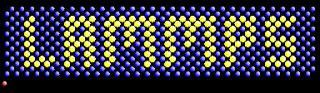

Tools of the trade
MOPAC®
Free for academics
APPLICATIONS OF ATOMISTIC CALCULATIONS (2025-2026)
Lecture 1: Introduction to atomistic calculations

Slide 14
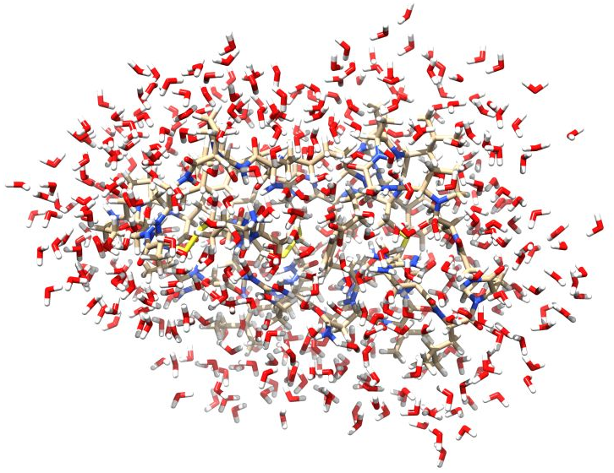
Can I play too? What kind of hardware I need?
Molecular system
Hardware
Crambin protein with 500 explicit waters
Total of 2142 atoms
! PBE def2-SVP DEF2-MTZVP/J NOPOP NOTRAH
Pmodel %maxcore 8000
MacBook Pro with M3 Max chip
(16 CPU cores/ 40 GPU cores, 128 GB RAM, 4 TB)
~ $3000+
~ 10 hours
Custom desktop computer:
CPU: Ryzen 5900XT
RAM: 64 GB
HDD: 1 TB
~ 800 USD
CPU benchmark:
M3 Max 16c: 41214 points
Ryzen 5900XT: 44041 points
APPLICATIONS OF ATOMISTIC CALCULATIONS (2025-2026)
Lecture 1: Introduction to atomistic calculations

Slide 15
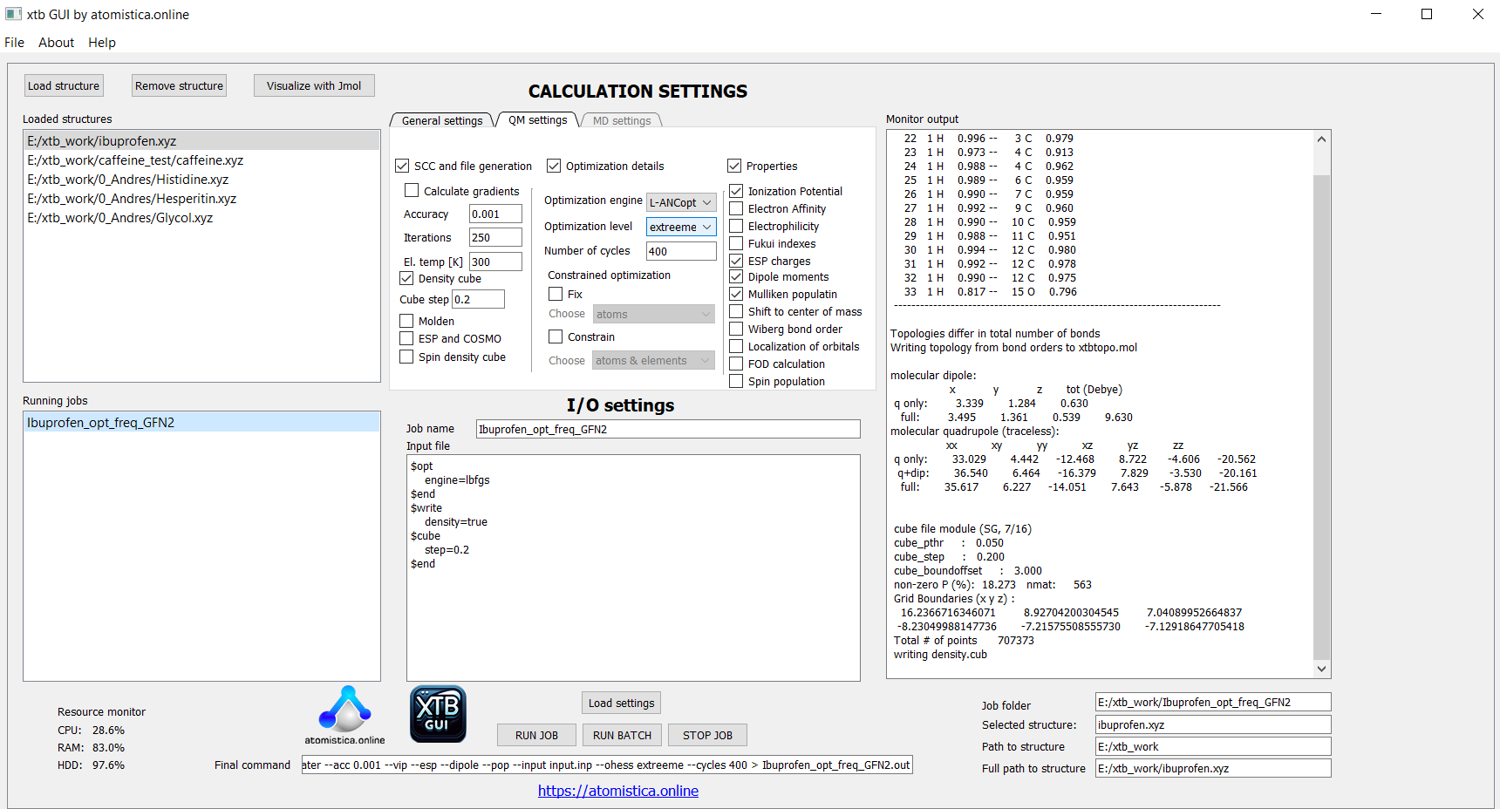
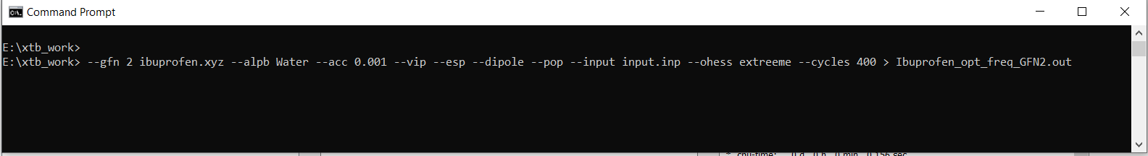

Slide 16
Applications of Atomistic Simulations in Energy Research
DFT CALCULATIONS
Hydrogen Adsorption and Storage
MD SIMULATIONS
Lithium-Sulfur Battery Systems
MOLECULAR DOCKING
Drug Discovery and Molecular Recognition
Focus
Molecular-level understanding of hydrogen interaction with surfaces and nanostructures
Key aspects to study
Adsorption and binding energies
Preferred adsorption sites
Charge transfer, electronic structure, binding spots
Goal
Identify materials with high and reversible hydrogen uptake capacity.
Focus
Atomistic dynamics of ion transport and polysulfide behavior
Key aspects to study
Li⁺ diffusion and conductivity
Solvent and electrolyte stability
Sulfur species migration and aggregation
Goal
Reveal transport mechanisms and design high-performance Li–S batteries.
Focus
Understanding how small molecules (drugs) bind to biological targets (proteins, DNA)
Key aspects to study
Binding affinity and docking scores
Preferred binding modes and active sites
Key intermolecular interactions (H-bonds, π-π, electrostatics)
Goal
Identify and optimize molecules with strong and selective binding to biological targets.
APPLICATIONS OF ATOMISTIC CALCULATIONS (2025-2026)
Lecture 1: Introduction to atomistic calculations

Slide 17
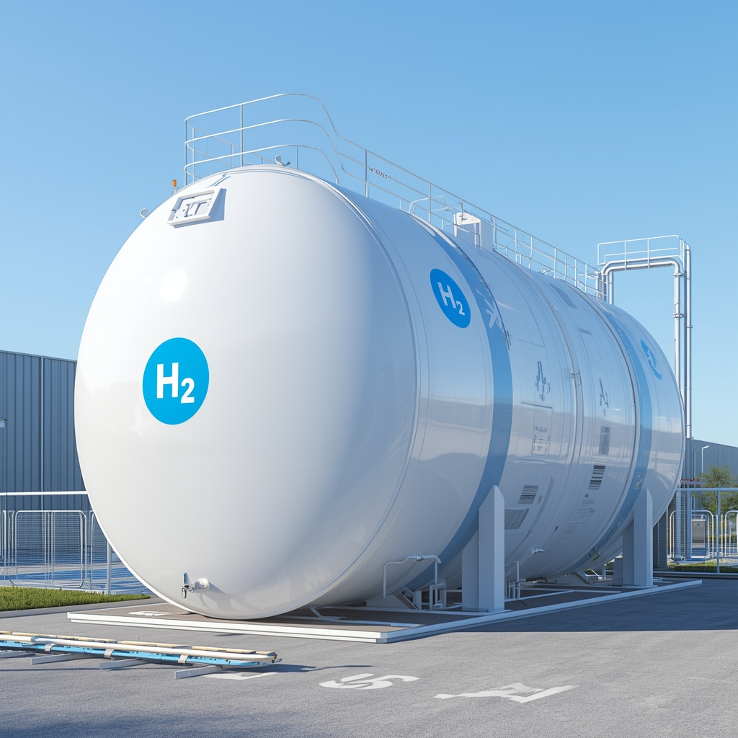
Example 1 – Hydrogen storage
Clean fuel:
Produces only water, with zero CO₂ at the point of use.
High energy density:
≈120 MJ kg⁻¹ - about three times that of gasoline.
Abundant but bound
Exists mainly in compounds like water and hydrocarbons.
Green potential
Renewable electrolysis enables carbon-free hydrogen production and energy storage.
Key challenges
Safe, efficient storage and transport due to low volumetric density.
APPLICATIONS OF ATOMISTIC CALCULATIONS (2025-2026)
Lecture 1: Introduction to atomistic calculations

Slide 18
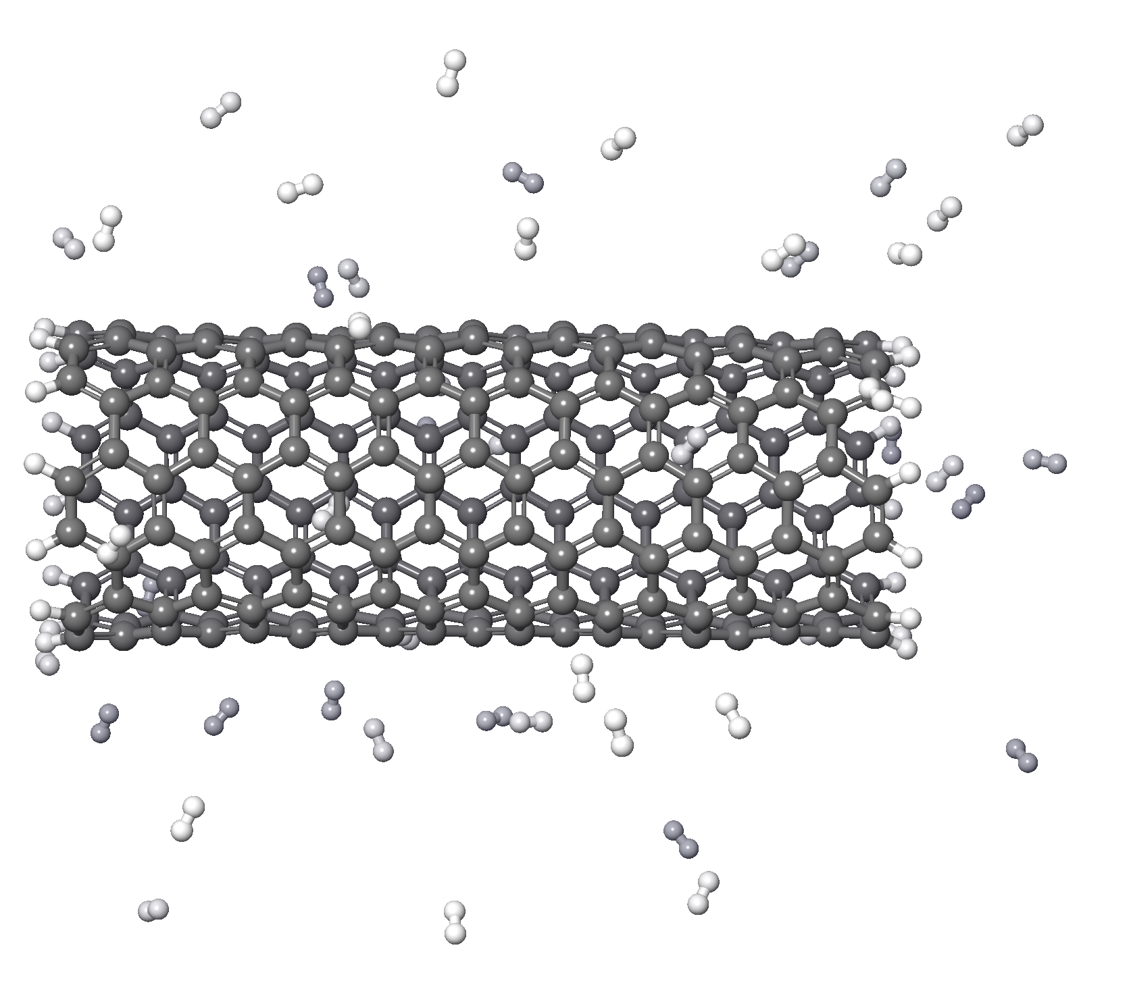
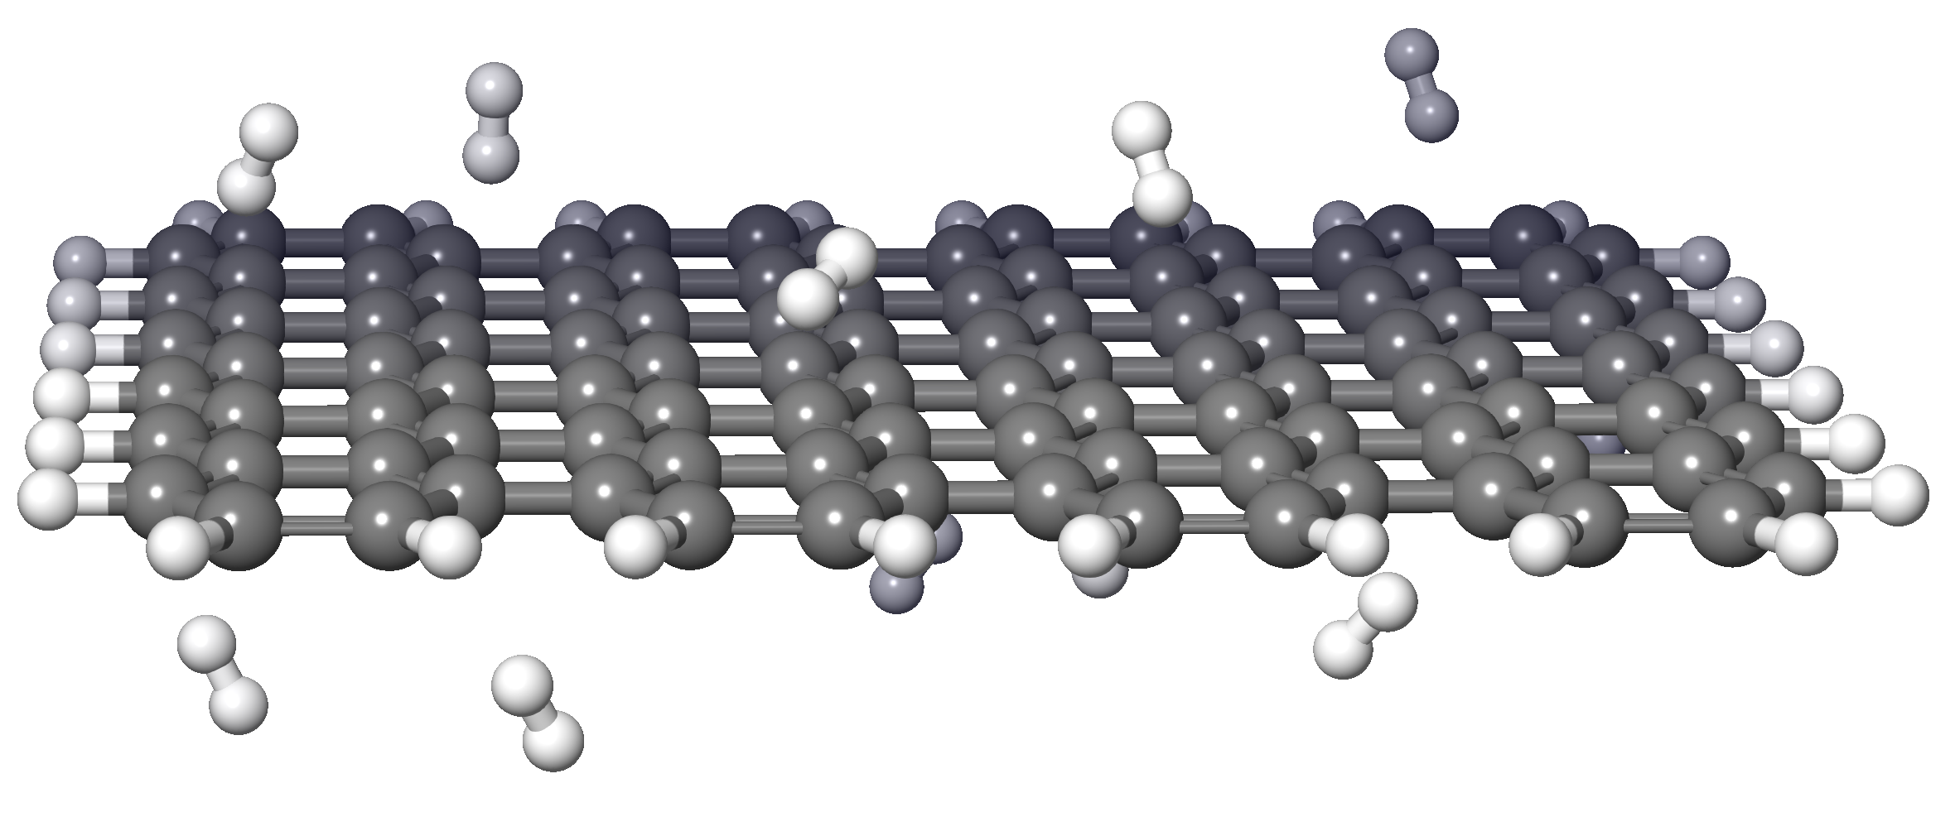
Hydrogen storage – Possible applications of atomistic calculations
DFT calculations
MD simulations
Adsorption energies
Quantify how strongly H₂ molecules or atomic H bind to graphene or CNT surfaces (physisorption vs chemisorption).
Charge-transfer analysis
Evaluate electron redistribution upon adsorption to identify dopant- or defect-induced polarization.
Electronic structure
Compute band structure changes to reveal how hydrogen uptake modifies conductivity.
Doping and defect effects
Model B, N, Ti, or Li substitution and vacancy sites to enhance H₂ binding
Desorption thermodynamics
Estimate energy barriers and reversibility of H release under operating conditions.
Hydrogen diffusion
Track mobility of H₂ or atomic H across carbon surfaces, through CNT channels, and within multilayer graphene.
Phase Behavior
Phase transitions upon hydrogen absorption (e.g., hydride formation).Volume expansion, stress/strain evolution in metal hydrides.
Temperature-dependent storage
Examine adsorption–desorption dynamics from cryogenic to ambient conditions.
Cluster formation and spillover
Simulate dissociation and migration of H atoms from catalytic dopants to lattice
Mechanical stability
Assess structural integrity and deformation of CNT/graphene frameworks.
APPLICATIONS OF ATOMISTIC CALCULATIONS (2025-2026)
Lecture 1: Introduction to atomistic calculations

Slide 19
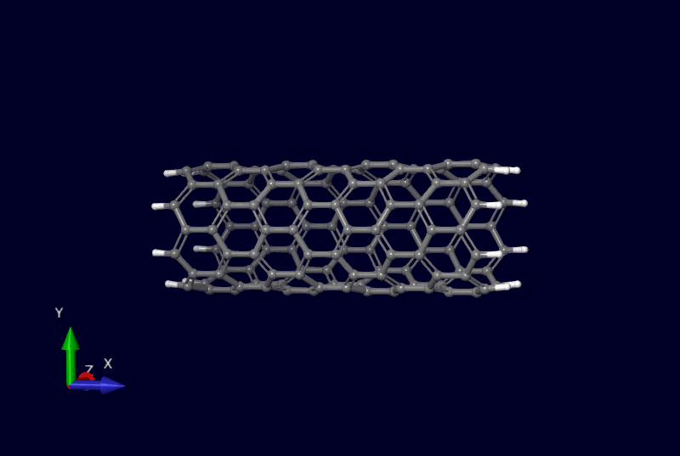
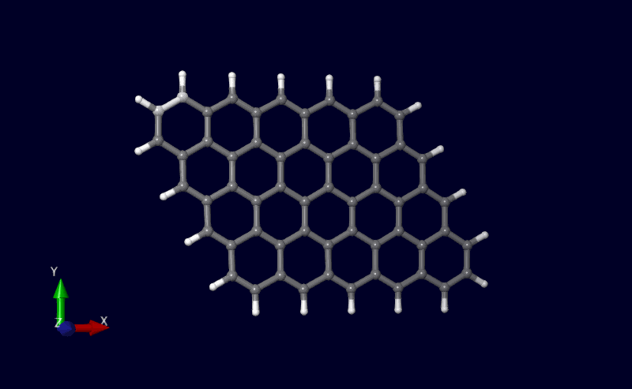
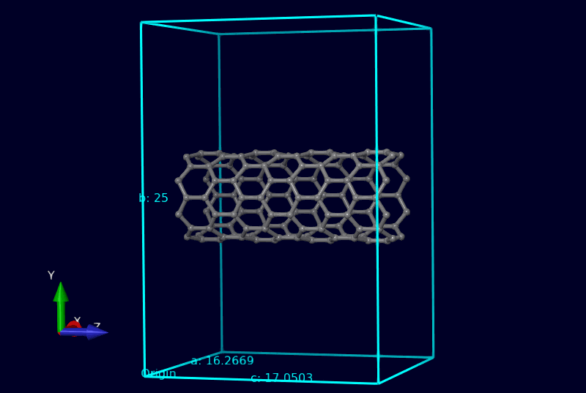
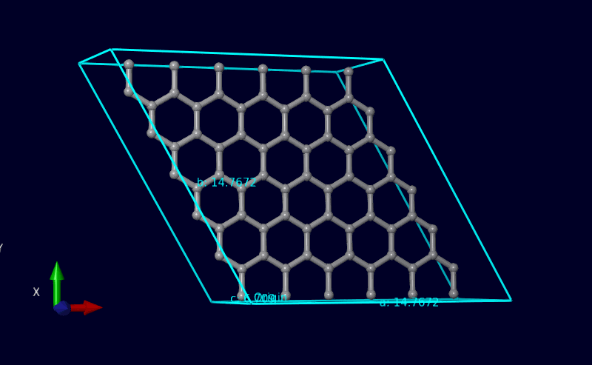

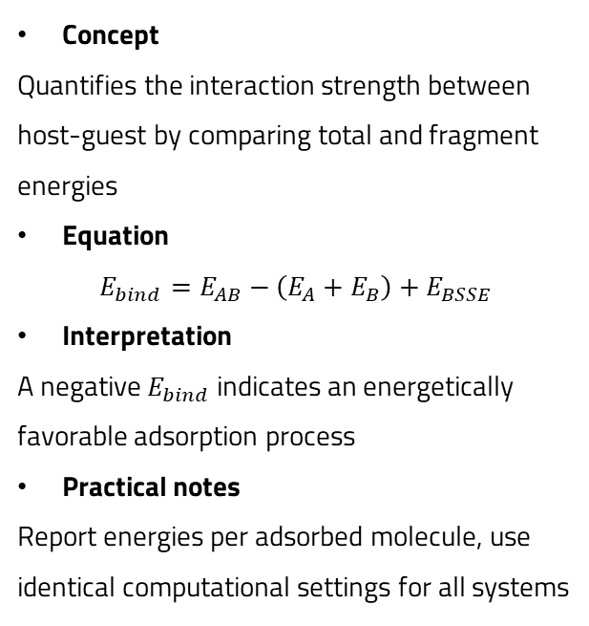
Binding energies via DFT
Binding energies
Concept
Quantifies the interaction strength between host-guest by comparing total and fragment energies
Equation
$$E_{bind}=E_{AB}−\left(E_{A}+E_{B}\right)+E_{BSSE}$$
Interpretation
A negative $E_{bind}$ indicates an energetically favorable adsorption process
Practical notes
Report energies per adsorbed molecule, use identical computational settings for all systems
Computational details $(E_{bind}$ with DFT)
Molecular nanotube
Molecular graphene
Type of atomistic model
Periodic vs. molecular DFT
Density functional
Empirically dispersion-corrected density functionals (PBE-D3, B3LYP-D3, etc)
Specially developed density functionals (M06-2X, MN15, ωB97X-V)
Composite methods
(r2SCAN-3c, ωB97X-3c)
Basis superposition error (BSSE)
Counterpoise method (CP)
Geometrical counterpoise (gCP)
Extrapolation
Periodic nanotube
Periodic graphene

Slide 20
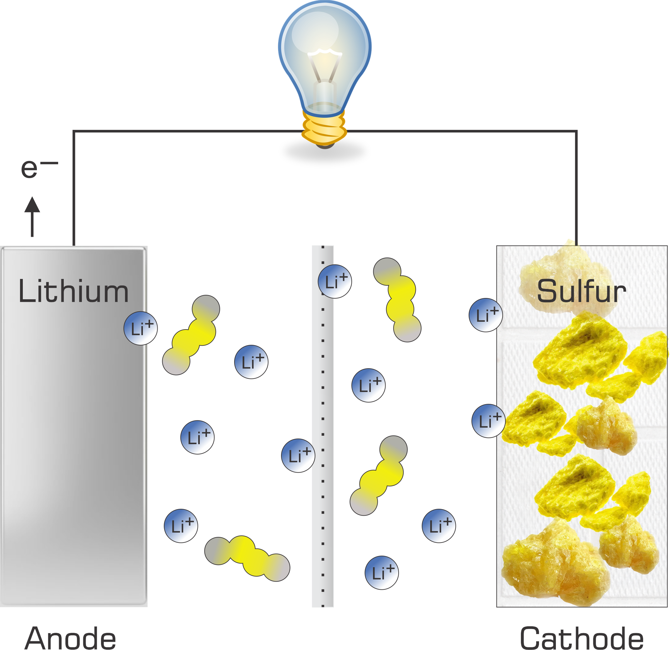
Case study 2 – Lithium-Sulfur (Li-S) batteries
High Energy Density:
About 2–3 times higher than conventional Li-ion batteries
High Specific Capacity
Sulfur provides 1675 mAh g⁻¹, based on full conversion to Li₂S
Lightweight and Low-Cost Materials
Both lithium and sulfur are abundant and inexpensive
Main Challenges
  The polysulfide shuttle effect,
  Large volume expansion (~80%)
  Poor conductivity of sulfur and Li₂S
  Limit cycle life and efficiency
Research Focus
  Developing conductive carbon hosts
  Cathode designs that improve Li⁺ diffusion
  Suppression of shuttle reactions
APPLICATIONS OF ATOMISTIC CALCULATIONS (2025-2026)
Lecture 1: Introduction to atomistic calculations

Slide 21
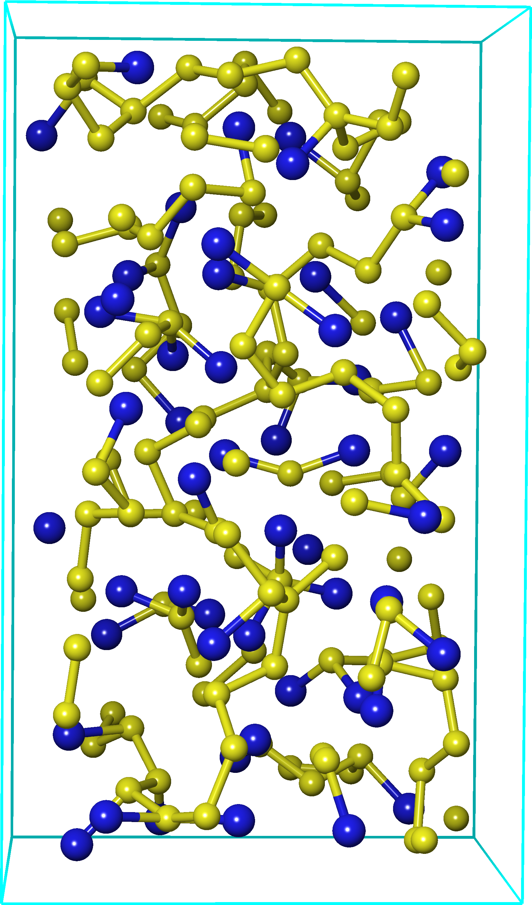
Case study 2 – Lithium-Sulfur (Li-S) batteries
Atomistic model of Li_{0.4}S
DFT calculations
MD simulations
Geometry optimization
Determine the most stable atomic arrangement of LiₓS phases (e.g., Li₂S, Li₀.₄S)
Electronic structure analysis
Calculate band structure and DOS to assess electronic conductivity changes
Charge distribution
Examine charge transfer between Li and S using Bader or Mulliken analysis
Formation energies
Evaluate thermodynamic stability of intermediate Li₂Sₓ species
Adsorption energies
Interactions of Li ions or polysulfides with conductive hosts and coatings (carbon, TiO₂)
Vibrational properties
Predict Raman/IR spectra to connect with experiment and monitor Li–S bond dynamics
Diffusion coefficients
Quantify Li⁺ mobility through Li–S matrix or electrolyte, crucial for charge transport
Temperature-dependent behavior
Simulate structural evolution at operating temperatures
Interfacial dynamics
Study Li⁺ transport across interfaces (e.g., cathode-electrolyte boundaries).
Thermal stability
Observe melting, phase transition, and degradation pathways
Polysulfide migration
Track formation and dissolution of Li₂Sₓ species contributing to the “shuttle effect
Mechanical properties
Evaluate elastic response, viscosity, and stress-strain behavior
Sulfur atoms
Lithium atoms
APPLICATIONS OF ATOMISTIC CALCULATIONS (2025-2026)
Lecture 1: Introduction to atomistic calculations

Slide 22
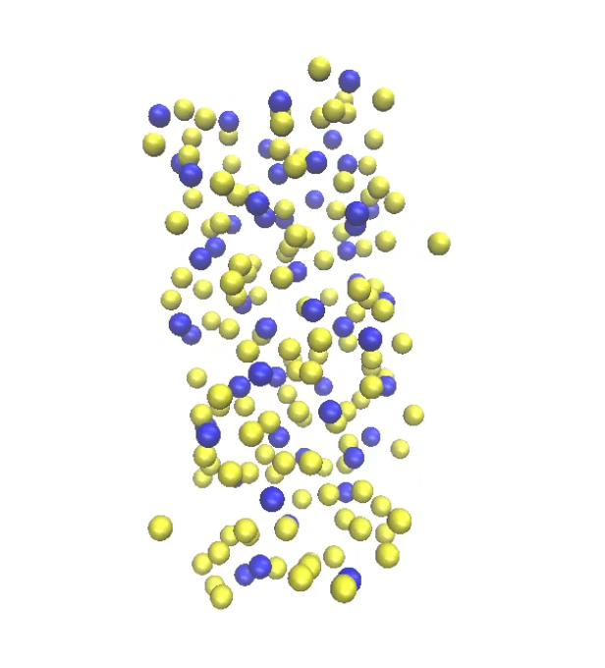
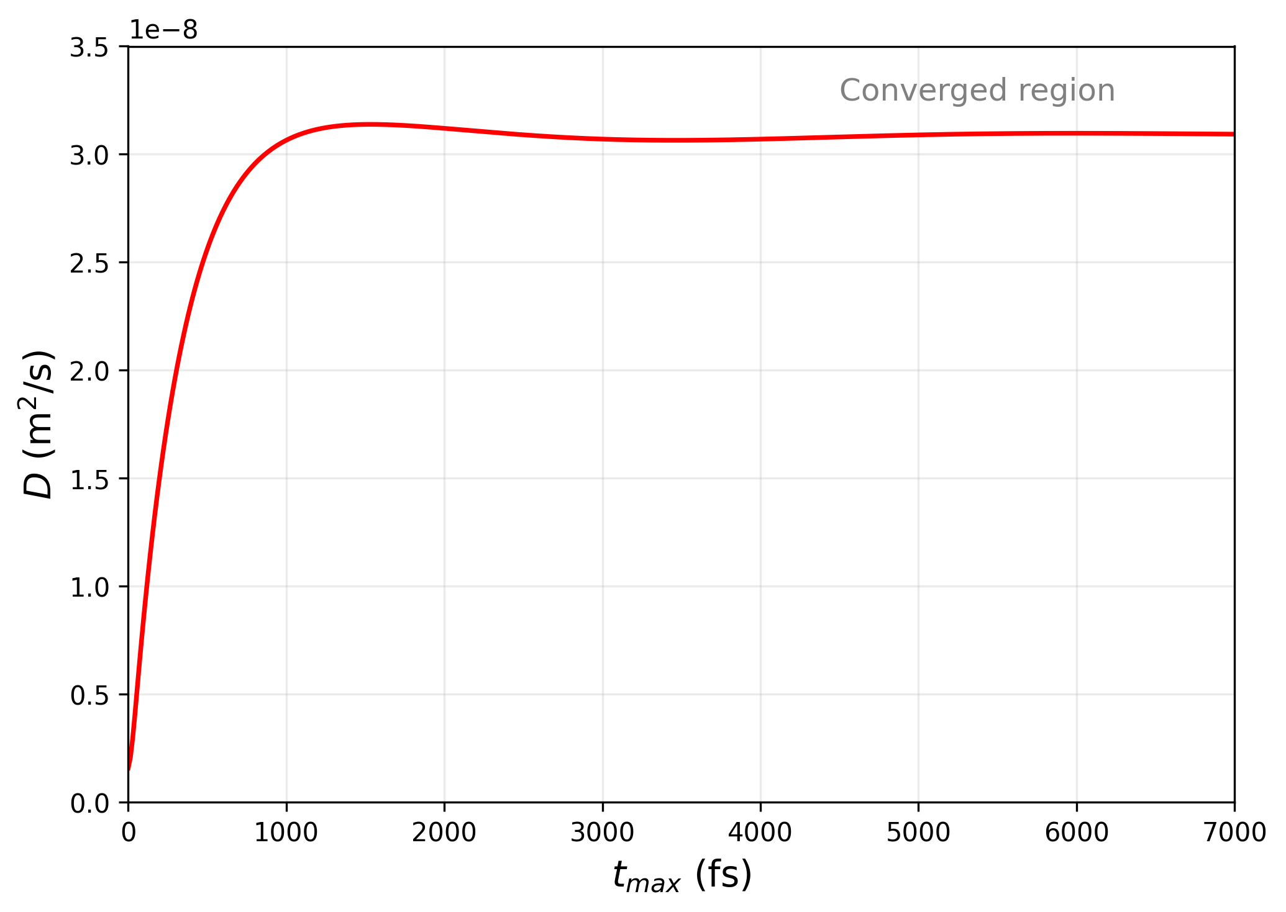
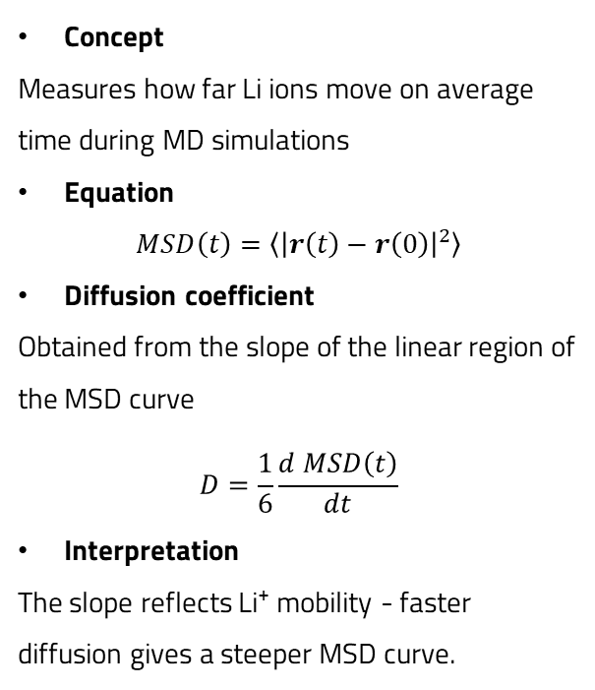
Case study 2 – Lithium-Sulfur (LiS) batteries
Trajectories of Li_{0.4}S MD simulation
MD simulation
Mean Squared Displacement (MSD) method
Force field
ReaxFF for Li-S systems
https://doi.org/10.1039/C4CP04532G
Key capabilities
              Describes bond formation and breaking
                Captures structural, mechanical, and kinetic properties
                Enables analysis of mechanical strength, yield stress, and Young’s modulus as functions of lithiation level.
                Provides diffusion coefficients for Li and S at various Li concentrations.
Concept
Measures how far Li ions move on average time during MD simulations
Equation
$$MSD\left(t\right)=\left\langle {\left|r\left(t\right)−r\left(0\right)\right|}^{2}\right\rangle$$
Diffusion coefficient
Obtained from the slope of the linear region of the MSD curve
$$D=\frac{1}{6}\frac{d MSD\left(t\right)}{dt}$$
Interpretation
The slope reflects Li⁺ mobility - faster diffusion gives a steeper MSD curve.
APPLICATIONS OF ATOMISTIC CALCULATIONS (2025-2026)
Lecture 1: Introduction to atomistic calculations

Slide 23
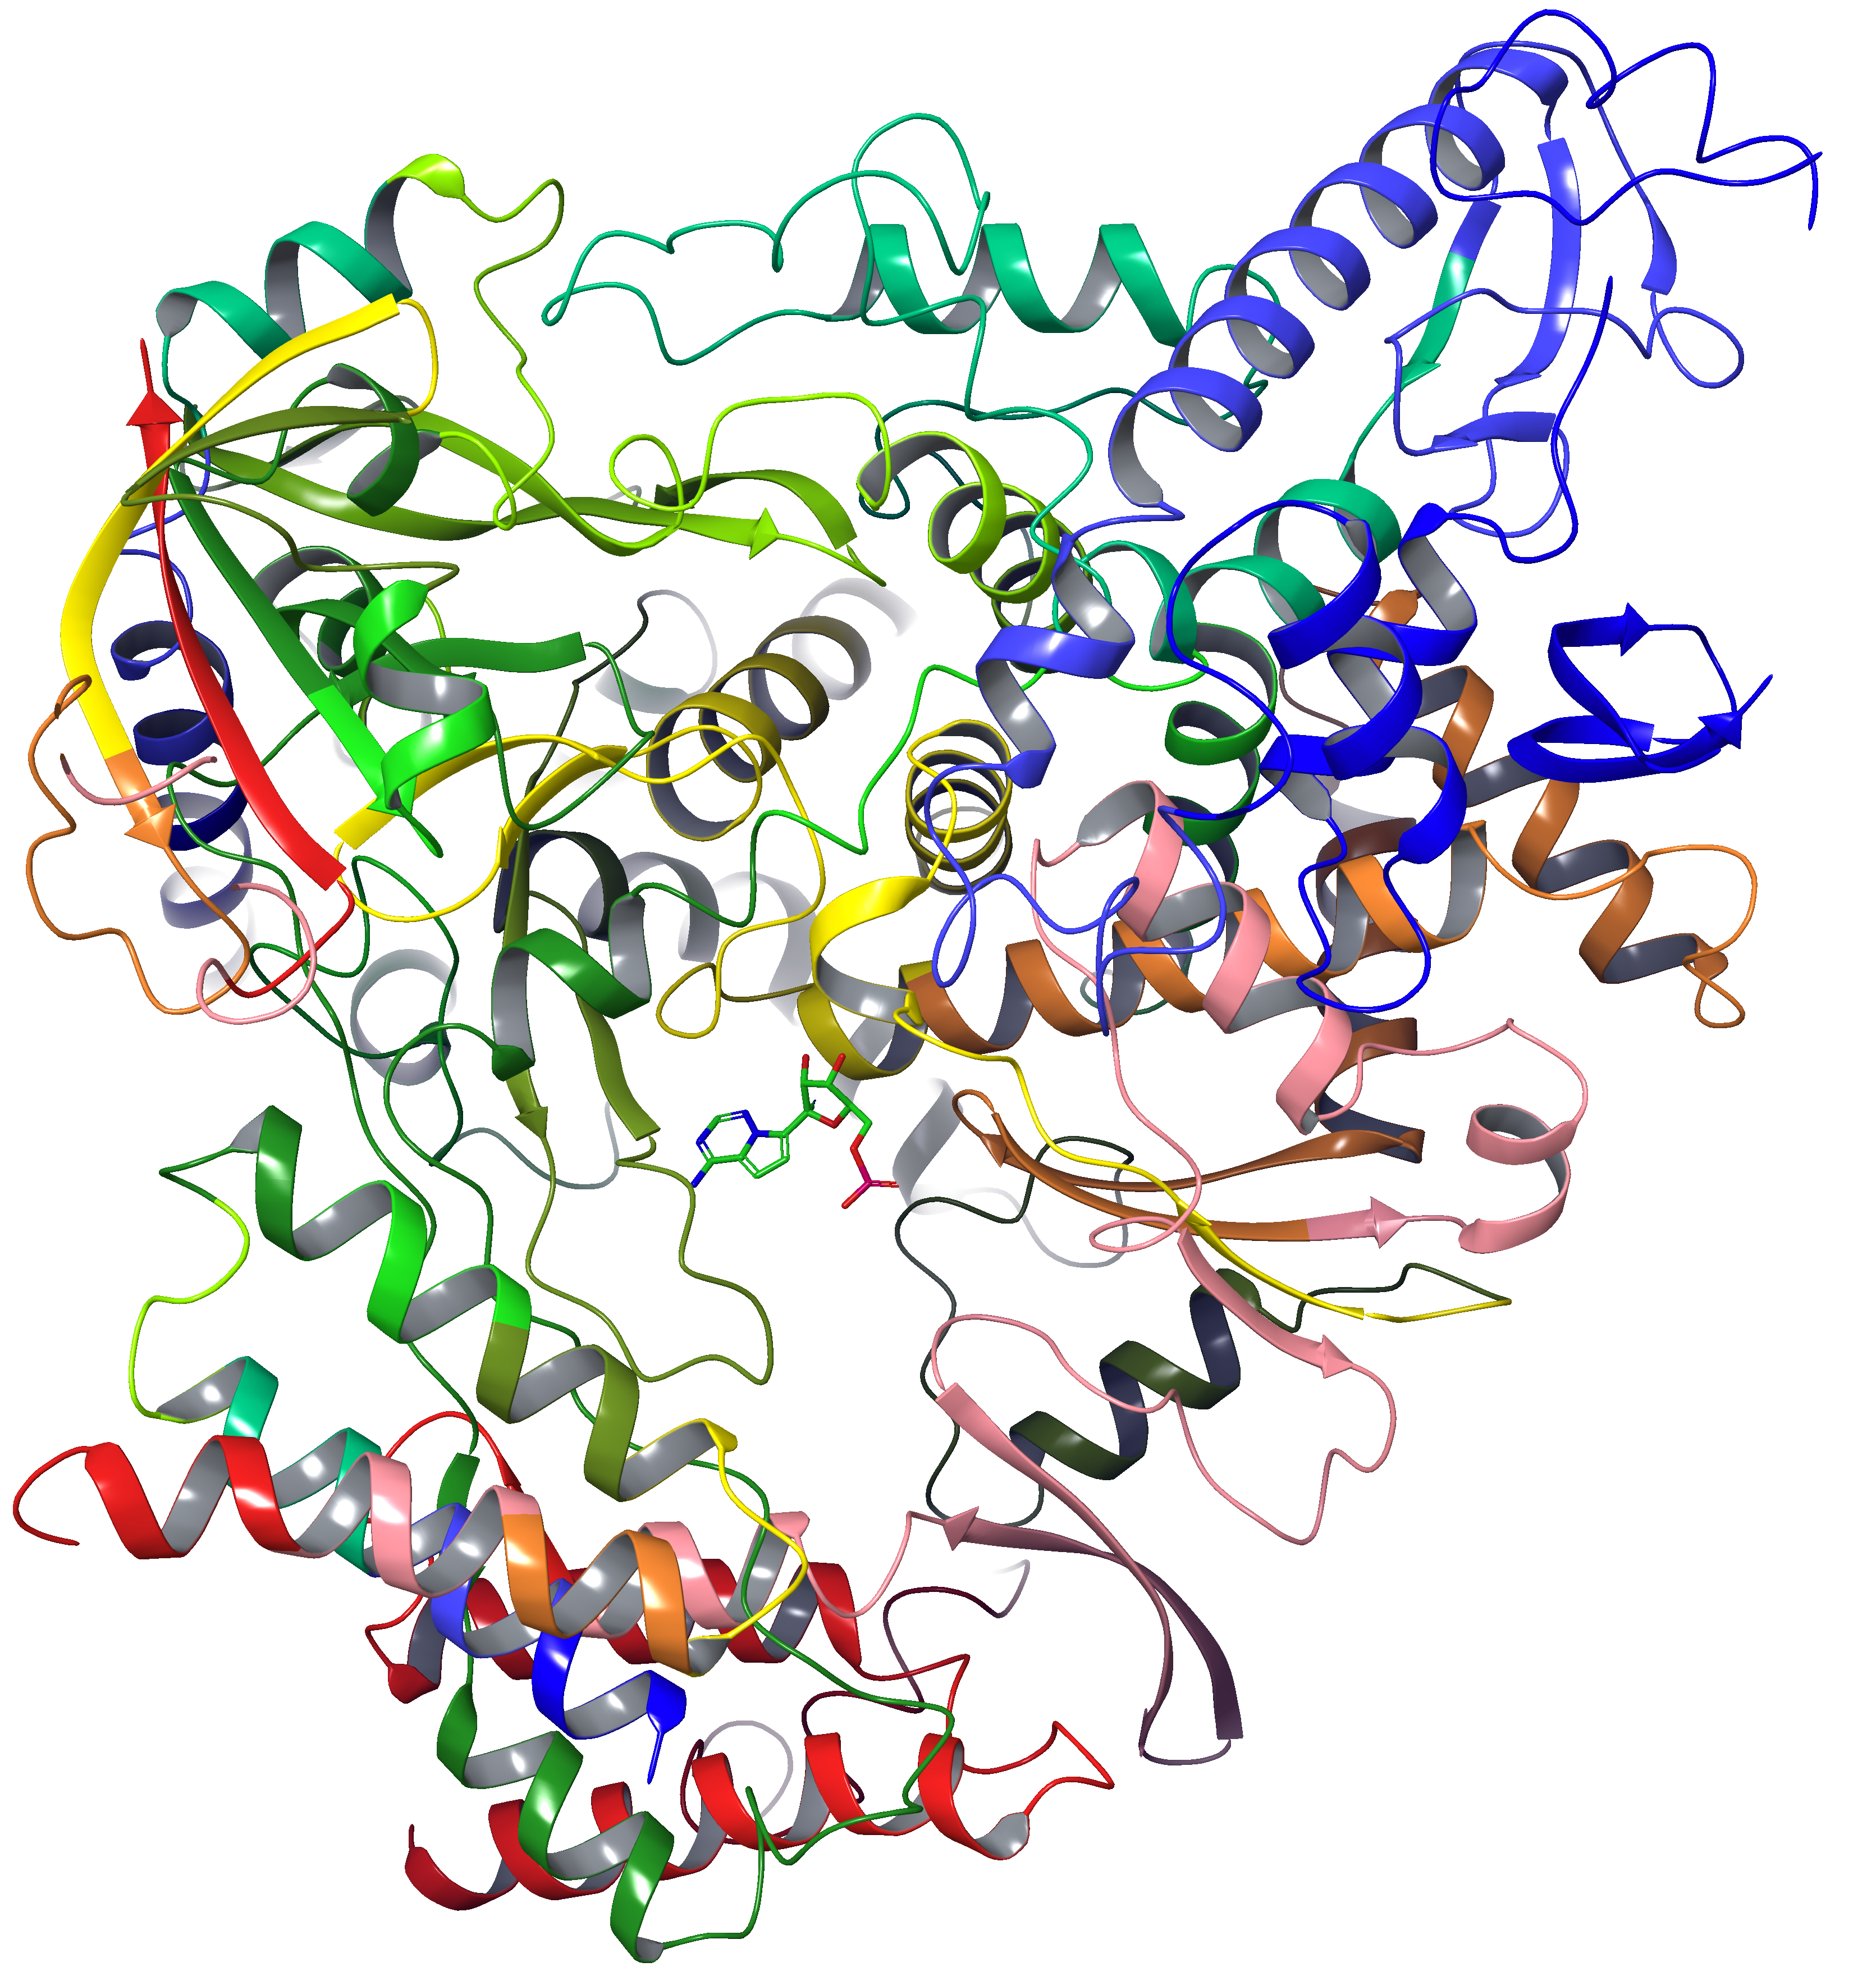
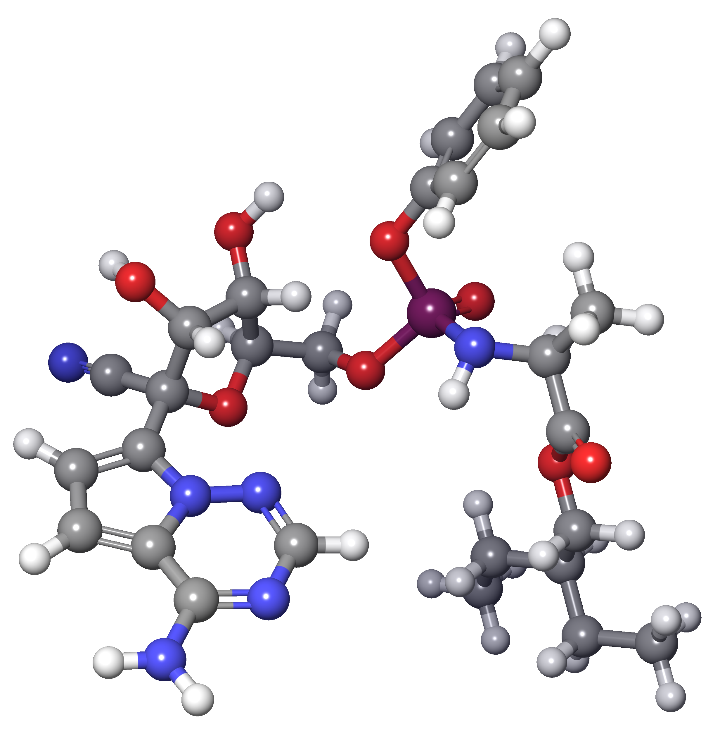
Case study 3 – Covid 19
7BV2
SARS-CoV-2 RNA-dependent RNA polymerase
Ligand: Remdesivir
HR cryo-EM structure
Remdesivir blocks viral RNA synthesis
Remdesivir
APPLICATIONS OF ATOMISTIC CALCULATIONS (2025-2026)
Lecture 1: Introduction to atomistic calculations

Slide 24

Materialistic point of view - Global salary landscape
Atomistic modeling careers
USA & CANADA
$90,000 – $150,000 / year (mid-level)
$150,000 – $200,000+ (senior / industry)
In pharma (e.g., Pfizer, GSK), senior scientists can reach $180k–200k+.
Source Glassdoor
Europe (Western Europe)
🇩🇪 Germany / 🇳🇱 Netherlands / 🇬🇧 UK / 🇨🇭 Switzerland
€50,000 – €90,000 / year (mid-level)
€90,000 – €130,000+ (senior, pharma/industry)
Switzerland stands out (often €120k–150k+ equivalent)
APPLICATIONS OF ATOMISTIC CALCULATIONS (2025-2026)
Lecture 1: Introduction to atomistic calculations

Slide 25


Visit
https://atomistica.online
Join Discord server of Atomistica
atomistica.online
APPLICATIONS OF ATOMISTIC CALCULATIONS (2025-2026)
Lecture 1: Introduction to atomistic calculations

