Slide 1



THE ROLE OF MOLECULAR MODELING IN THE PHARMACEUTICAL INDUSTRY: FROM STABILITY AND REACTIVITY TO DRUG DELIVERY
Dr. Stevan Armaković
University of Novi Sad, Faculty of Sciences
Department of Physics
www.armakovic.com
www.aidasco.org
www.atomistica.online

Slide 2
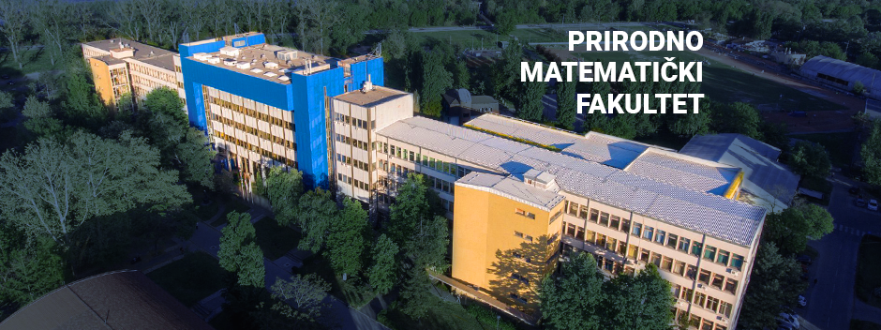


EMOS research group
Education, Multidisciplinarity, Optimization and Sustainability - EMOS
Department of Chemistry, Biochemistry and Environmental Protection
Department of Physics
https://emos.armakovic.com

Slide 3

The Drug Development Process
Discovery & Development
Preclinical Research
Clinical Research
FDA Review
Safety Monitoring
By FDA
Molecular modeling
STAGE 5
STAGE 4
STAGE 3
STAGE 2
Interesting facts
STAGE 1
R&D costs around 200 billion per year
World consumes 60 billion aspirin tablets each year
USA participates up 40% of the worldwide pharma ind.
FDA approves about 50 drugs each year

Slide 4
What are
MOLECULAR MODELING
Branch of science that predicts selected properties starting from molecular structure/model
Molecular modeling
&
Atomistic calculations
ATOMISTIC CALCULATIONS
Calculations that incorporate atomic-level information to provide macroscopic properties

Slide 5
What can be obtained via atomistic calculations?
Structural properties
Bond lengths
Crystal structure
Charge distribution
Electrostatic potential maps
Average local ionization energies
Spectroscopy
IR
NMR
Conductivity
Interactions
Lattice parameter
Symmetry
Dipole moments
UV/Vis
Reorganization energies
Charge transfer rates
Charge mobility
Binding energies
Binding characterization
Electron density difference
Phonons
Band structure
Band gap
Binding preference
Energy decomposition
Raman
Cell volume
Charge transfer
You name it, atomistic calculations can help you at least a little bit

Slide 6
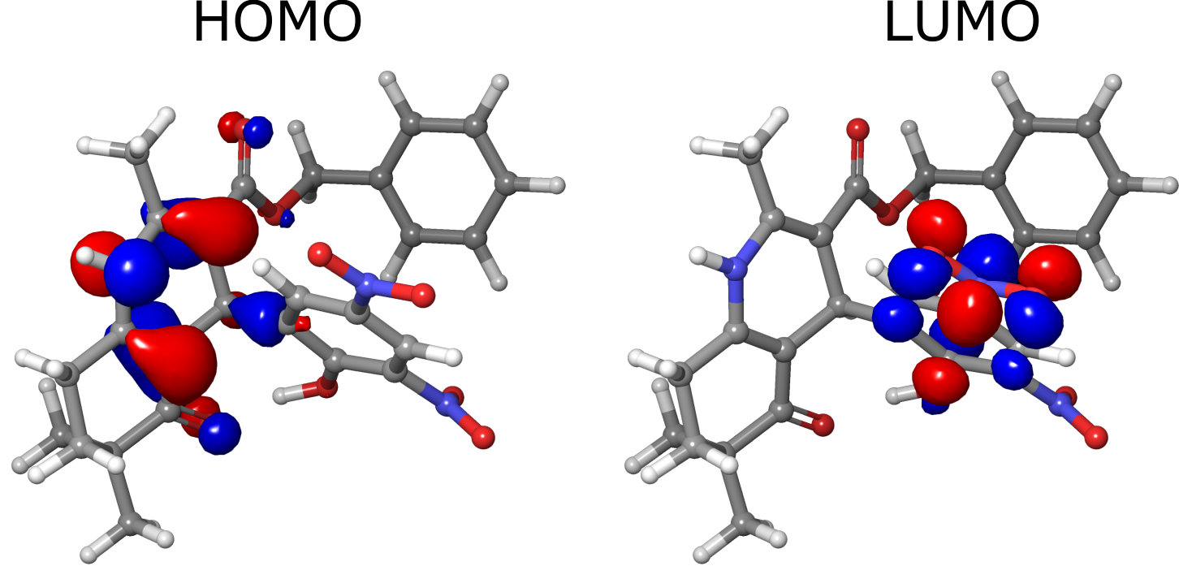
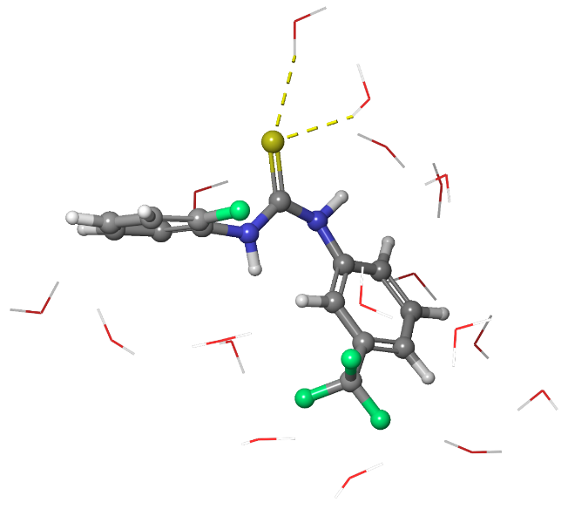
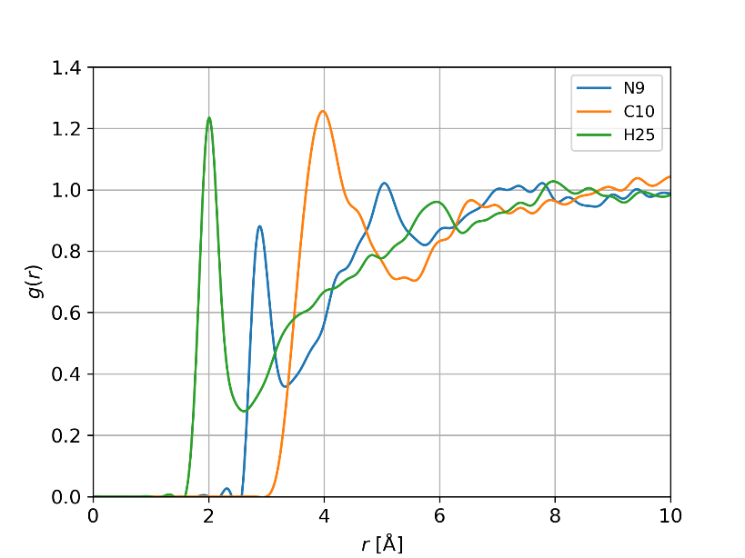
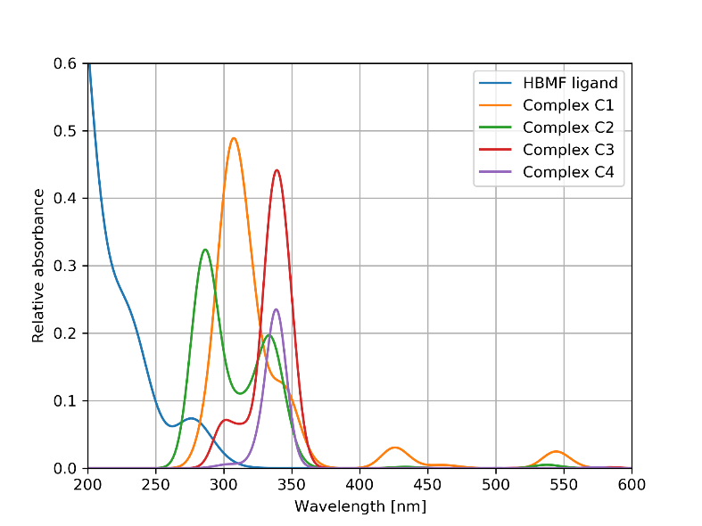
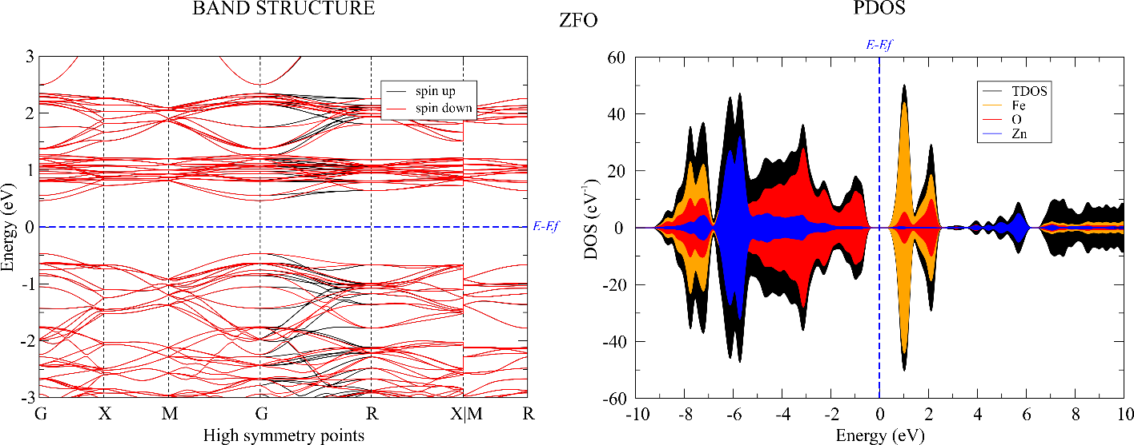
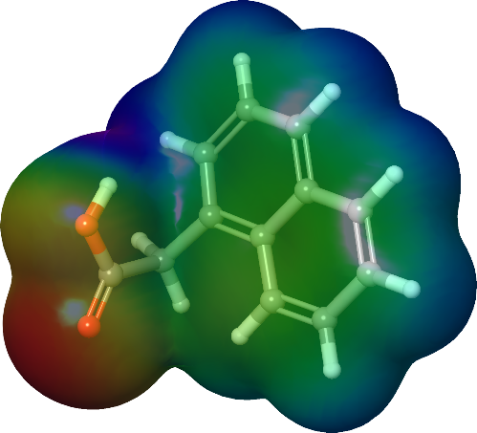
Modeling in EMOS group

Slide 7


Basic workflow in molecular modeling
STEP 1
STEP 2
STEP 3
Code for
atomistic calculations
Input
Output
GREAT, LETS GO, WHAT ARE WE WAITING FOR

Slide 8
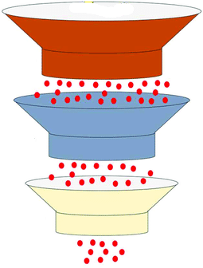
The role of molecular modeling in pharma industry
Filter 1
To experiments
Filter 2
Filter 3
Best candidates

Slide 9
PART 2
Molecular docking
Stability
Excipient identification
Drug delivery
Molecular modeling in pharma industry

Slide 10
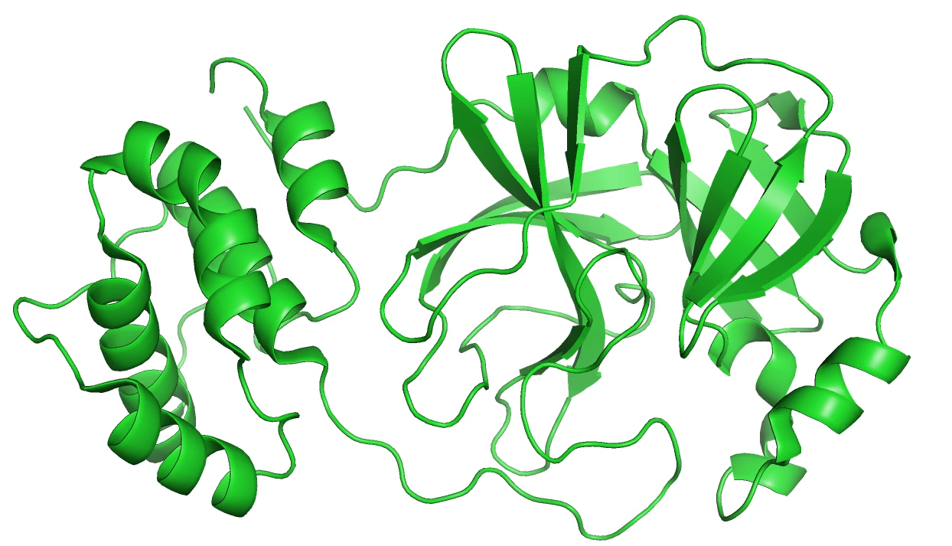
Molecular docking
Predict and analyze the binding interactions between ligand and protein
SARS-CoV-2 main protease
Try different conformations against protein, calculate binding affinity
rcsb.org code: 6LZE
The crystal structure of COVID-19 main protease in complex with an inhibitor 11a
10.1126/science.abb4489
Structure-based design of antiviral drug candidates targeting the SARS-CoV-2 main protease

Slide 11
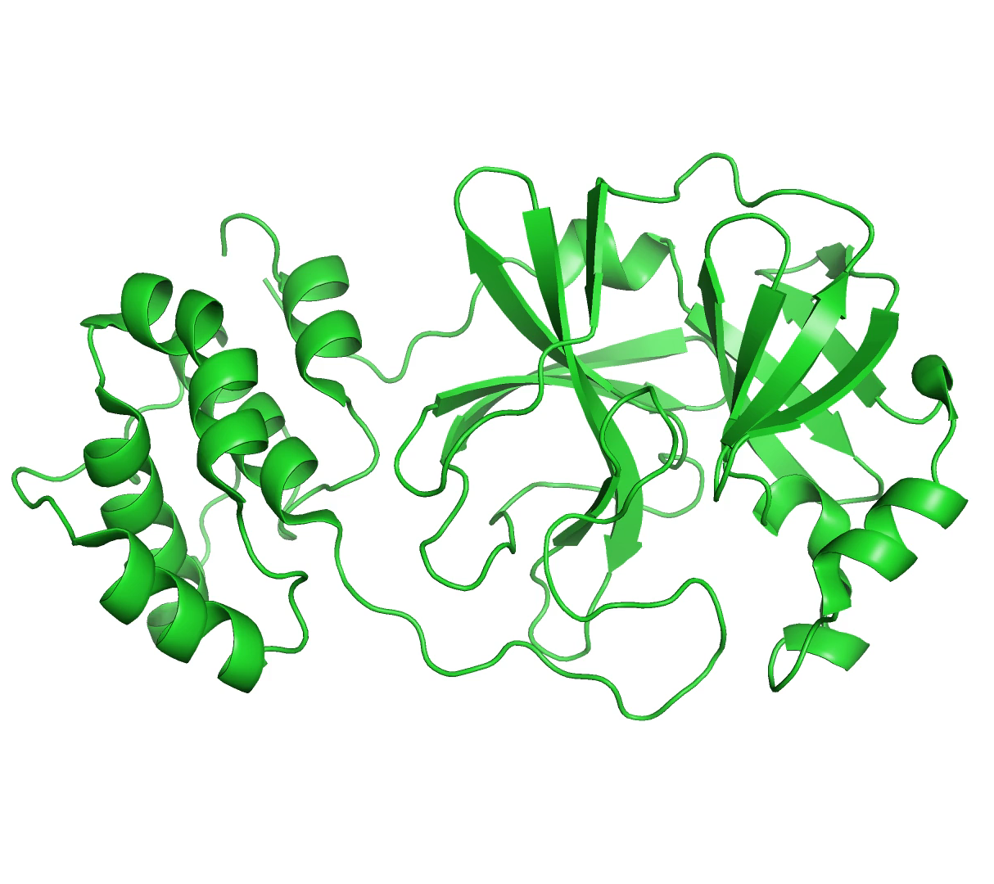
Molecular docking
Extremely useful for target design
&
Drug repurposing

Slide 12
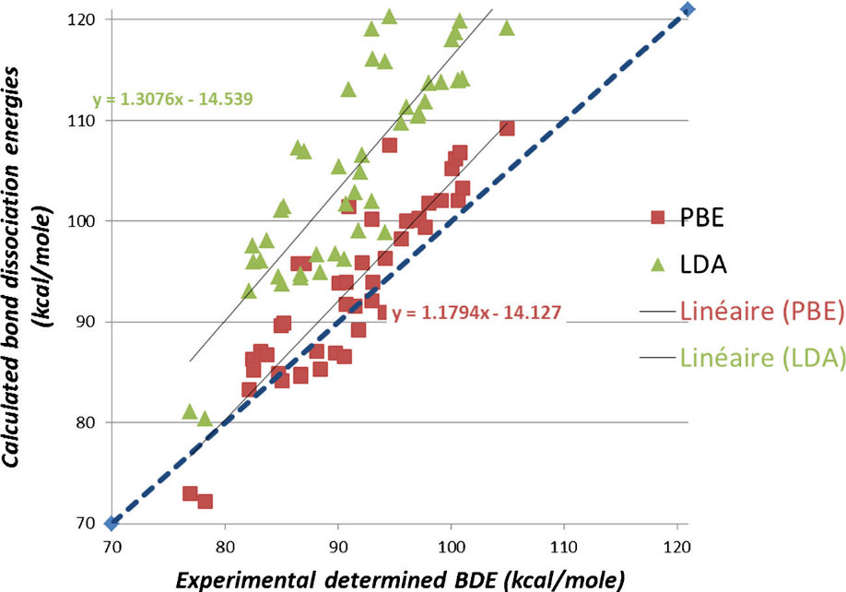
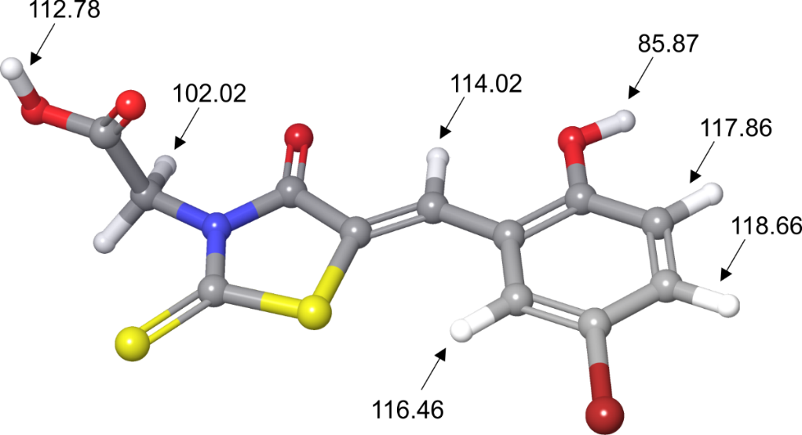
Stability of active component
“Chemical degradation and stability in formulation is a
recurrent issue in pharmaceutical development of drugs”
Lienard et al. Pharm Res (2015) 32:300–310
AUTOXIDATION MECHANISM:
drug molecule reacts with oxygen from the air without the need for an external catalyst
Autoxidation mechanism is correlated with
bond dissociation for hydrogen abstraction (H-BDE)

Slide 13
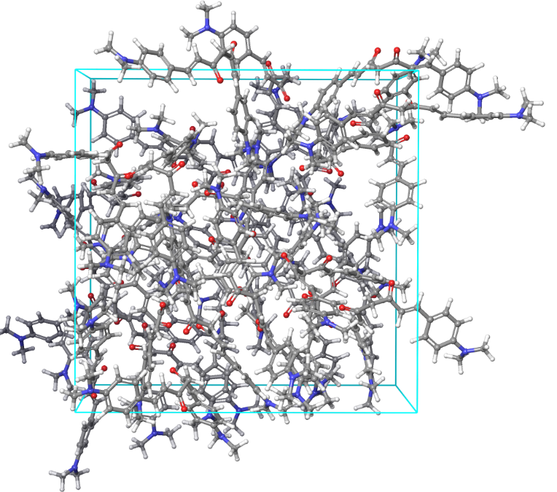
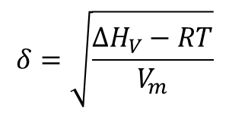
Miscibility
ability of two or more substances to mix together in any proportion to form a homogeneous (uniform) mixture
Molecule with suitable properties is “just” part of the story
It is often necessary to mix active components with different compounds to improve:
Stability
Solubility
Delivery
etc
$$δ=\sqrt{\frac{ΔH_{V}−RT}{V_{m}}}$$
Excipients

Slide 14
Miscibility
ability of two or more substances to mix together in any proportion to form a homogeneous (uniform) mixture
The case of ibuprofen
Carrier | Predicted | Experiment | Is Miscible
PVP | 2.8 | 1.6 | Yes
LutrolF68 | 3.6 | 1.9 | Yes
Maltose | 9.3 | 18.0 | No
Sorbytol | 10.1 | 17.3 | No
Xylitol | 11.0 | 16.2 | No
Example taken from: https://www.schrodinger.com/science-articles/pharmaceutical-formulation

Slide 15
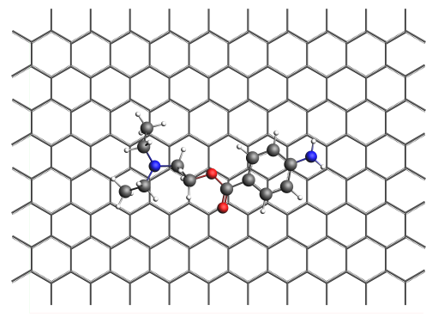
Drug delivery
 | NOV @ Graphene | LID @ Graphene | ART @ Graphene
Configuration #1 | -22.45 | -23.94 | -21.28
Configuration #2 | -22.47 | -23.02 | -21.13
Configuration #3 | -21.93 | -23.17 | -25.76
Configuration #4 | -9.39 | -22.46 | -16.00
Configuration #5 | -6.60 | -23.08 | -24.50
Configuration #6 | -9.41 | -23.39 | -30.80
https://doi.org/10.1016/j.molliq.2022.120301

Slide 16
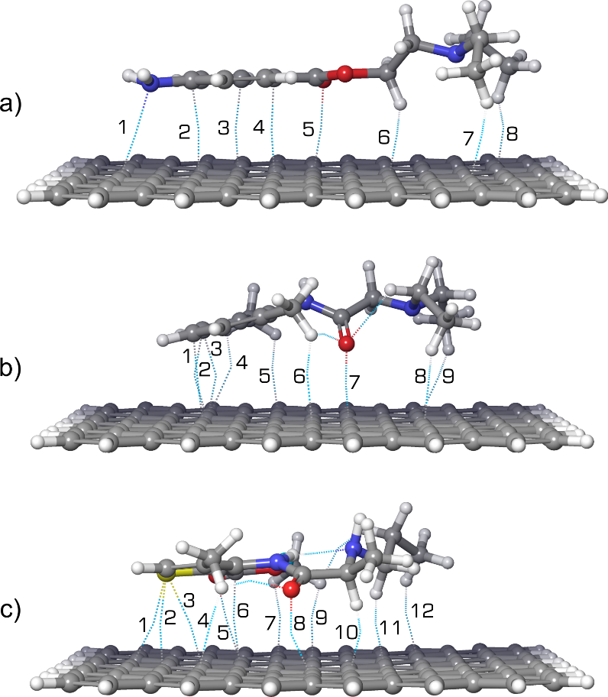
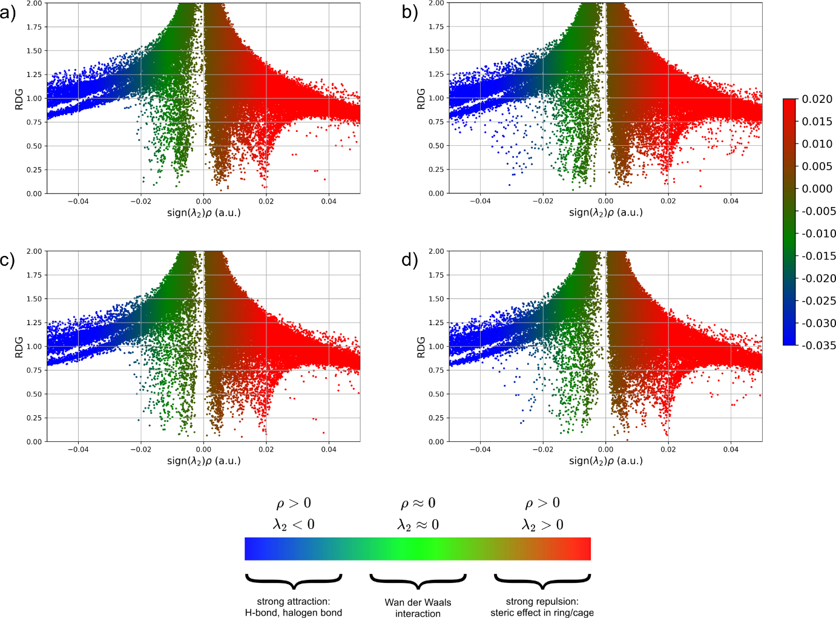
The role noncovalent interactions

Slide 17
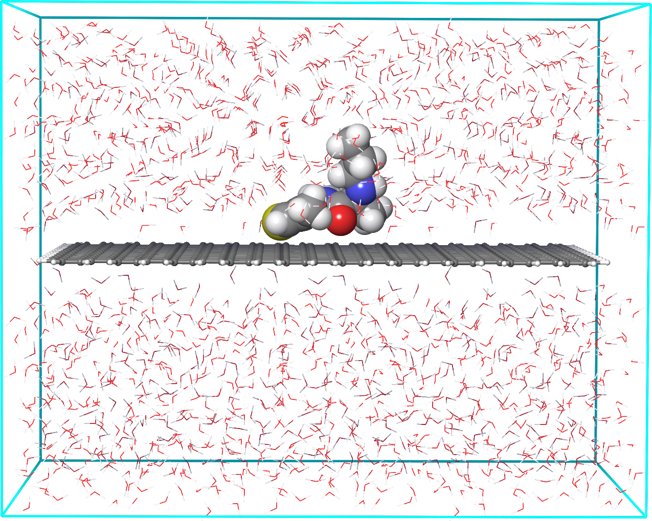
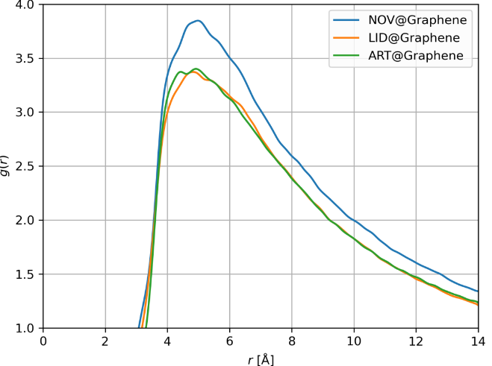
Drug delivery – more realistic models
MD models with explicit solvent
Radial distribution functions

Slide 18
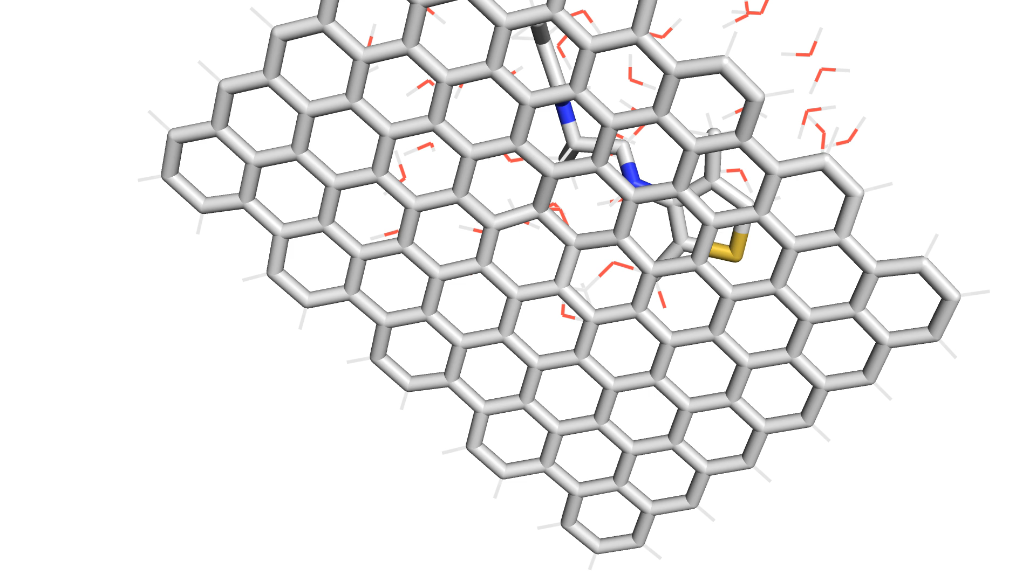

Slide 19
Types of tools for modeling
FUNCTIONALITY
AVAILABILITY
Generate input
Run calculations
Analyze output
Open source
Free for academics
Commercial

Slide 20
PART 3
Presenting atomistica online
https://atomistica.online

Slide 21
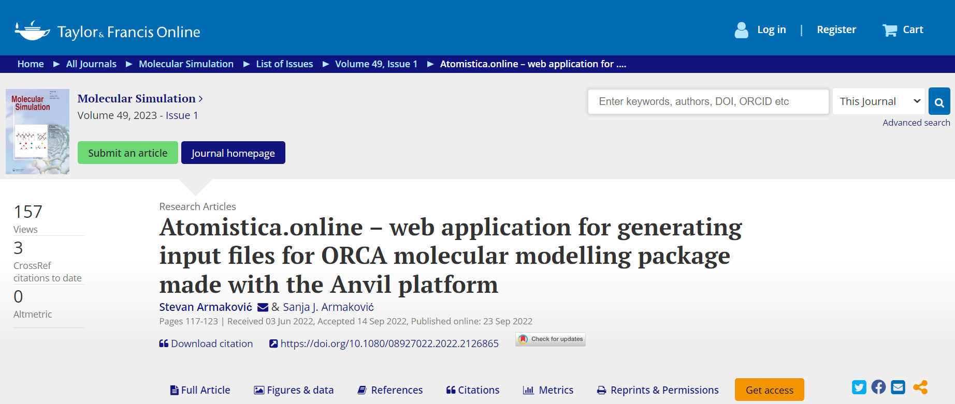
atomistica.online – molecular modeling platform
Initially conceived “just” as an online input generator for ORCA program.
Now it is a free molecular modeling platform
Intended for teaching molecular modeling and for beginners in this field.
Developed using python and the Anvil platform.
Presented in a paper published in “Molecular Simulation” journal (IF: 2.346)

Slide 22
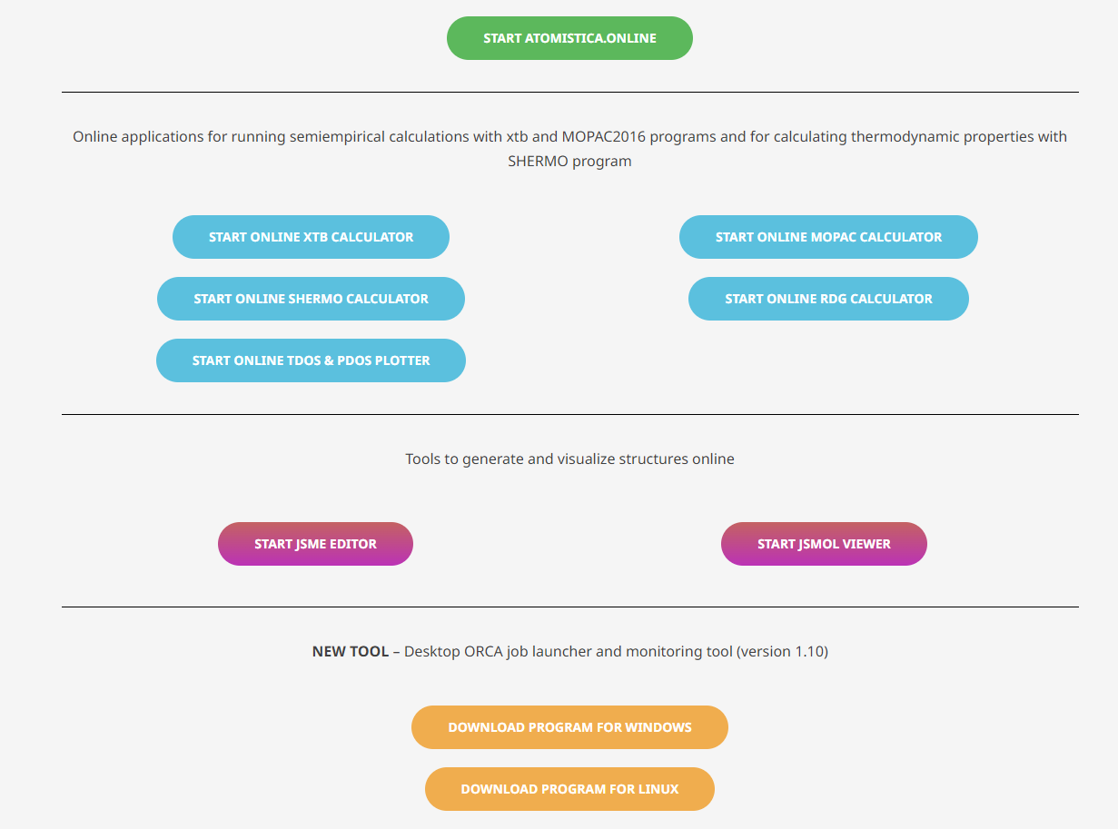

Slide 23
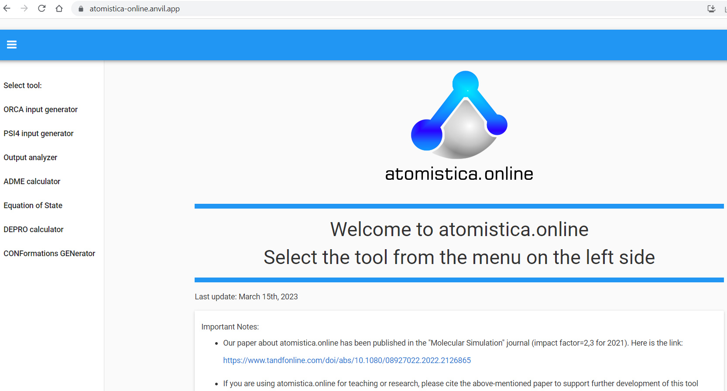

Slide 24
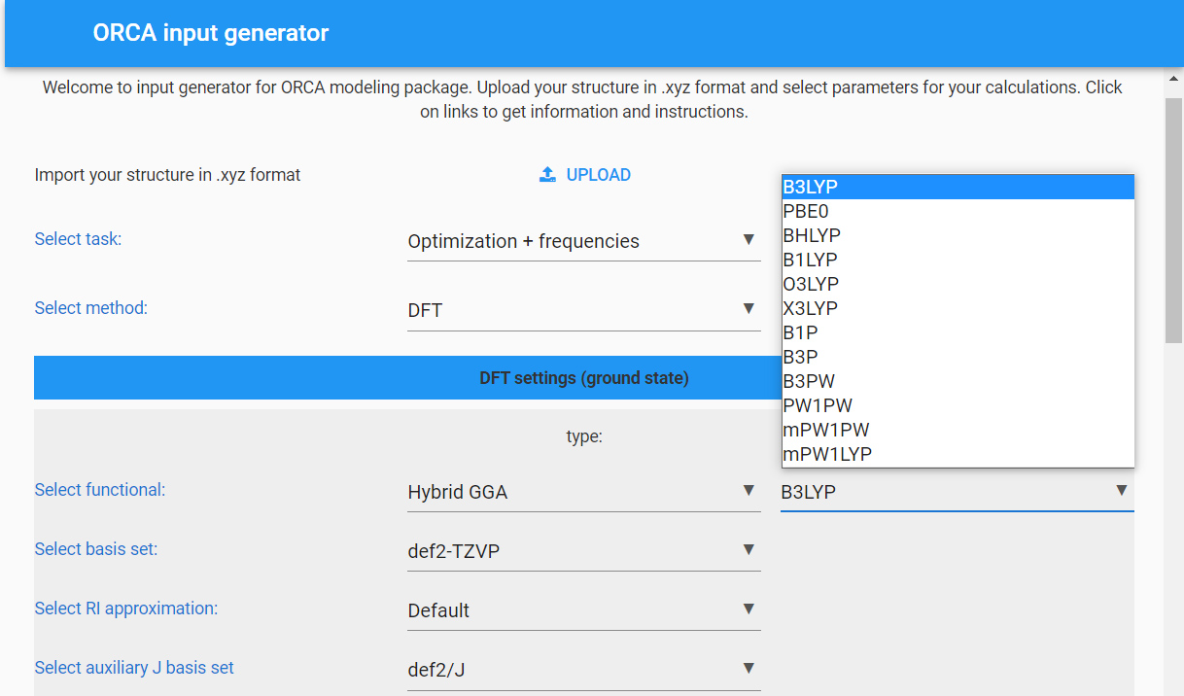
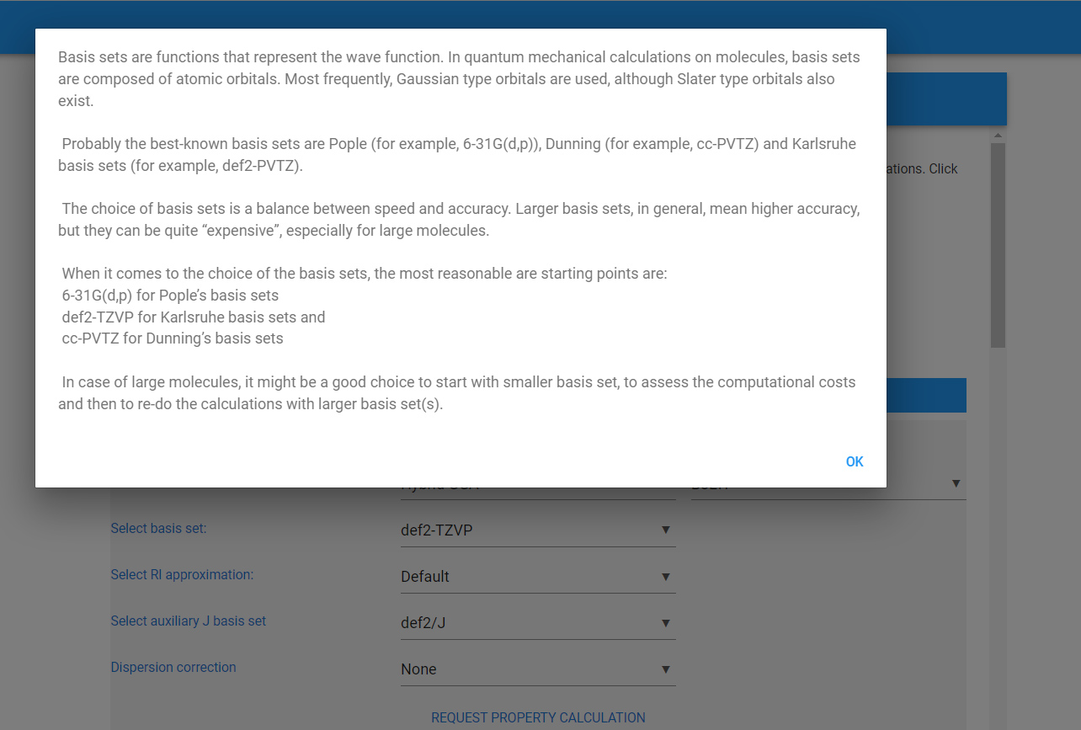

Slide 25
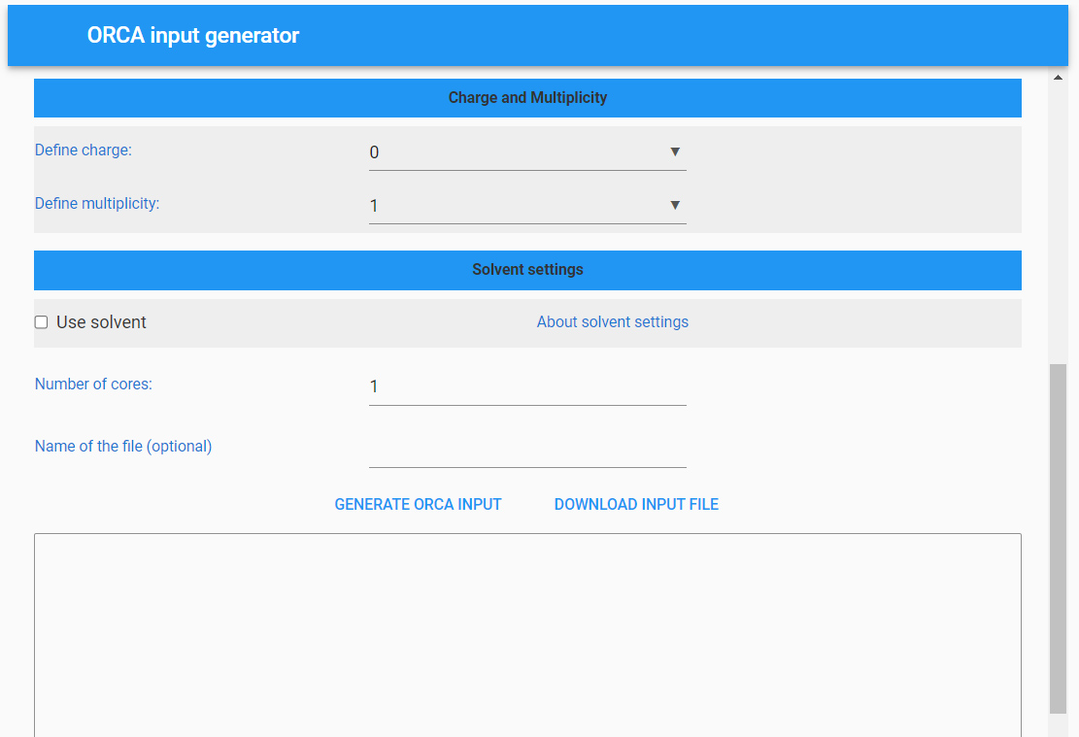
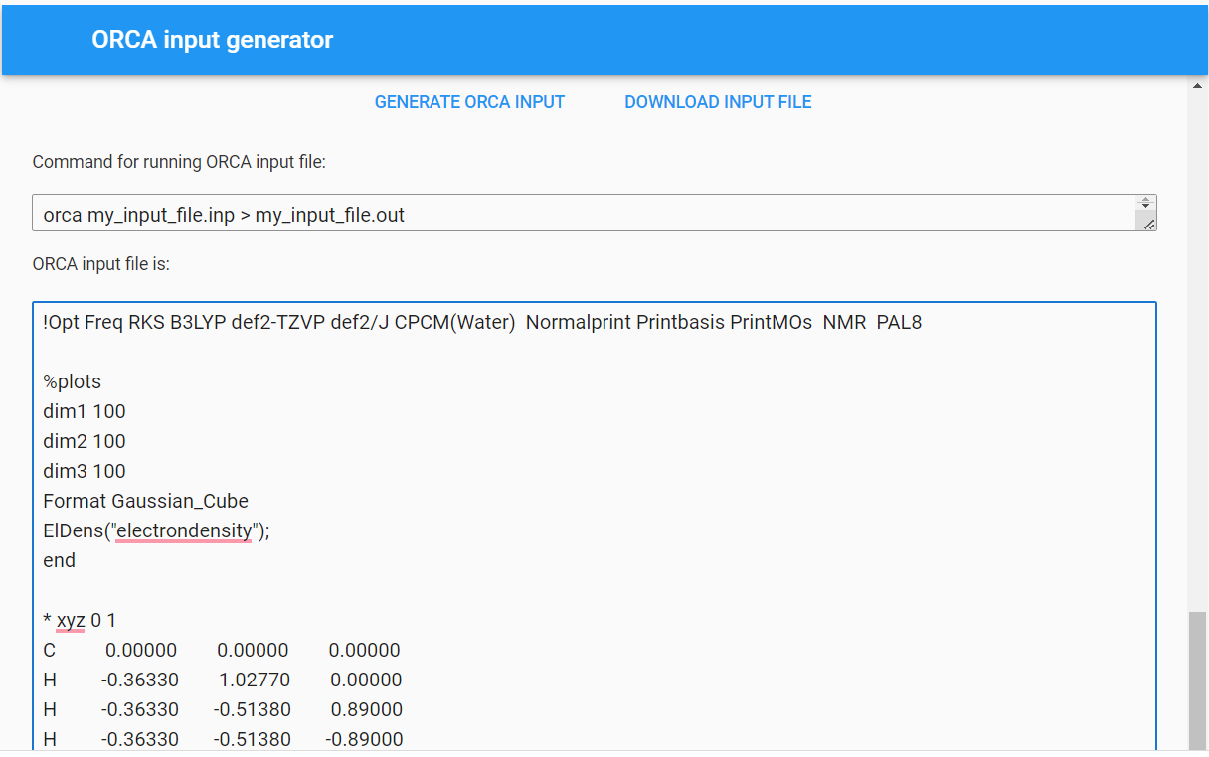

Slide 26
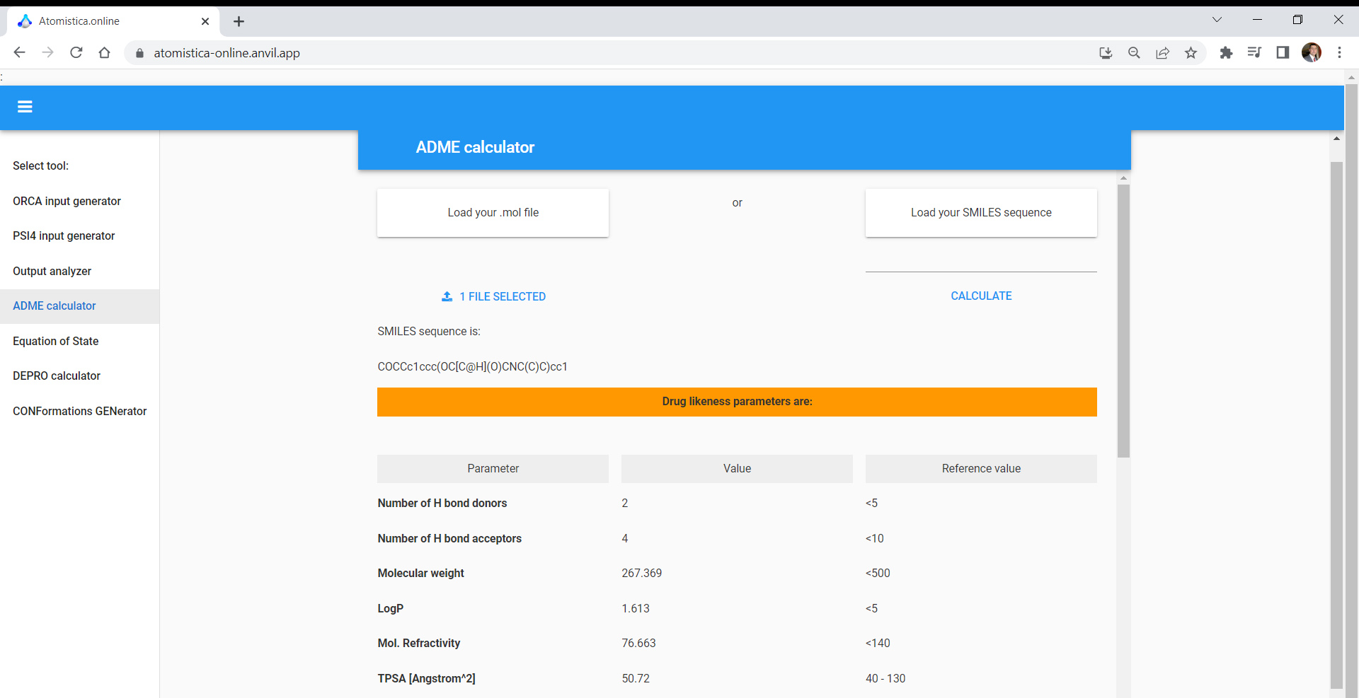

Slide 27
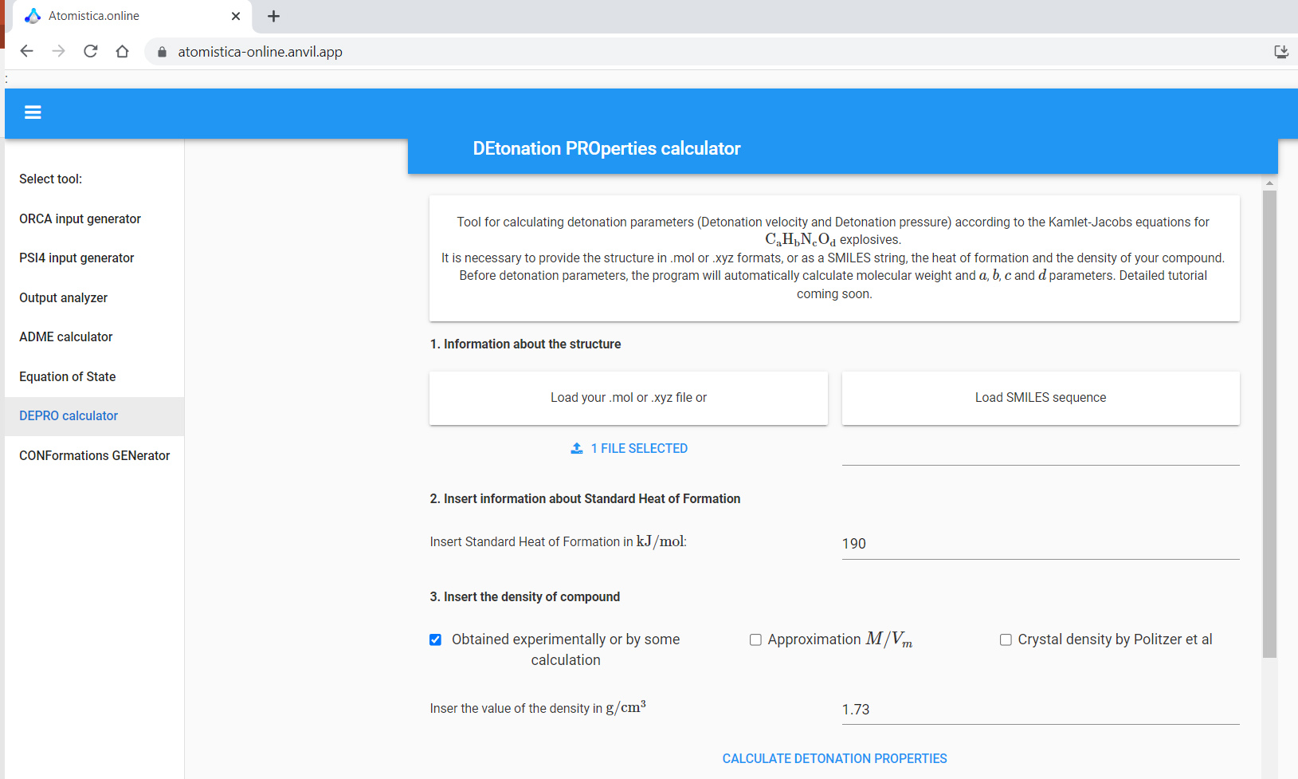

Slide 28
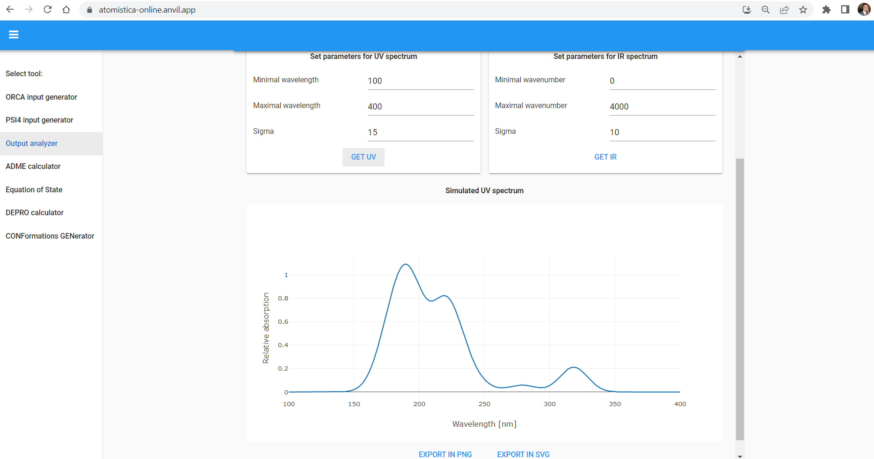

Slide 29
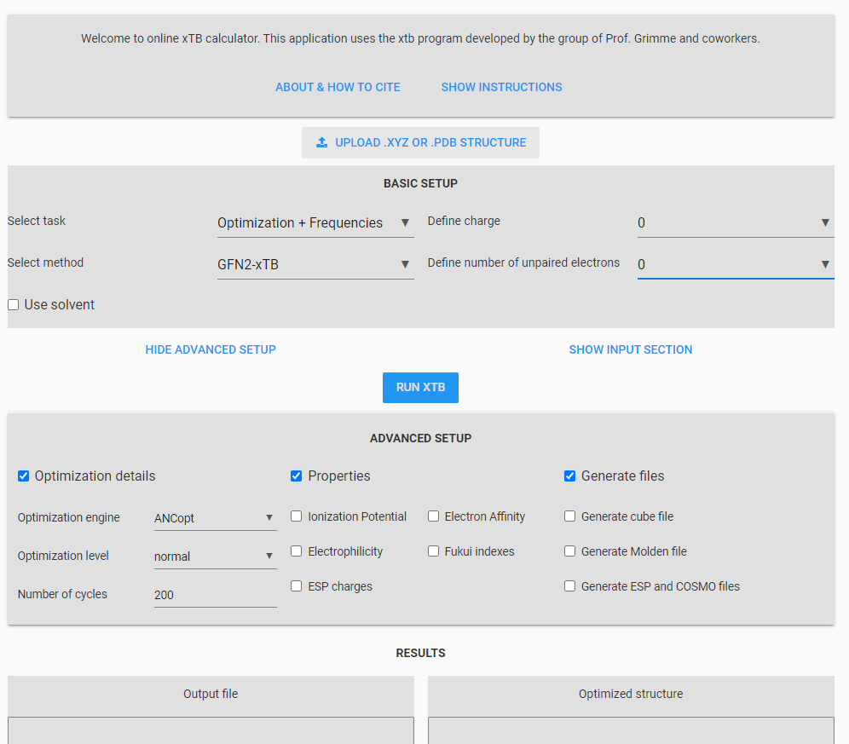

Slide 30
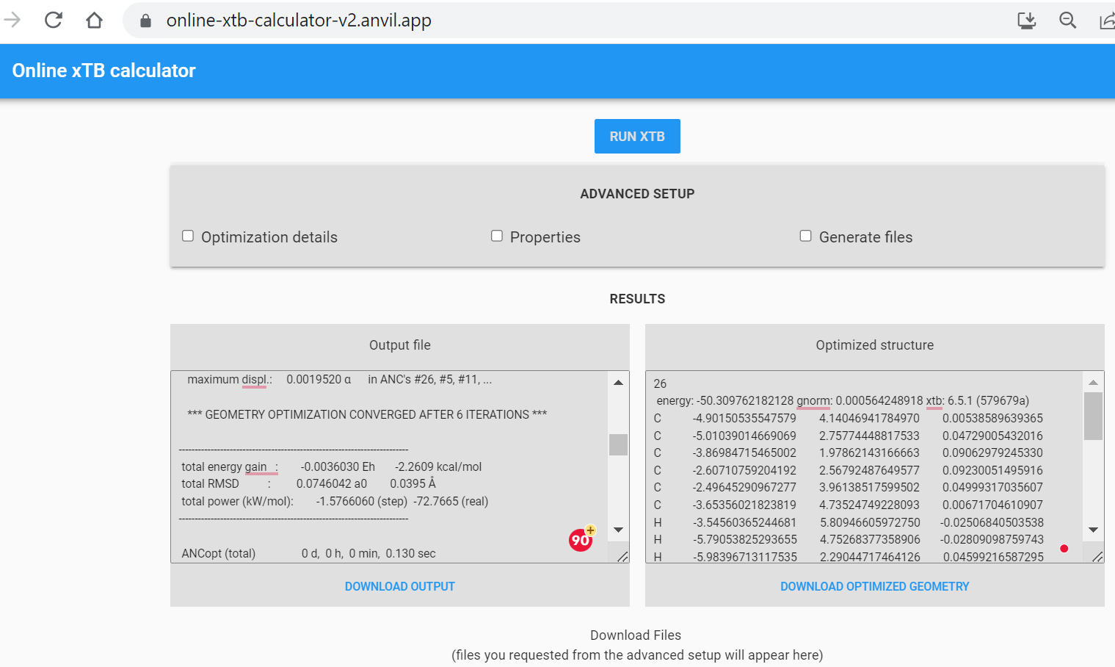

Slide 31
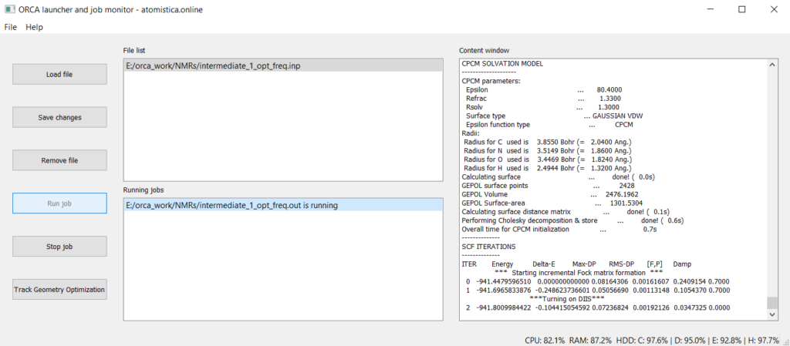

Slide 32
atomistica.online summary
Free and available online, no need to install or maintain anything
Perfect for teaching fundamental concepts of molecular modeling
Can be used to perform modern semiempiric calculations with xTB and MOPAC2106 directly from browser
Automation of Multiwfn tasks
Interface suited for beginners in the field
https://atomistica.online

Slide 33


https://aidasco.org/

